Slide 1
Notes:
11111111111111111111111111111111
22222222222222222222222222222222
33333333333333333333333333333333

Slide 2
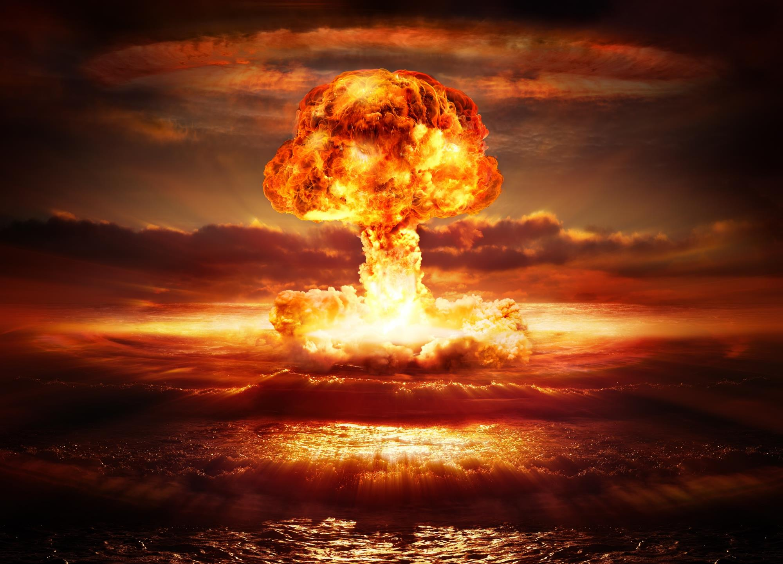
How to Die…
and Do It Right
delighting.org
Notes:
Copyright ©2016, Michael Dant, All Rights Reserved

Slide 3
How to Die…
and Do It Right
delighting.org
Notes:
Scripture: Galatians 5:24 “Now those who belong to Christ Jesus have crucified the flesh with its passions and desires.”
Hymn #1: #327 I’d Rather Have Jesus
Hymn #2: #322
Copyright ©, 2014 by Michael Dant

Slide 4
How to Die…
and Do It Right
delighting.org
Notes:
[pray]

Slide 5
Notes:
Monday, August 6, 1945
Captain William S. Parsons
70% of buildings, 80,000 people
Whether or not we agree with U.S.
destructive power -Unimaginable

Slide 6
Notes:
Where did the power come from?
Parsons merely flipped a switch
He didn’t…

Slide 7
Notes:
Parsons-weak human being
But he could flip a switch
What would have happened? Switch
Man without bomb is helpless
bomb without man is useless

Slide 8
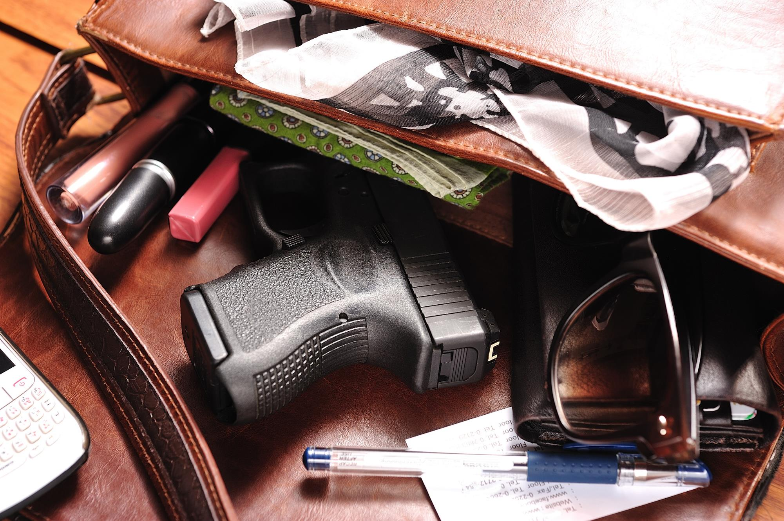
Notes:
December 30, 2014
Veronica Rutledge’s 2-year old son
Veronica-research scientist
Child could barely walk

Slide 9
Notes:
Veronica bigger, smarter, stronger
The baby could pull the trigger
Guns-great equalizers
Their power greater than that of the one

Slide 10


Notes:
In the temporal realm
The destruction and violence caused by weapons are deplorable and tragic
I do not own a weapon, nor ever wish to.

Slide 11
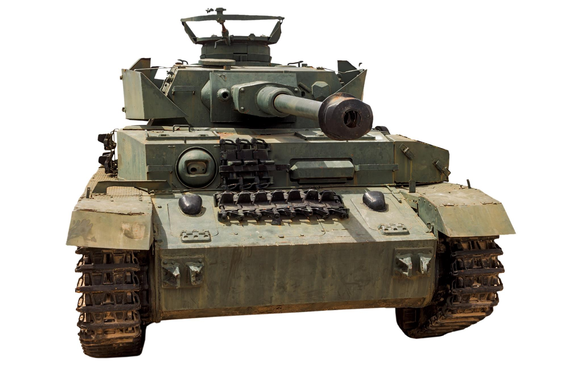
Notes:
But in the spiritual realm
in the battle against self
I want the most powerful weapons available

Slide 12
Notes:
I am not strong enough-fight myself
I can’t create the weapon/ammunition
God is the atomic bomb in my life
If self-be defeated-will have to be God

Slide 13
Notes:
But I can pull the trigger
I can unleash the awesome power
I can let God fight self in me
I can surrender

Slide 14
“As the will of man co-operates with the will of God, it becomes omnipotent”
Christ Object Lessons, p. 333
“To this end I labor, struggling with all HIS energy, which so powerfully works in me”
- Colossians 1:29, NIV
Notes:
But I can’t surrender without His help
He must work in me both to will…
The good news is [click]
I can say with Paul [click]

Slide 15
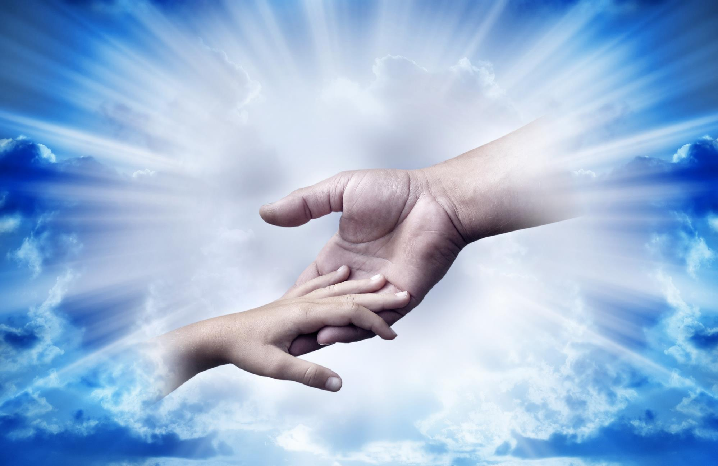
“As the will of man co-operates with the will of God, it becomes omnipotent”
Christ Object Lessons, p. 333
Notes:
[Key Phrase]

Slide 16

Notes:
Surrender is drowning in the will…
How do we surrender?
Surrender is easy…conceptually
Just ask – flip the switch
…but really want it-core of being

Slide 17
Notes:
Excruciatingly difficult decision
Self entwined
enjoy selfish choices
attracted to selfish ways
addicted to self

Slide 18
Notes:
Surrender is drowning ….
Like any drowning person, we fight
Resist drowning- gasp, gurgle, sputter

Slide 19
Notes:
We cry out “ Stop, Lord” – He does
Self is a demon that does not come
out easily. [click]

Slide 20
“The warfare against self is the greatest battle that was ever fought. The yielding of self, surrendering all to the will of God…is not an easy attainment. And yet it is [our] privilege and [our] duty to be a perfect overcomer here ”
Testimonies for the Church, vol. 3, p. 106, 107
Notes:
[read]
God will not pull the trigger.
But He can get us to the point…

Slide 21
“The warfare against self is the greatest battle that was ever fought. The yielding of self, surrendering all to the will of God…is not an easy attainment. And yet it is [our] privilege and [our] duty to be a perfect overcomer here ”
Testimonies for the Church, vol. 3, p. 106, 107
Notes:
We can’t surrender ourselves
but we can cooperate…
How can we, in practical terms,
cooperate with God
in the surrender process?

Slide 22
Key phrase
“As the will of man co-operates with the will of God, it becomes omnipotent”
Christ Object Lessons, p. 333

Slide 23
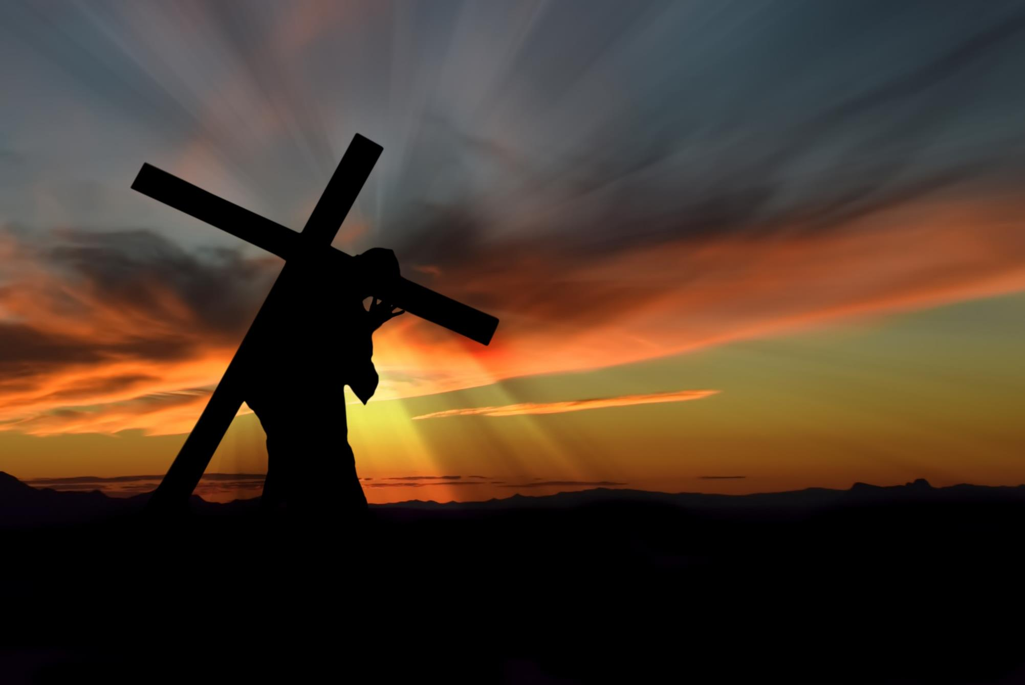
“To this end I labor, struggling with all his energy, which so powerfully works in me”
Colossians 1:29
Notes:
[read]
How can we, in practical terms,
cooperate with God
in the surrender process?

Slide 24
“No outward observances can take the place of simple faith and entire renunciation of self. But no man can empty himself of self. We can only consent for Christ to accomplish the work. Then the language of the soul will be, Lord, take my heart; for I cannot give it. It is Thy property. Keep it pure, for I cannot keep it for Thee. Save me in spite of myself, my weak, unchristlike self. ”
Christ Object Lessons, p.159
Notes:
[read]
Took me over 4 decades to learn to surrender
Many in this room may already be surrendered

Slide 25
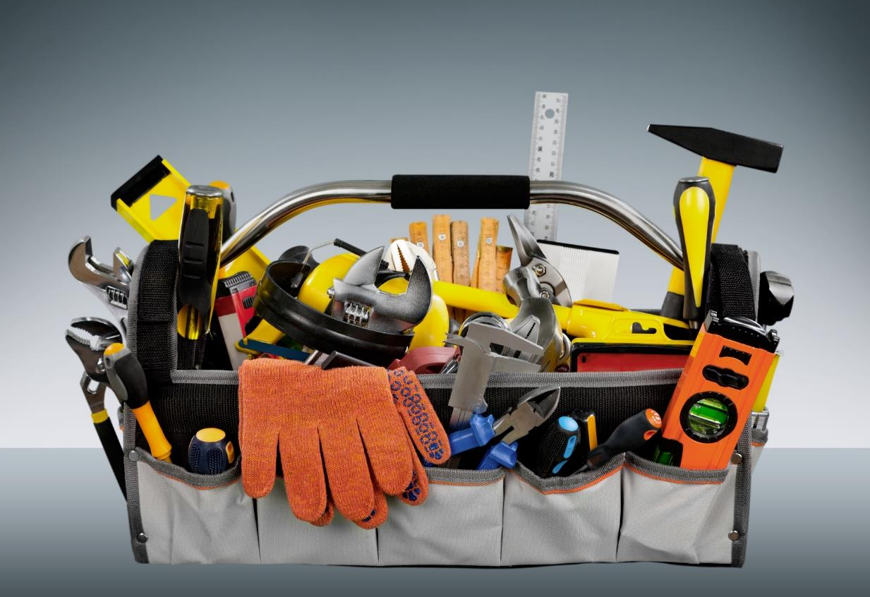
Surrender Toolbox
Notes:
can’t surrender ourselves by ourselves
We can collaborate with God
It helps to have the right tools
Surrender toolbox
Image: https://commons.wikimedia.org/wiki/File:Toolbox_(226362564).jpg

Slide 26

Surrender Toolbox
Repent
Notes:
#1 Repent
Recognize sinful condition
turn away-revulsion

Slide 27
#1 Repent
“Now in those days John the Baptist came, preaching in the wilderness of Judea, saying, ‘Repent, for the kingdom of heaven is at hand.’” Mat. 3:1-2
“after John had been taken into custody, Jesus came into Galilee, preaching the gospel of God, and saying, ‘The time is fulfilled, and the kingdom of God is at hand; repent and believe in the gospel’”
Mark 1:14-15
Notes:
John the Baptist’s main message
[click]
Christ took up where John left
[click]

Slide 28

#1 Repent
“The Pharisee stood and was praying this to himself: ‘God, I thank You that I am not like other people: swindlers, unjust, adulterers, or even like this tax collector. I fast twice a week; I pay tithes of all that I get.’”
Notes:
Jesus-powerful story-Pharisee-tax
[click-read]
Easy to have this haughty attitude
almost unconsciously
[continued]

Slide 29
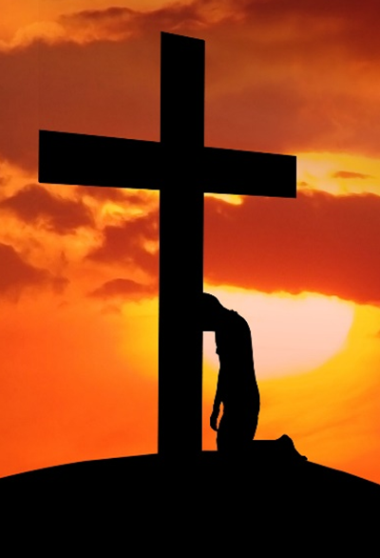
#1 Repent
"But the tax collector, standing some distance away, was even unwilling to lift up his eyes to heaven, but was beating his breast, saying, `God, be merciful to me, the sinner!‘”
- Luke 18:11-13
Notes:
[read]
Repentance is recognizing/sorrow
[continued]

Slide 30

Notes:
“Don’t want to say my prayers”
“Don’t want to ask-forgive”
“they are rather nice.”-do we say

Slide 31
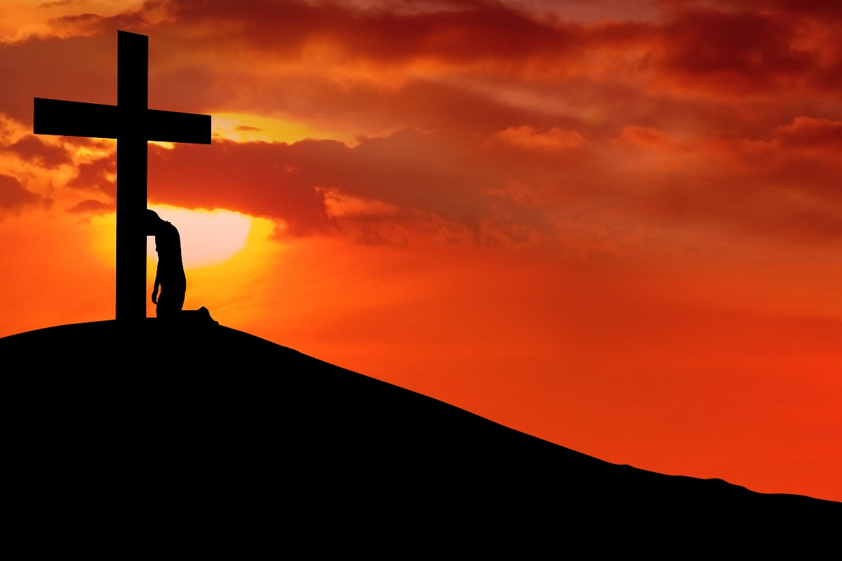
“Then you will remember your evil ways and your deeds that were not good, and you will loathe yourselves in your own sight for your iniquities and your abominations”
Ezekiel 36:31
Notes:
Ezekiel [click - read]
Healthy loathing, joy & true self-worth
Ellen White [next slide]

Slide 32
“Repentance includes sorrow for sin and a turning away from it. We shall not renounce sin unless we see its sinfulness; until we turn away from it in heart, there will be no real change in the life”
Steps to Christ, p. 23
Notes:
[read]
Jesus sais to Laodicea, “Be zealous, therefore, and repent

Slide 33
Surrender Toolbox
Repent
Learn about surrender
  “Self-surrender is the substance of the teachings of Christ”
Desire of Ages, p. 523
Notes:
#2 Learn about surrender
my experience – New Testament
I discovered that [click-read]
Heart vs. head – “You will know…”

Slide 34
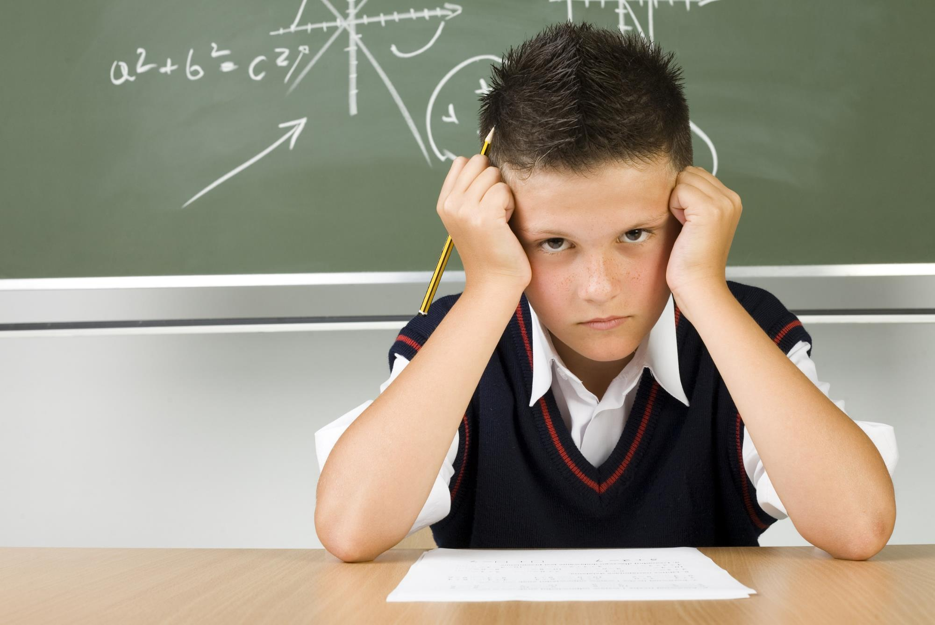
Notes:
John Bradshaw story
Wanted to do the assignment
[continued]
John Bradshaw
beginning of 4th grade, just skipped 3rd grade
Had no clue how to do math assignment – sounds like a normal math class to me ☺
Everyone else working away studiously
John wanted to the assignment badly, but simply did not no how
In his frustration John burst into tears
Teacher helped
Now John new how to do the assignment and his tears turned to joy
John’s problem with the mathematics assignments was not an unwillingness to do it. In fact he longed to do it. The problem was that he had no idea how to even begin to do it.

Slide 35
Notes:
Same with the Christian life
“Destroyed for lack of knowledge”
Jesus-You shall know the truth

Slide 36
Surrender Toolbox
Repent
Learn about surrender
Ask relentlessly
Notes:
#3 Ask relentlessly for surrender
Angel-wrestling prayer
Like Jacob on river bank-lonely night

Slide 37
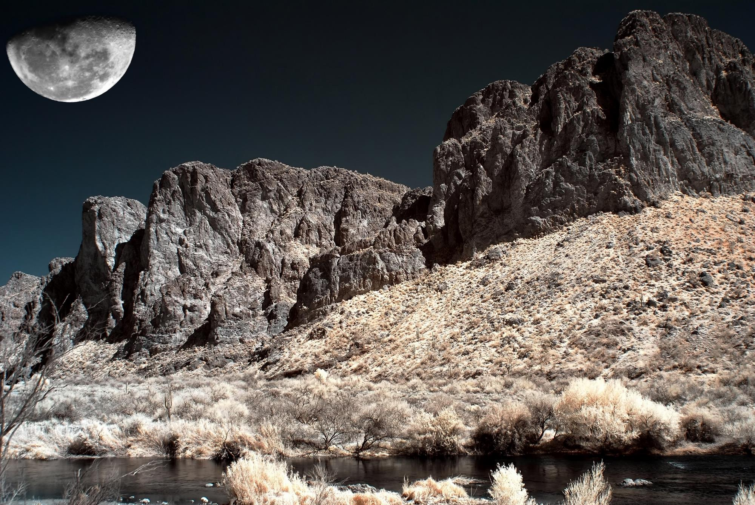
“Prayer is heaven’s ordained means of success in the conflict with sin and the development of Christian character. The divine influences that come in answer to the prayer of faith will accomplish in the soul of the suppliant ALL FOR WHICH HE PLEADS.”
Acts of the Apostles, p. 564
Notes:
[read]
Why do we plead?
We don’t try to convince God

Slide 38
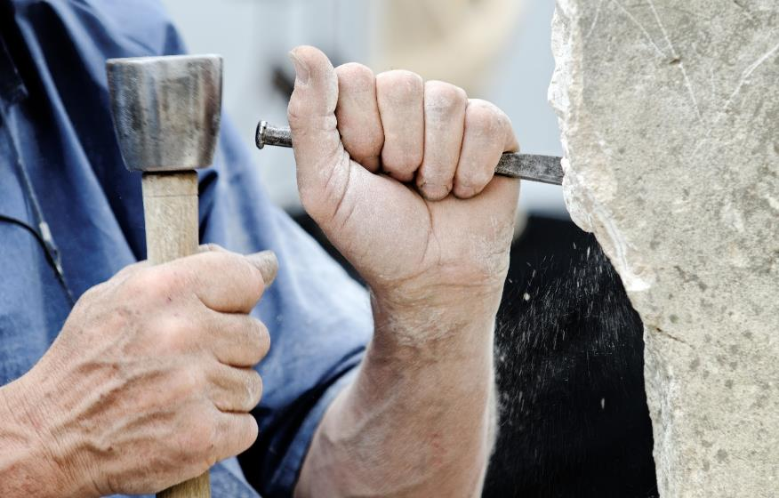
Knee work
Notes:
Pastor watching marble cutter
“I wish I could deal such clanging
blows on stony hearts”
Maybe you could, if you worked
like me…on your knees

Slide 39
Knee work
Notes:
Surrender is knee work
cling to God
Don’t let Him go
like Jacob

Slide 40
Surrender Toolbox
Repent
Learn about surrender
Ask relentlessly
Count the costs
Notes:
[recap]
[click] #4 Count the costs
Understanding the consequences

Slide 41
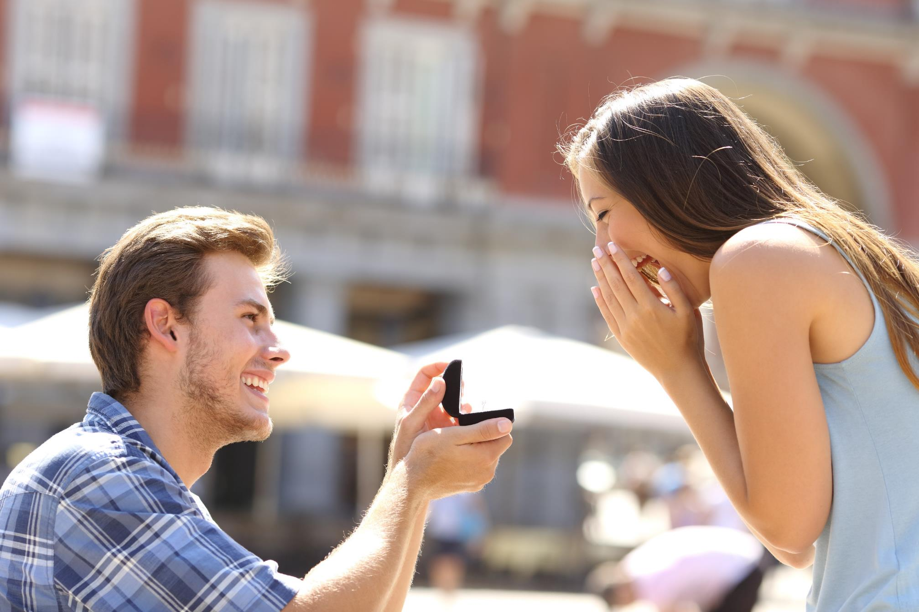
Notes:
Jesus-edge of surrender-proposes
Joyfully “Yes!”
until eternity do us part
what will my life be like?
asking hard questions

Slide 42
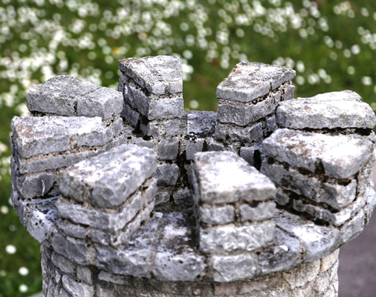
“For which one of you, when he wants to build a tower, does not first sit down and calculate the cost to see if he has enough to complete it? Otherwise, when he has laid a foundation and is not able to finish, all who observe it begin to ridicule him, saying, ‘This man began to build and was not able to finish.’”
Notes:
Jesus gave two powerful cost-counting illustrations
[click]
[continued]

Slide 43
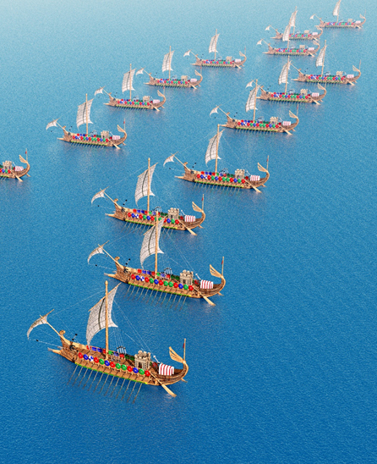
Or what king, when he sets out to meet another king in battle, will not first sit down and consider whether he is strong enough with ten thousand men to encounter the one coming against him with twenty thousand? Or else, while the other is still far away, he sends a delegation and asks for terms of peace”
Luke 14:28-32
Notes:
[read]
Counting the costs-context?
These sandwiched between…
[continued]

Slide 44

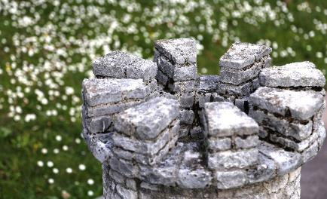
Count the costs
“Whoever does not carry his own cross and come after Me cannot be My disciple.” (verse 27)
“So then, none of you can be My disciple who does not give up all his own possessions.” (verse 33)
Notes:
Verse just before [click – read]
Then the two illustration
Verse just after [click – read]

Slide 45
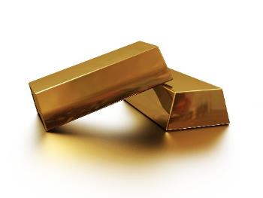
Count the costs
“But whatever things were gain to me, those things I have COUNTED as loss for the sake of Christ. More than that, I COUNT all things to be loss in view of the surpassing value of knowing Christ Jesus my Lord, for whom I have suffered the loss of all things, and COUNT them but rubbish so that I may gain Christ,”
Philippians 3:7-8
Notes:
Paul counted the costs - reports
[click – read]
Go into surrender-eyes open

Slide 46
Surrender Toolbox
Repent
Learn about surrender
Ask relentlessly
Count the costs
Be willing to be made willing
Notes:
#5 Be willing to be made willing
power of choice-not strong enough
Self is too strong-choose to be made…

Slide 47

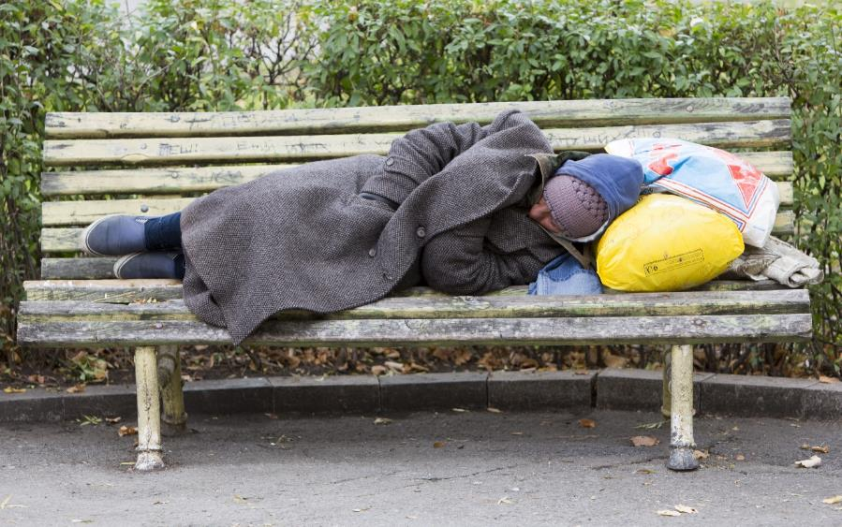
Notes:
Teacher: Rich man & Lazarus
rich man while I live
Lazarus when I die
Natural reaction

Slide 48
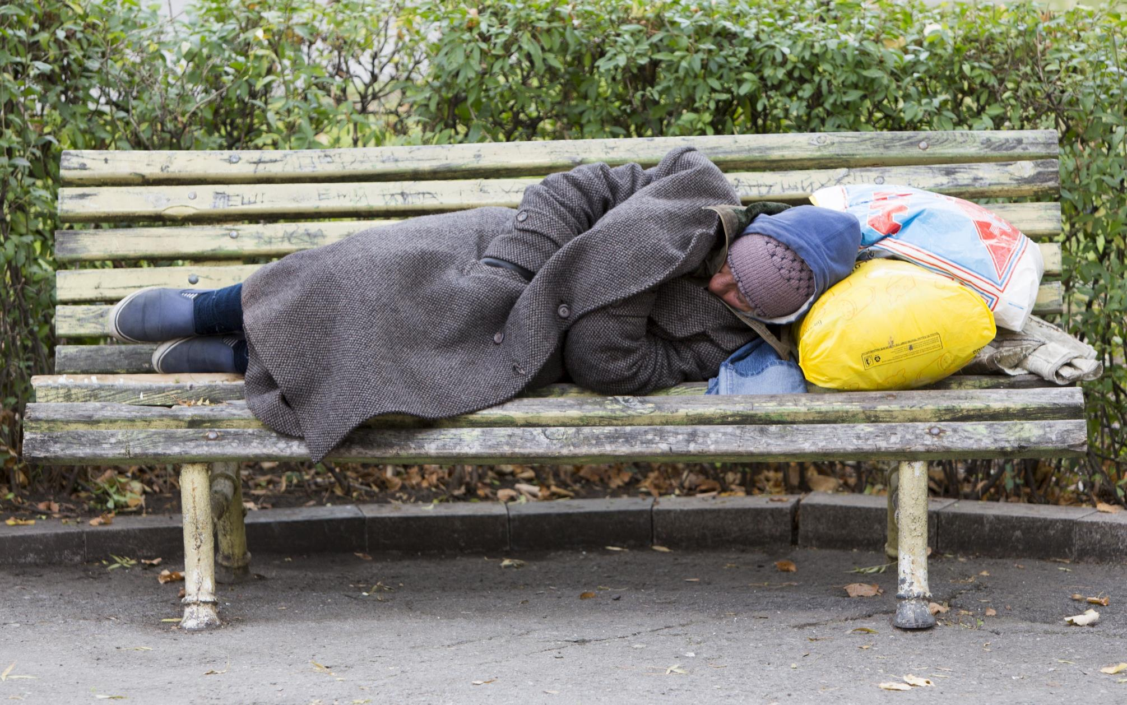
Notes:
God is calling us to fully embrace-Laz
“Lord, I want to…willing to be made
My dad’s experience
[continued]

Slide 49
Notes:
“Will of man cooperates with will of God, it becomes omnipotent”
“for it is God who is at work in you, both to will and to work for His good pleasure” (Philippians 2:13).

Slide 50
Surrender Toolbox
Repent
Learn about surrender
Ask relentlessly
Count the costs
Be willing to be made willing
Embrace change
Notes:
[recap]
#6 Embrace change [click]
We often don’t like change
uncomfortable [continued]

Slide 51

Notes:
Agile programming illustration
[continued]

Slide 52
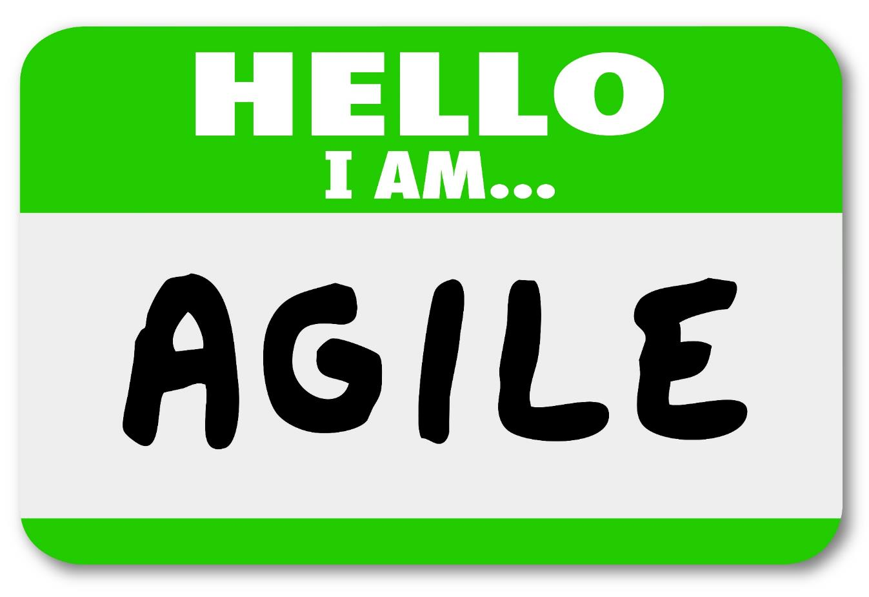
Notes:
Christians must be “agile”
we have a name for this change…
Sanctification not by osmosis
change is good
God continually pushes us/ teaches us

Slide 53
Notes:
Cartoon-Who wants change?
Change not popular, easy-comfortable
But Christian life is change
pushing out of comfort zones

Slide 54
Surrender Toolbox
Repent
Learn about surrender
Ask relentlessly
Count the costs
Be willing to be made willing
Embrace change
Focus on Jesus
Notes:
[recap]
#7 Focus on Jesus [click]
All about focusing on Jesus

Slide 55
John, the beloved disciple
“he beheld the tenderness and forbearance of Jesus, and heard His lessons of humility and patience. Day by day his heart was drawn out to Christ, until he lost sight of self in love for his Master. ”
Acts of the Apostles, p. 557
Notes:
John focused on Jesus[read]
Time looking at Christ
Spending time with our lover
without distractions

Slide 56
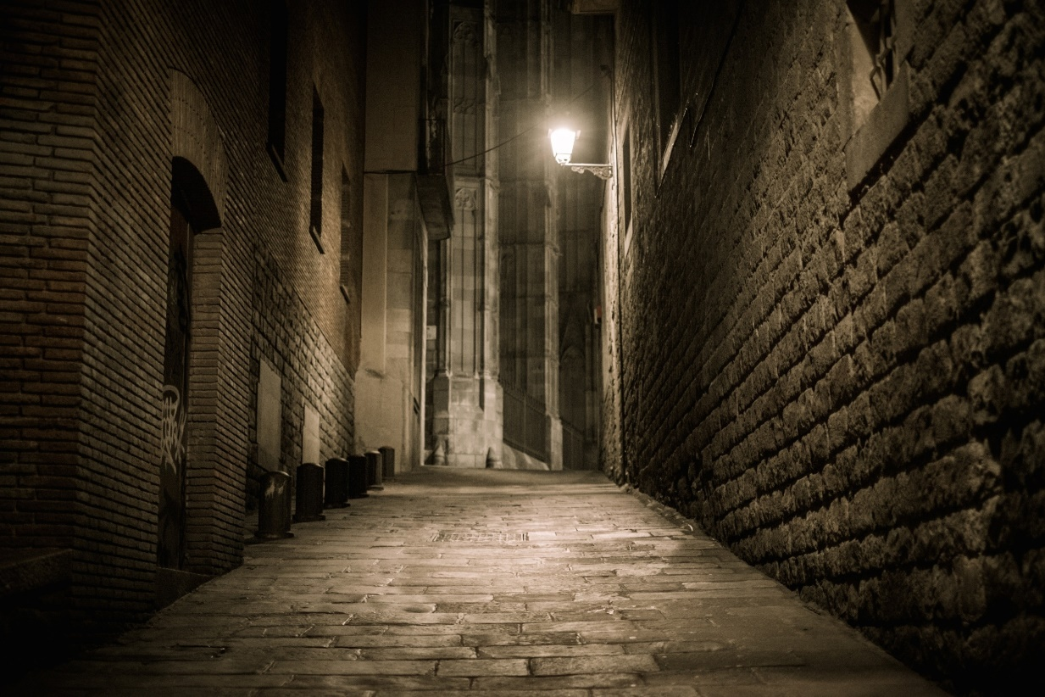
Notes:
Professor Lewis Swift
Warner observatory, Rochester NY
sculptor friend: Mundy-almost blind
put out street light
“I see it! I see it!”

Slide 57
Notes:
Professor Swift recognized…
Getting rid of distractions

Slide 58
Surrender Toolbox
Repent
Learn about surrender
Ask relentlessly
Count the costs
Be willing to be made willing
Embrace change
Focus on Jesus
Notes:
[recap] with Power of choice
“Will of man cooperates-will of God”

Slide 59
“The warfare against self is the greatest battle that was ever fought. The yielding of self, surrendering all to the will of God…is not an easy attainment. And yet it is [our] privilege and [our] duty to be a perfect overcomer here ”
Testimonies for the Church, vol. 3, p. 106, 107
Notes:
Surrender is drowning [click]
Only God can do it…
[continued]

Slide 60
Notes:
Pull trigger-die right
[pray]

