Slide 1
Notes:
11111111111111111111111111111111
22222222222222222222222222222222
33333333333333333333333333333333

Slide 2

Drowning in the Will of the Almighty
delighting.org
Notes:
Copyright ©2016, Michael Dant, All Rights Reserved

Slide 3
Drowning in the Will of the Almighty
delighting.org
Notes:
Scripture: Psalms 73:25 “Whom have I in heaven but You? And besides You, I desire nothing on earth?”
Hymn #1: #76 O Love That Wilt Not Let Me GO
Hymn #2: #322 Nothing Between

Slide 4

How Can I Enjoy God?
Notes:
[Review]
Love for God transforms
Great commandment

Slide 5

Notes:
[Review]
Seed of love for God

Slide 6

Notes:
[Review]
God’s commands gifts –invitations
Obedience is not WHY, it is HOW

Slide 7

Daily Choices
Notes:
[Review]
By our choices we get to choose how sweet Jesus is to us
or give us a disrelish for sacred thing

Slide 8
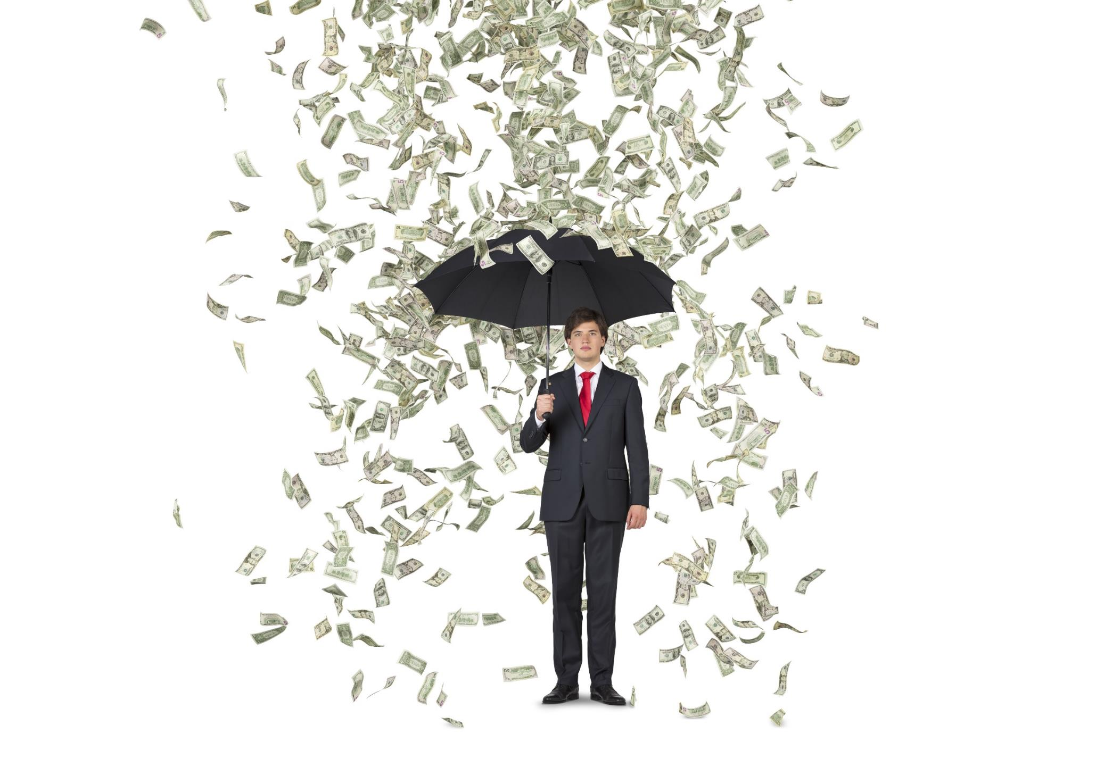
Notes:
[Review]
By nature we fight God
Self is the enemy we most

Slide 9

Surrender is radical
Notes:
Aron Ralston
Blue John Canyon, Utah

Slide 10

Notes:
Carl Grant – table tennis, Osaka Japan
That’s Mr. Chen – he’s our cook
Google Images: labeled for noncommercial reuse
http://www.abc.net.au/news/2012-08-06/chinese-table-tennis-player-ning-ding-in-the-semi-finals/4181286

Slide 11
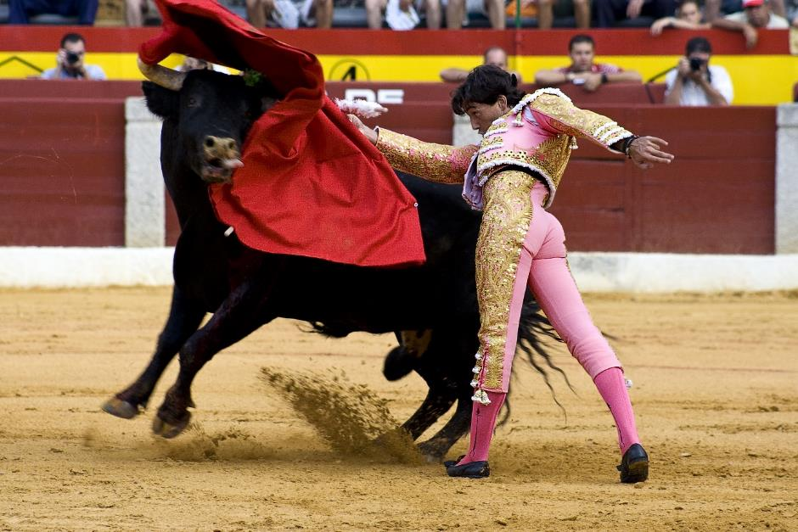
Our greatest enemy
“Everyone who enters the pearly gates of the city of God will enter there as a conqueror, and his greatest conquest will have been the conquest of self.”
God’s Amazing Grace, p. 31
Notes:
Self is enemy – laughs at feeble efforts
Intertwined - addicted to self
That is why [click-read]

Slide 12
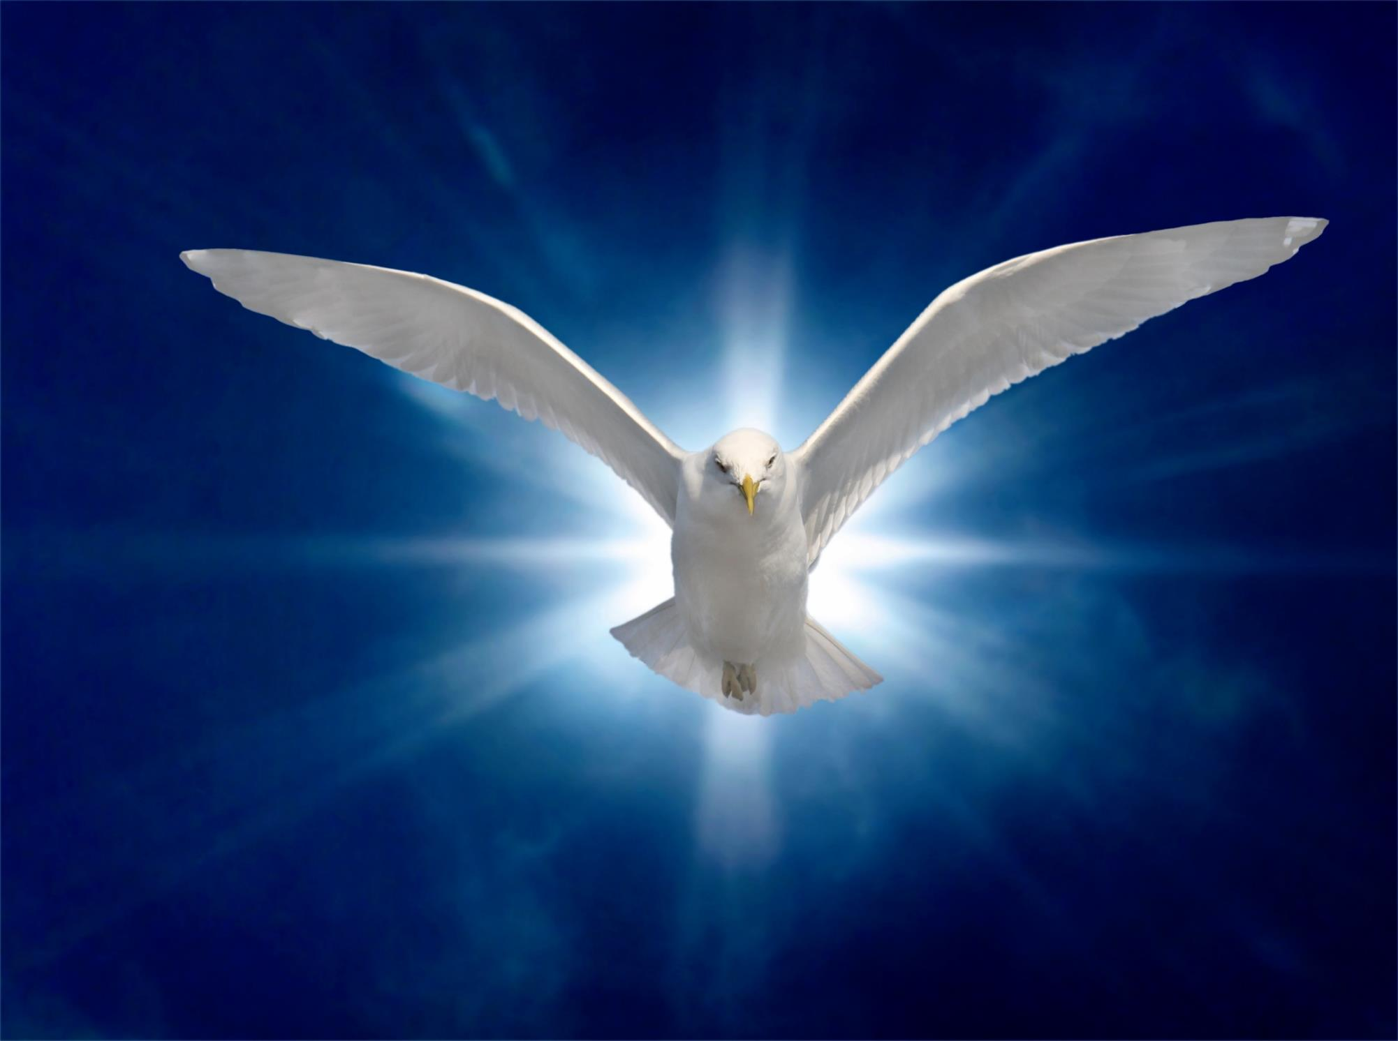
“That which is born of the flesh is flesh, and that which is born of the Spirit is spirit”
- John 3:6
Notes:
How can we fight self?
Nicodemus
The cure is to be born of Spirit
re-creative power
not a flesh patch-up [click]

Slide 13
“That which is born of the flesh is flesh, and that which is born of the Spirit is spirit”
- John 3:6
Notes:
We all have “flesh” problem
The cure is to be born again
[continued]

Slide 14
“That which is born of the flesh is flesh, and that which is born of the Spirit is spirit”
- John 3:6
Notes:
Holy Spirit is working ON vs. IN
Broad road vs. narrow way
Jesus’ hurry-God WITH vs. God IN us

Slide 15
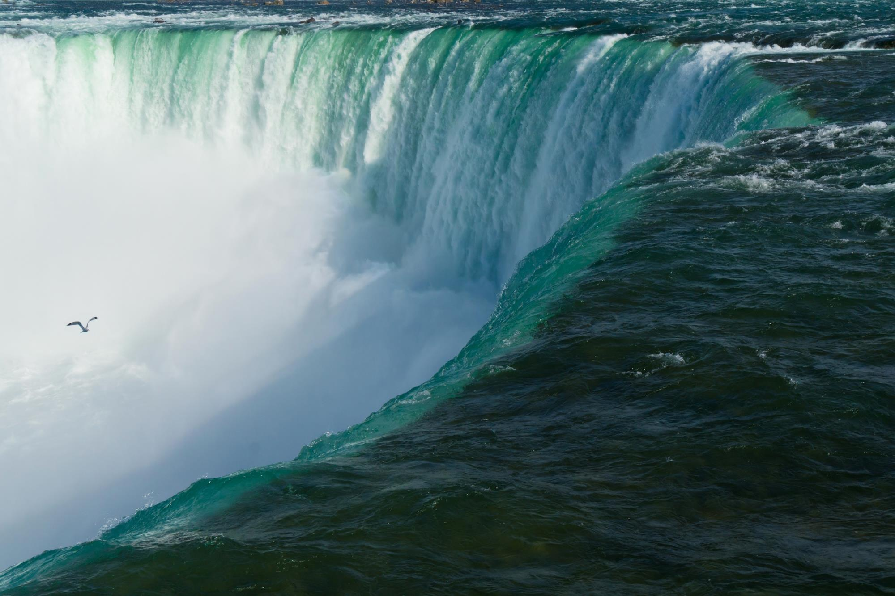
Notes:
American with Englishman friend
Foot of Niagara Falls – greatest unused
“Ah, no”- Holy Spirit of the living God

Slide 16
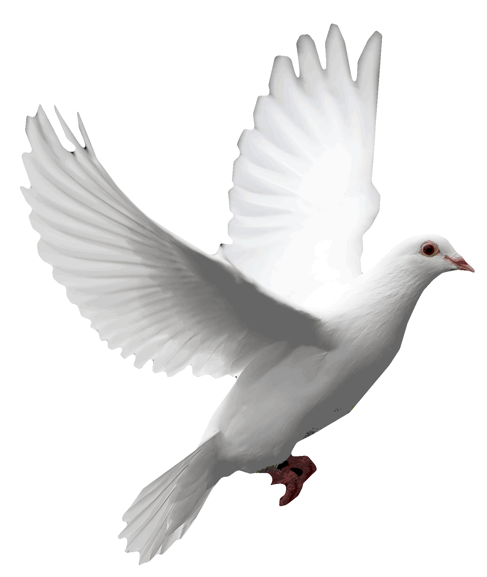
Administration
Self-control
Peace
Convicts us of sin
Love
Knowledge
Tongues
Guides us
Wisdom
Gentleness
Comforts us
Healing
Goodness
Speaks through us
Miracles
Teaching
Apostleship
Makes us holy
Joy
Helps
Patience
Prophecy
Faith
Kindness
Teaches us truth
Faithfullness
Notes:
The Holy Spirit…[keep clicking until Miracles]
Greatest need-greatest unused power

Slide 17
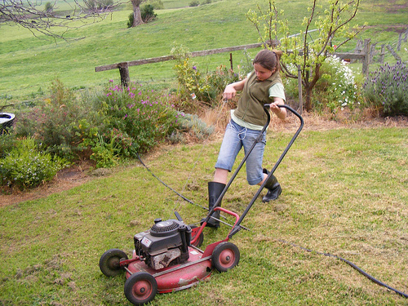
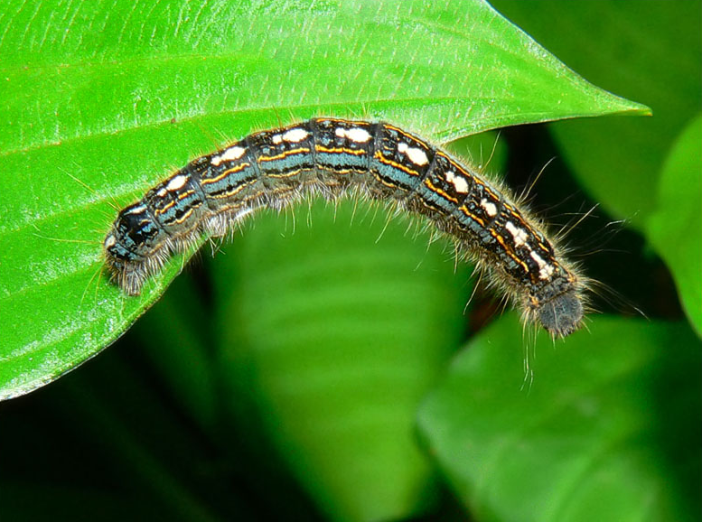
Hopeless without the Holy Spirit
Notes:
Without Holy Spirit
lawnmower without spark plug
caterpillar to become butterfly
Caterpillar must die and be reborn

Slide 18

How can I be filled with the Holy Spirit?
Notes:
Holy Spirit is the answer – but how?
Most common question
We cry out, but where is He?

Slide 19
Notes:
The answer is simple
If we wish-Spirit-filled, self-empty
Only prerequisite
God is able, willing, and eager

Slide 20
Self is the problem
Holy Spirit is the solution
Surrender is the key
Notes:
[click 3]

Slide 21
Only God can do it.
Only you and I can let Him.
Notes:
Why is surrender so important?
How is surrender the key?
It is because [click]
[continued]

Slide 22
it
Only God can do it.
Only you and I can let Him.
Notes:
[read] one-most important concepts
[click] No matter what “it” is…
And only you and I can let Him
If we ever fail to receive-God’s good

Slide 23
Only God can do it.
Only you and I can let Him.
Notes:
He is the one who will
transform hearts, minds, will
faith to move mountains
work in us to know, will, do
No matter what “it” is…

Slide 24
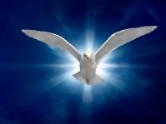
How do I receive the Holy Spirit?
“The Father ‘giveth not the Spirit by measure unto Him.’ So with the followers of Christ. We can receive of heaven's light only as we are willing to be emptied of self. We cannot discern the character of God, or accept Christ by faith, unless we consent to the bringing into captivity of every thought to the obedience of Christ. To all who do this the Holy Spirit is given without measure”
Desire of Ages, p. 181
Notes:
How do we receive the Holy Spirit?
The answer is simple: Surrender [click]

Slide 25
Self is the Problem
The Holy Spirit is the Solution
Surrender is the Key
Notes:
[click 3]
Why don’t we have more of the Holy Spirit?

Slide 26
Backbone of the Christian life
Sanctification
Obedience
Love
Holy Spirit/Conversion
Grace through Faith
Justification
Surrender
Repentance
Notes:
How is surrender the key?
Backbone of Christian life [click 8]
It’s all grace – comes through faith

Slide 27
Backbone of the Christian life
Sanctification
Obedience
Love
Holy Spirit/Conversion
Grace through Faith
Justification
Surrender
Repentance
Notes:
Notice surrender [click]
If the devil can derail
[click to pull out surrender]
[next slide to show results]

Slide 28
Backbone of the Christian life
Sanctification
Obedience
Surrender
Holy Spirit
Love
Justification
Conversion
Repentance
Notes:
Photograph of my Christian life
If surrender fails…

Slide 29

Key Phrase
Only God can do it.
Only I can let Him.
Self is the problem.
The Holy Spirit is the Solution.
Surrender is the key.
Notes:
[Key Phrase] Let’s say it together
Whatever “IT” is…

Slide 30

“If all were willing, all would be filled with the Spirit.”
Acts of the Apostles, p. 50
Notes:
Why don’t we have more-HS?
Jesus desires-more than father
But many of us today-not willing
[click]

Slide 31
Conversion is rare
“The new birth is a rare experience in this age of the world. This is the reason why there are so many perplexities in the churches. Many, so many, who assume the name of Christ are unsanctified and unholy. They have been baptized, but they were buried alive. Self did not die, and therefore they did not rise to newness of life in Christ.”
-- Manuscript Release 148, 1897
Notes:
But all are not willing
Conversion rare in Nicodemus’ time
Same today-we are told [click]
This was my experience-baptized age

Slide 32
Conversion misunderstood
“Many who speak to others of the need of a new heart do not themselves know what is meant by these words. The youth especially stumble over this phrase, ‘a new heart.’ They do not know what it means. They look for a special change to take place in their feelings. This they term conversion. Over this error thousands have stumbled to ruin, not understanding the expression, ‘Ye must be born again.’”
-- Messages to Young People, p. 71
Notes:
I fear that conversion-misunderstood
[click]
[continued]

Slide 33
Conversion misunderstood
“Satan leads people to think that because they have felt a rapture of feeling, they are converted. But their experience does not change. Their actions are the same as before. Their lives show no good fruit. They pray often and long and are constantly referring to the feelings they had at such a time. But they do not live the new life. They are deceived. Their experience goes no deeper than feeling.”
-- YI, Sept. 26, 1901
Notes:
[read] Conversion is rare
Conversion can be lost
Rich, but wretched & miserable…

Slide 34
Self is the Problem
The Holy Spirit is the Solution
Surrender is the Key
Notes:
[read]

Slide 35

What is surrender?
Notes:
Surrender is key, but it is difficult
and not well understood
We TALK a lot about surrender…
but we don’t always SAY a lot
Surrender questions
Even defining surrender-difficult

Slide 36

Notes:
Even defining surrender-difficult
one of my favorite definitions
Charles Finney - noted revivalist
Stop-claim deed - Essentially saying…

Slide 37
Notes:
Another of my favorite definitions –drowning

Slide 38
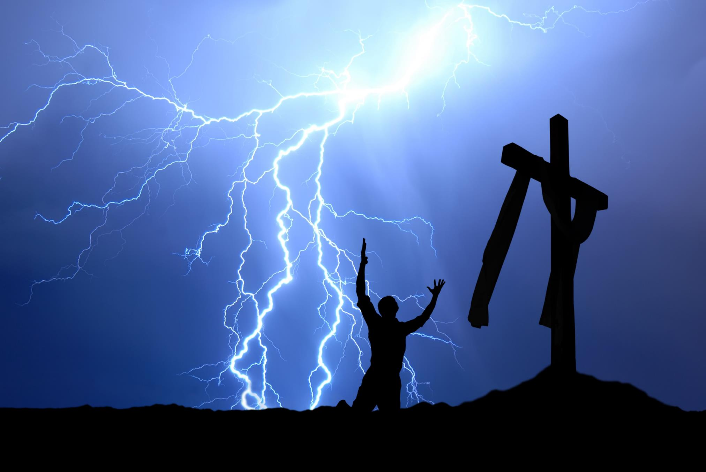
Notes:
Another-getting out of God’s way…

Slide 39

Spirit-inspired,
Spirit-enabled
settled commitment
to give God all my choices,
in every area of my life,
all the time.
Notes:
More complete definition
[click multiple times - read]
[continued]

Slide 40
Spirit-inspired,
Spirit-enabled
settled commitment
to give God all my choices,
in every area of my life,
all the time.
Notes:
Re-emphasize highlighted words
Spirit – monkish legalism
Settled – stone-cold sober, fought
Choices – giving our will back to God
every – unreservedly
all – non-stop

Slide 41

Both an Event and a Process
Event
Process
  “If anyone wishes to come after Me, he must deny himself, and take up his cross daily and follow Me” -- Luke 9:23
Notes:
Perhaps one reason-difficult to unders.
[click – event] hard-fought commit…
life-changing
[click – process] [click-read]
[click – process verse]

Slide 42

An event and a process
Notes:
Marriage event: ceremony
Marriage process:
understand, work together

Slide 43

NOT a process in the sense…
Notes:
Sense in which marriage NOT process
commit adultery less and less
Stand at alter and commit 80%, 90%
[Continued]

Slide 44
An event and a process
“Wash yourselves, make yourselves clean; Remove the evil of your deeds from My sight. Cease to do evil, Learn to do good;…”
Isaiah 1:16-17
Notes:
Same with Christian life
“Lord, I know this is a bad choice…but”
not surrender, but compromise
[click twice – read]

Slide 45
Surrender is
all-or-nothing
and
all-at-once
Notes:
All-or-nothing
All-at-once

Slide 46
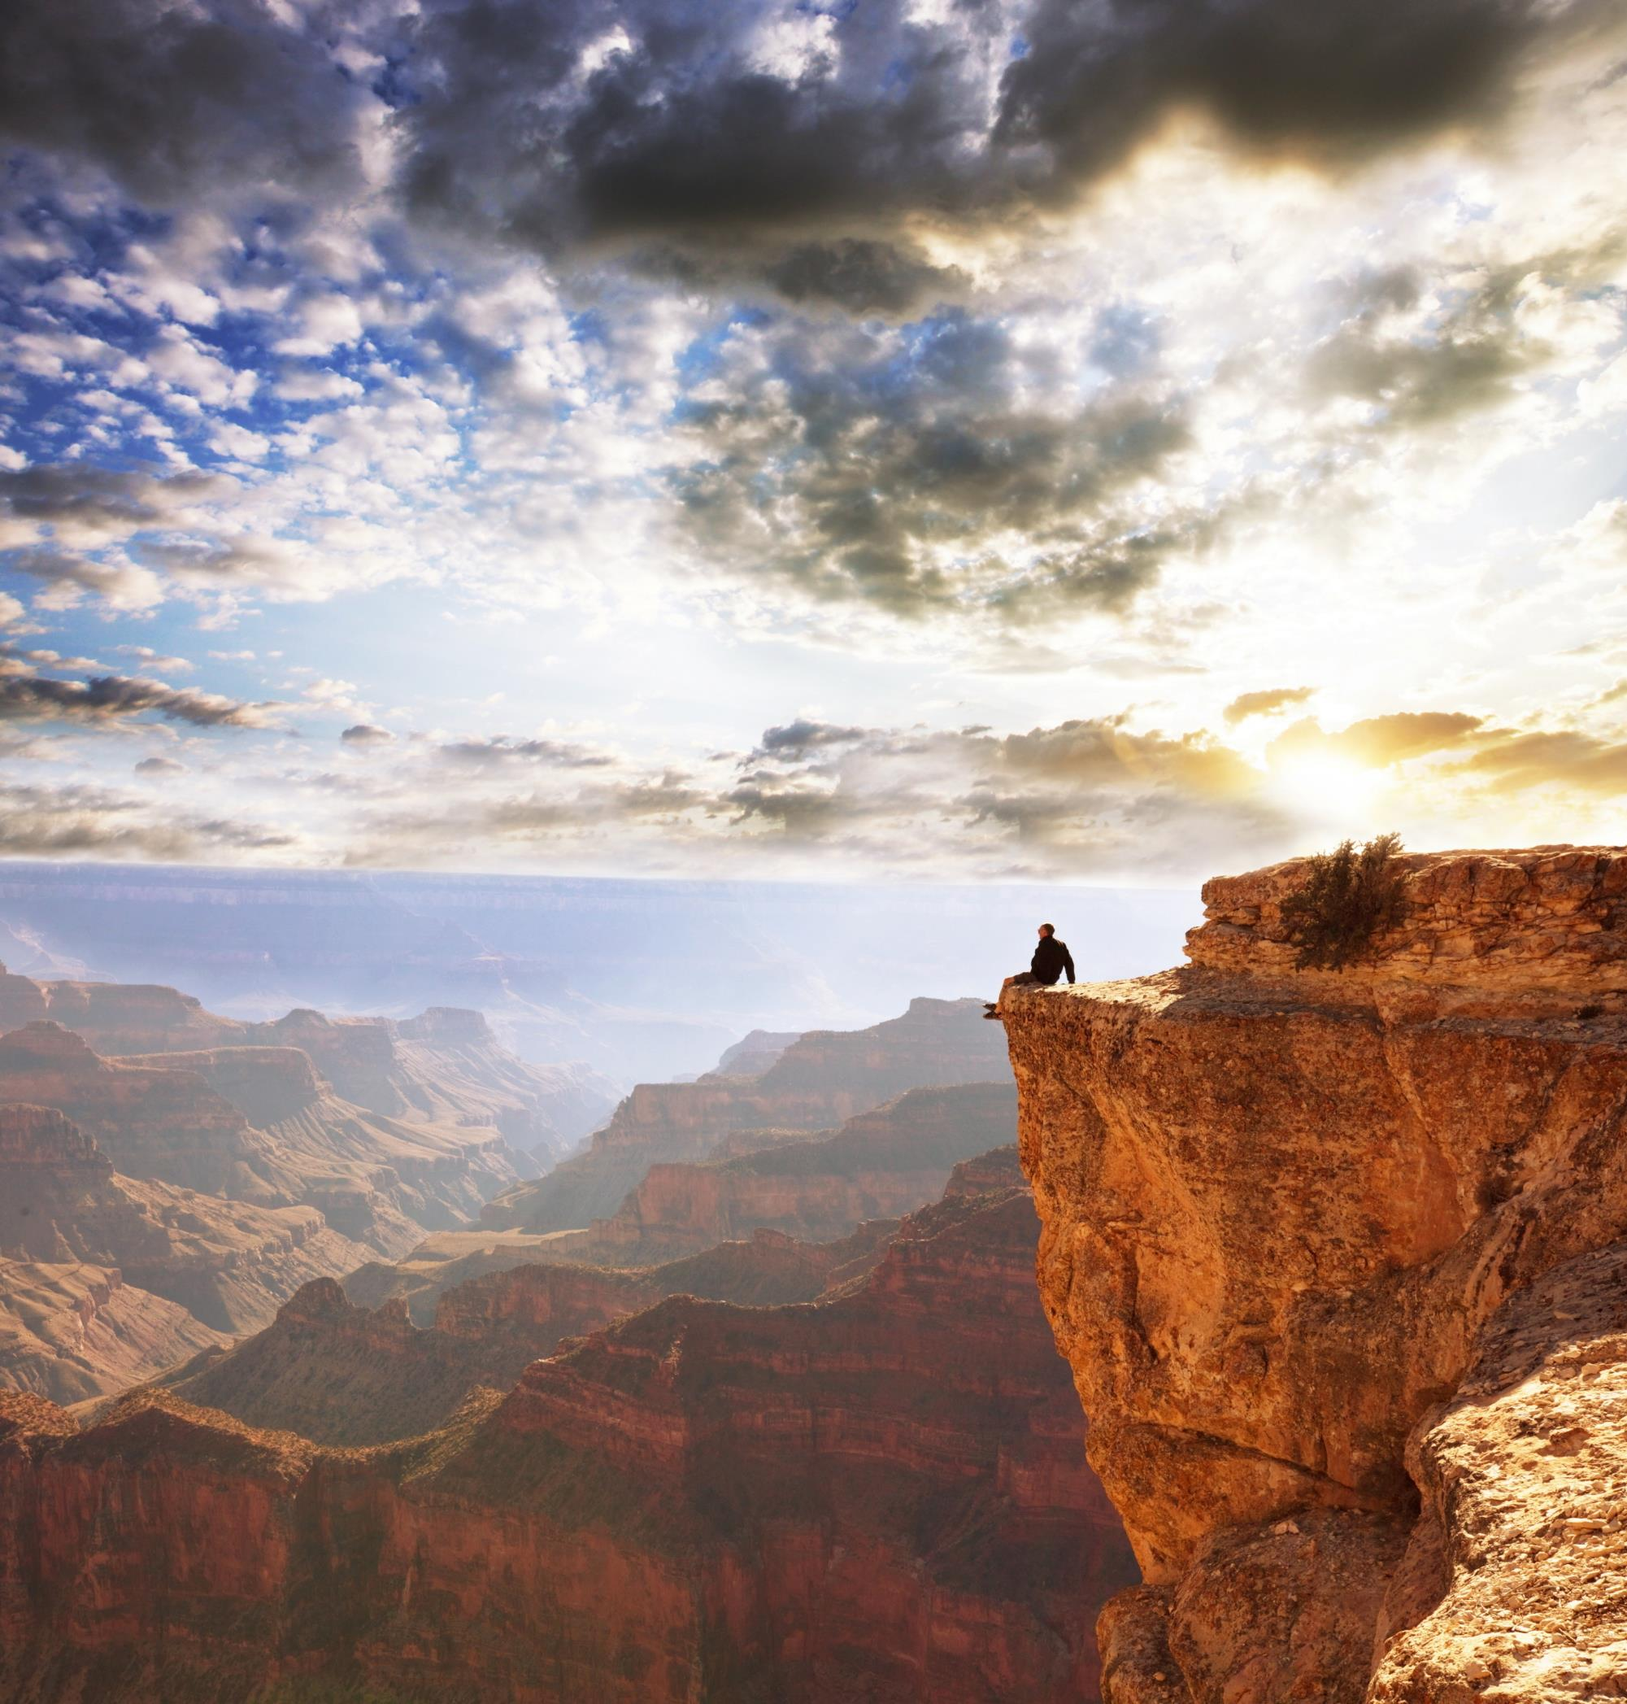
Surrender is all-or-nothing, all-at-once
Notes:
Startingly obvious statement
large canyon not crossed by series
Surrender leap of faith, 100%

Slide 47
“There are some who seem to be always seeking for the heavenly pearl. But they do not make an entire surrender of their wrong habits. They do not die to self that Christ may live in them. Therefore they do not find the precious pearl. They have not overcome unholy ambition and their love for worldly attractions.
Notes:
[read] [continued]

Slide 48
They do not take up the cross and follow Christ in the path of self-denial and sacrifice. Almost Christians, yet not fully Christians, they seem near the kingdom of heaven, but they cannot enter there. Almost but not wholly saved, means to be not almost but wholly lost.
Christ Object Lessons, p. 118
Notes:
[read]
Repeat last sentence
There are no “little” bad choices…

Slide 49
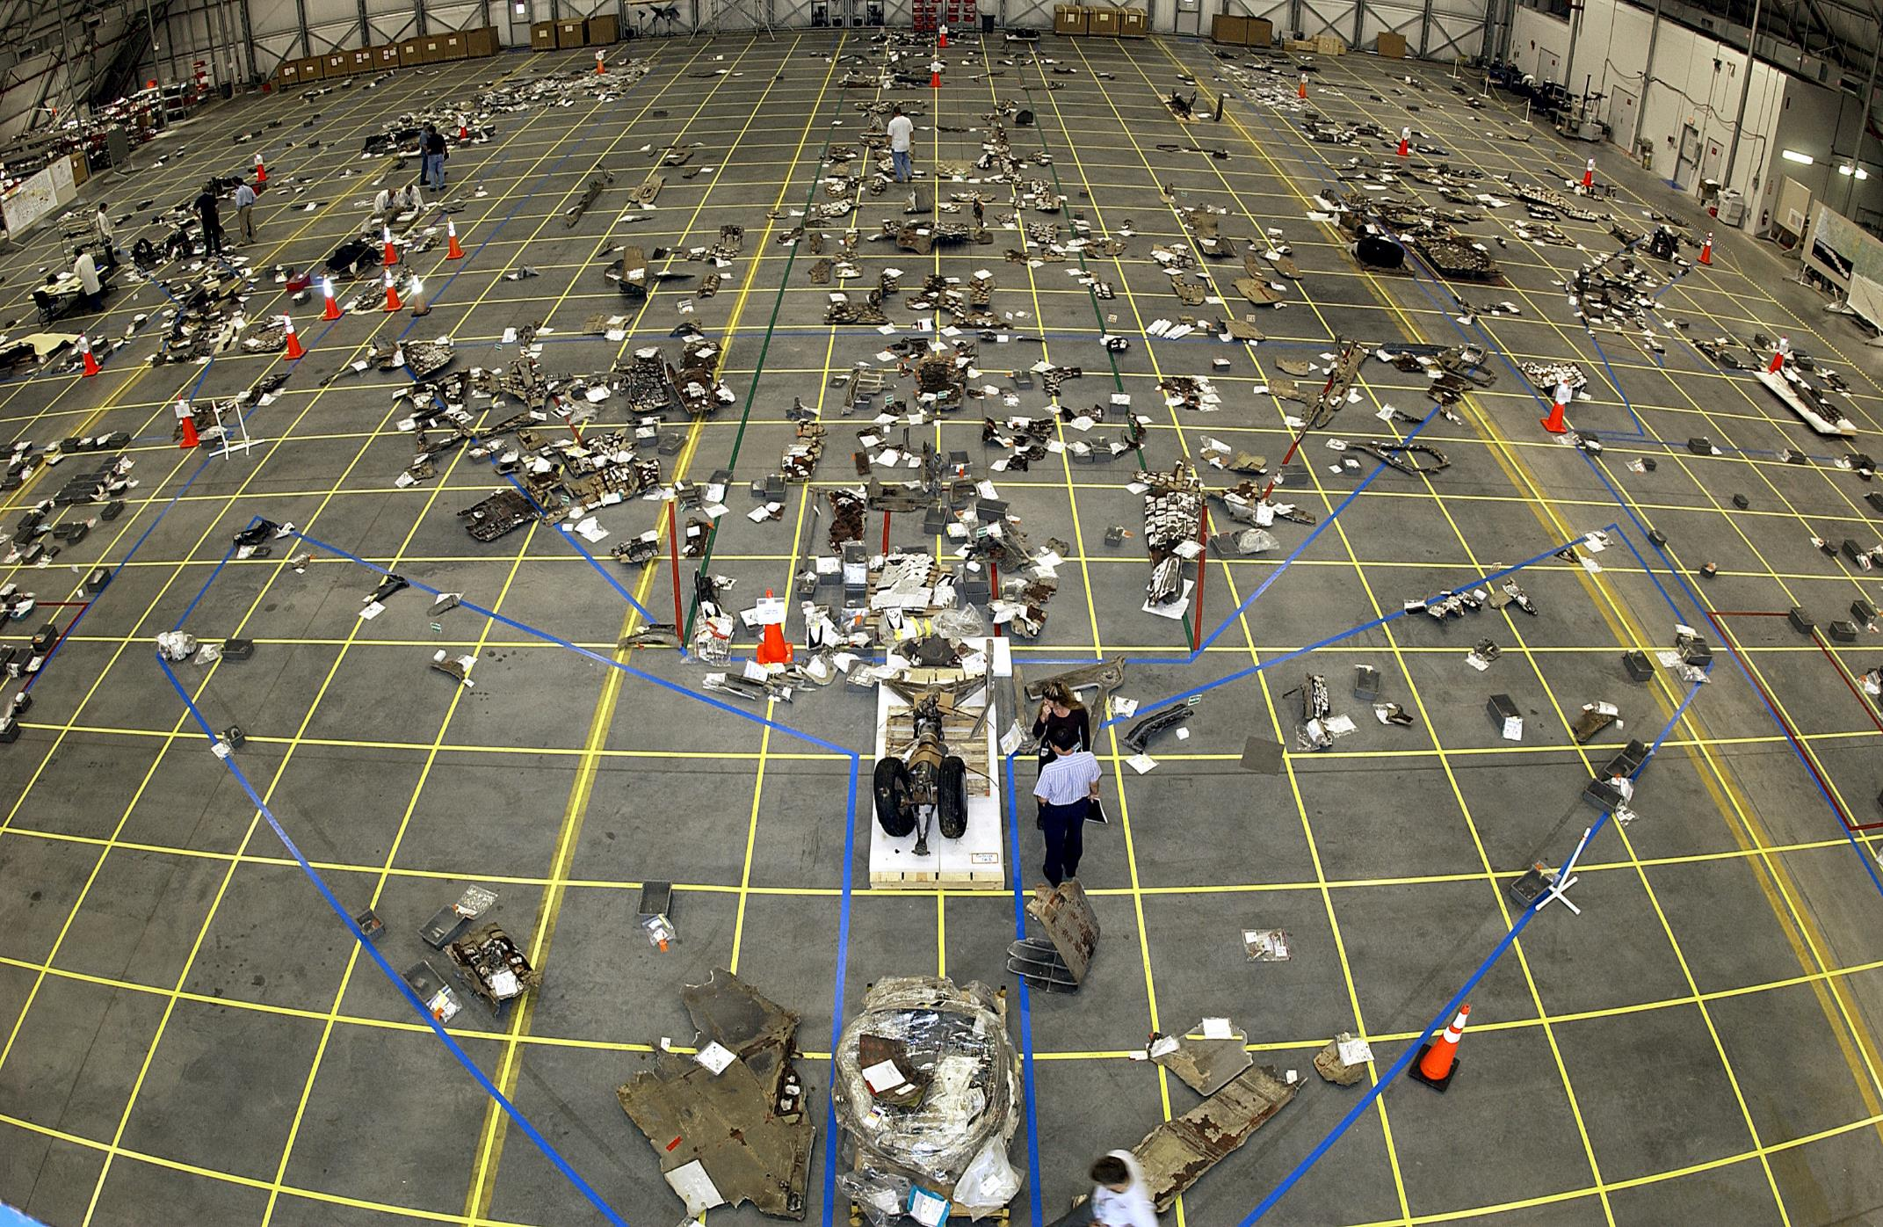
Notes:
February 1, 2003 Columbia disinteg
Texas & Louisiana
Hole created 15 days earlier-foam
82 seconds after launch
Photo: Google image https://en.wikipedia.org/wiki/Space_Shuttle_Columbia_disaster

Slide 50
Notes:
Real tragedy - Four other flights
17 years earlier-Challenger o-rings
“Normalization of deviance”
[continued]

Slide 51
Normalization of Deviance
Notes:
Lukewarm “normalization…”
Surrender – no “little” known bad
It’s just a “little”thing - every gate
Nonchalant with choices
Peers, parents, pastors

Slide 52
There are no “little” things in surrender
“We do not belong to Christ unless we are His wholly”
Christ’s Object Lessons, p. 50
Let none deceive themselves with the belief that they can become holy while willfully violating one of God’s requirements. The commission of a known sin silences the witnessing voice of the Spirit and separates the soul from God”
The Great Controversy, p. 472
Notes:
“Not Lord OF all, not Lord AT all”
EGW puts it this way[click - read]
[click – read]
My spiritual poverty

Slide 53
Notes:
No “little” - As soon as we realize…
7 yr. boy “Christian” e-mailed Santa
“How bad can I be before I lose my
presents?’”
“how much can I get away with?”

Slide 54
“Whom have I in heaven but You? And besides You, I desire nothing on earth?”
Psalms 73:25
Notes:
Holy Spirit is the power of Christian…
When we see the hopeless mire of
the self problem
And then recognize the good news…
Our hearts call out to God [click]

Slide 55
Only God can do it.
Only I can let Him.
Self is the problem.
The Holy Spirit is the Solution.
Surrender is the key.
Notes:
[Read]
[call-Drowning in the will…]
[pray]

