Slide 1
Notes:
11111111111111111111111111111111
22222222222222222222222222222222
33333333333333333333333333333333

Slide 2
My Story
www.delighting.org
Notes:
Copyright ©2016, Michael Dant, All Rights Reserved

Slide 3
My Story
www.delighting.org
Notes:
Scripture: Philippians 4:8
Hymn #1: #325 - Jesus, I My Cross Have Taken
Hymn #2: #320 - Lord of Creation

Slide 4
Review
Surrender is the seed of love for God.
Surrender is the key to obeying God joyfully.
Surrender lets Jesus justify us—all of us.
Surrender makes room for the Holy Spirit to dwell IN us.
Surrender is the key to the successful Christian life.
Only God can do it. Only we can let Him.
Notes:
[Review-What have we discovered]
[click many times]
Delighting in the Almighty – surrender
It seems that surrendering whole-heartedly to God is important

Slide 5
Review – Defining surrender
Surrender is:
  drowning in the will of the Almighty.
  getting out of God’s way so that He can be Almighty God in me.
  a Spirit-inspired, Spirit-enabled, settled commitment to give God every choice, in every area of my life, all the time.
  both an event and a process.
  all-or-nothing and all-at-once.
Notes:
[Review-Defining surrender]
[many clicks]

Slide 6
My Story
www.delighting.org
Notes:
There is no magic formula
details may not-same for everyone
Share my story
Perhaps my experience can be helpful

Slide 7

Rich, the Poor Man – A Parable
Notes:
Parable: Rich, the poor man

Slide 8

The “Good” Kid
Notes:
I am Rich: 4th generation SDA
Good home – Bible Stories 11 times
Adventist schools
Missionary overseas 6 years
Ordained elder

Slide 9
The “Good” Kid
Notes:
Never did drugs, alchohol, pre-m sex
Kiss my wife – quick study
President of AYBL in Academy
Key to Ad building-Maintenance dorm
never abused that trust

Slide 10

The “Bad” Kid
Notes:
Outside-good-Inside polluted by sin
Addictions, bad habits
Serious character flaws, slave of sin
Tragedy not sinful tendencies-all have

Slide 11
The “Bad” Kid
“…resist the devil, and he will flee from you”
James 4:7
Notes:
Tragedy-not much progress
Sincerely pleaded-victory-besetting
Wonderful promise [click – read]

Slide 12
The “Bad” Kid
“…resist the devil, and he will flee from you”
James 4:7
Notes:
But that never worked for me
“Why do I even try”

Slide 13

Notes:
Baptized at 11 or 12
Misunderstood surrender-incremental
After 3 decades – no real progress
in fact picked up new ones
worse off than when I started

Slide 14
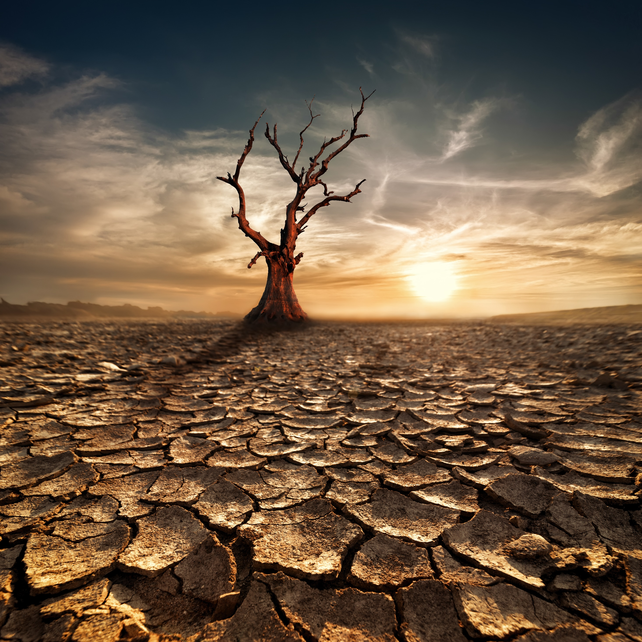
Notes:
Desert experience-“God, if you exist…”
I have no proof
I won’t be in heaven
Better-than-average - Faithless skeptic
Did my own thing

Slide 15
Notes:
Selfish-pleasure seeking – months
God did not give up on me
depths of physical & spiritual slavery

Slide 16

I find the key
Notes:
Campmeeting with mom
“What if?” unreservedly, unresist…
Did not immediately jump in - burned

Slide 17

“Self-surrender is the substance of the teachings of Christ”
Desire of Ages, p. 523
Notes:
study surrender – New Testament
What I found astounded me
Found that [click – read]

Slide 18
“Self-surrender is the substance of the teachings of Christ”
Desire of Ages, p. 523
Notes:
How could surrender be the substance
and I miss it?
I realized that I may never have
been converted – sang song, prayed

Slide 19
Misunderstanding conversion
Many…look for a special change to take place in their feelings. This they term conversion. Over this error thousands have stumbled to ruin, not understanding the expression, "Ye must be born again.”
Messages to Young People, p. 71
Notes:
[read]
Importance of counting the costs
“little” open gates preventing God

Slide 20

Counting the costs
“Finally, brethren, whatever is true, whatever is honorable, whatever is right, whatever is pure, whatever is lovely, whatever is of good repute, if there is any excellence and if anything worthy of praise, dwell on these things.”
Philippians 4:8
Notes:
One of those “little” open gates-movies
I knew they did not meet the standard
Phil. 4:8 [click – read]

Slide 21
Counting the costs
“Finally, brethren, whatever is true, whatever is honorable, whatever is right, whatever is pure, whatever is lovely, whatever is of good repute, if there is any excellence and if anything worthy of praise, dwell on these things.”
Philippians 4:8
Notes:
I knew-instigated unhealthy emotions
encouraged snacking unhealthy food
used up large chunks of time
made it more difficult to enjoy Bible
door for worldly ideas, values

Slide 22
Counting the costs
“Finally, brethren, whatever is true, whatever is honorable, whatever is right, whatever is pure, whatever is lovely, whatever is of good repute, if there is any excellence and if anything worthy of praise, dwell on these things.”
Philippians 4:8
Notes:
Tried many times to give up movies
Saturday night “ropes of sand”
But I knew that surrender meant-must go

Slide 23

Notes:
One reason movies so difficult
Air travel for work
3 overseas trips – 3 weeks
England, Ireland, France

Slide 24
Notes:
Decided must surrender everything…
after I got back
Bad experience – England trip
needed to try to reduce movies

Slide 25

Notes:
Ireland experience
willing and able
miracle
bad timing

Slide 26
Notes:
Surrender was the culmination of a process of several months
New airplane-wide screen-map

Slide 27
James 4:7
Notes:
Surprised at how easy to resist movie
James 4:7 really says [click-Bible]

Slide 28
Key phrase
“Submit therefore to God. Resist the devil and he will flee from you.”
James 4:7
Notes:
[read together]
Submit must come first
then the resisting…

Slide 29

Desperate devil
Notes:
Coming home from France
entertainment guide
purser’s announcement
G-rated comedy

Slide 30
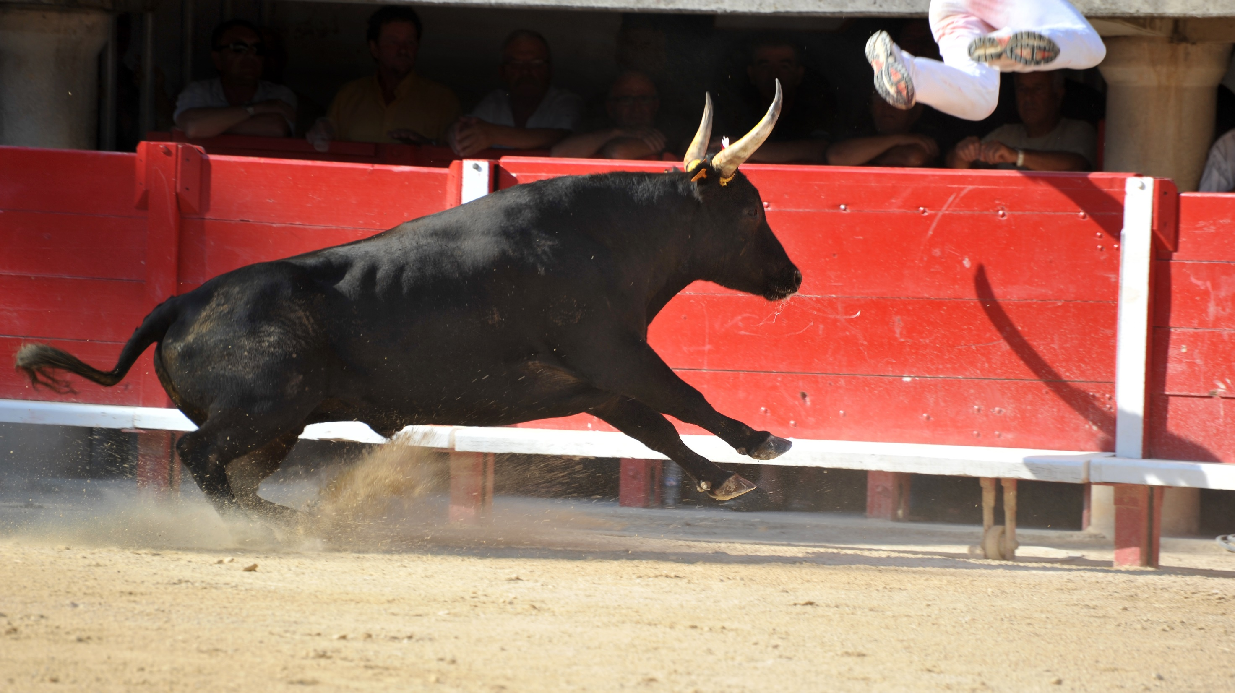
Notes:
Miraculous victory -photo
known chosen sins
power of God – 1st time in my life
Love for prayer-Delighting
Moving to the desert-bland diet

Slide 31
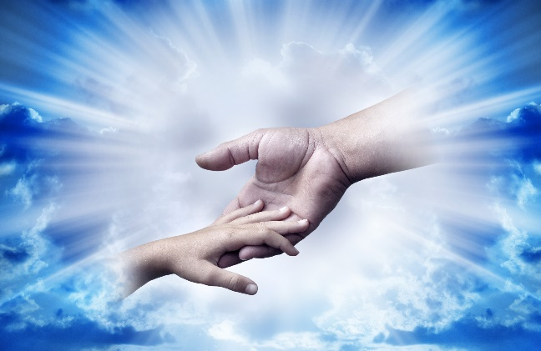
Victory over sin!
“When the soul surrenders itself to Christ, a new power takes possession of the new heart. A change is wrought which man can never accomplish for himself. It is a
supernatural work, bringing a
supernatural element into human
nature.”
Notes:
[read] [continued]

Slide 32
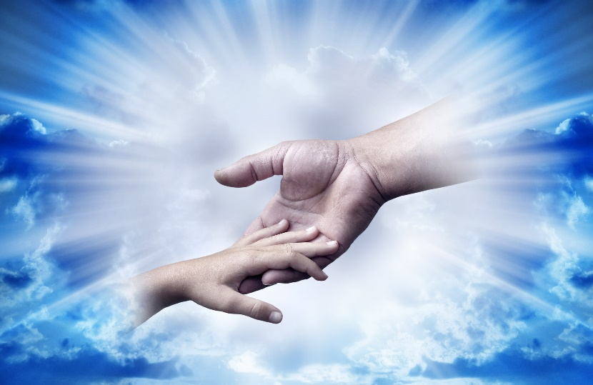
Victory over sin!
The soul that is yielded to Christ becomes His own fortress, which He holds in a revolted world, and He intends that no authority shall be known in it but His own.
Notes:
[read][continued]

Slide 33
Victory over sin!
A soul thus kept in possession by the heavenly agencies is impregnable to the assaults of Satan. But unless we do yield ourselves to the control of Christ, we shall be dominated by the wicked one” Desire of Ages p. 324
Notes:
[read]
I can tell you by experience
this is a true statement

Slide 34
Victory over sin!
A soul thus kept in possession by the heavenly agencies is impregnable to the assaults of Satan. But unless we do yield ourselves to the control of Christ, we shall be dominated by the wicked one” Desire of Ages p. 324
Notes:
Am I perfect?
mistakes, shortcom, character flaws,
sinner standing in the need of grace
Difference? No known bad choices

Slide 35
Victory over sin!
A soul thus kept in possession by the heavenly agencies is impregnable to the assaults of Satan. But unless we do yield ourselves to the control of Christ, we shall be dominated by the wicked one” Desire of Ages p. 324
Notes:
Spiritual panic attacks
what had I done?
give up all my choices?
was it possible?
One foot in front of the other

Slide 36
Notes:
Not everyone has a struggle with movies
Everyone has an area – struggle with

Slide 37
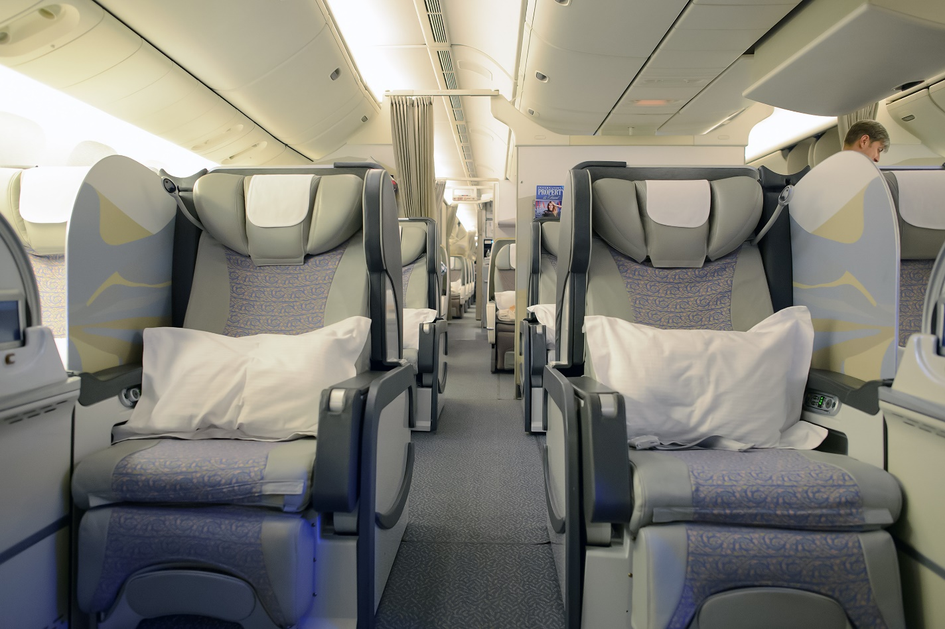
First-class Christian Experience
Notes:
Plane in Germany – on my way home
Testimony-Got rid of ComCast
Clutching first-class ticket
May we all enjoy the first-class…
[call] [prayer]

