Slide 1
Notes:
11111111111111111111111111111111
22222222222222222222222222222222
33333333333333333333333333333333

Slide 2
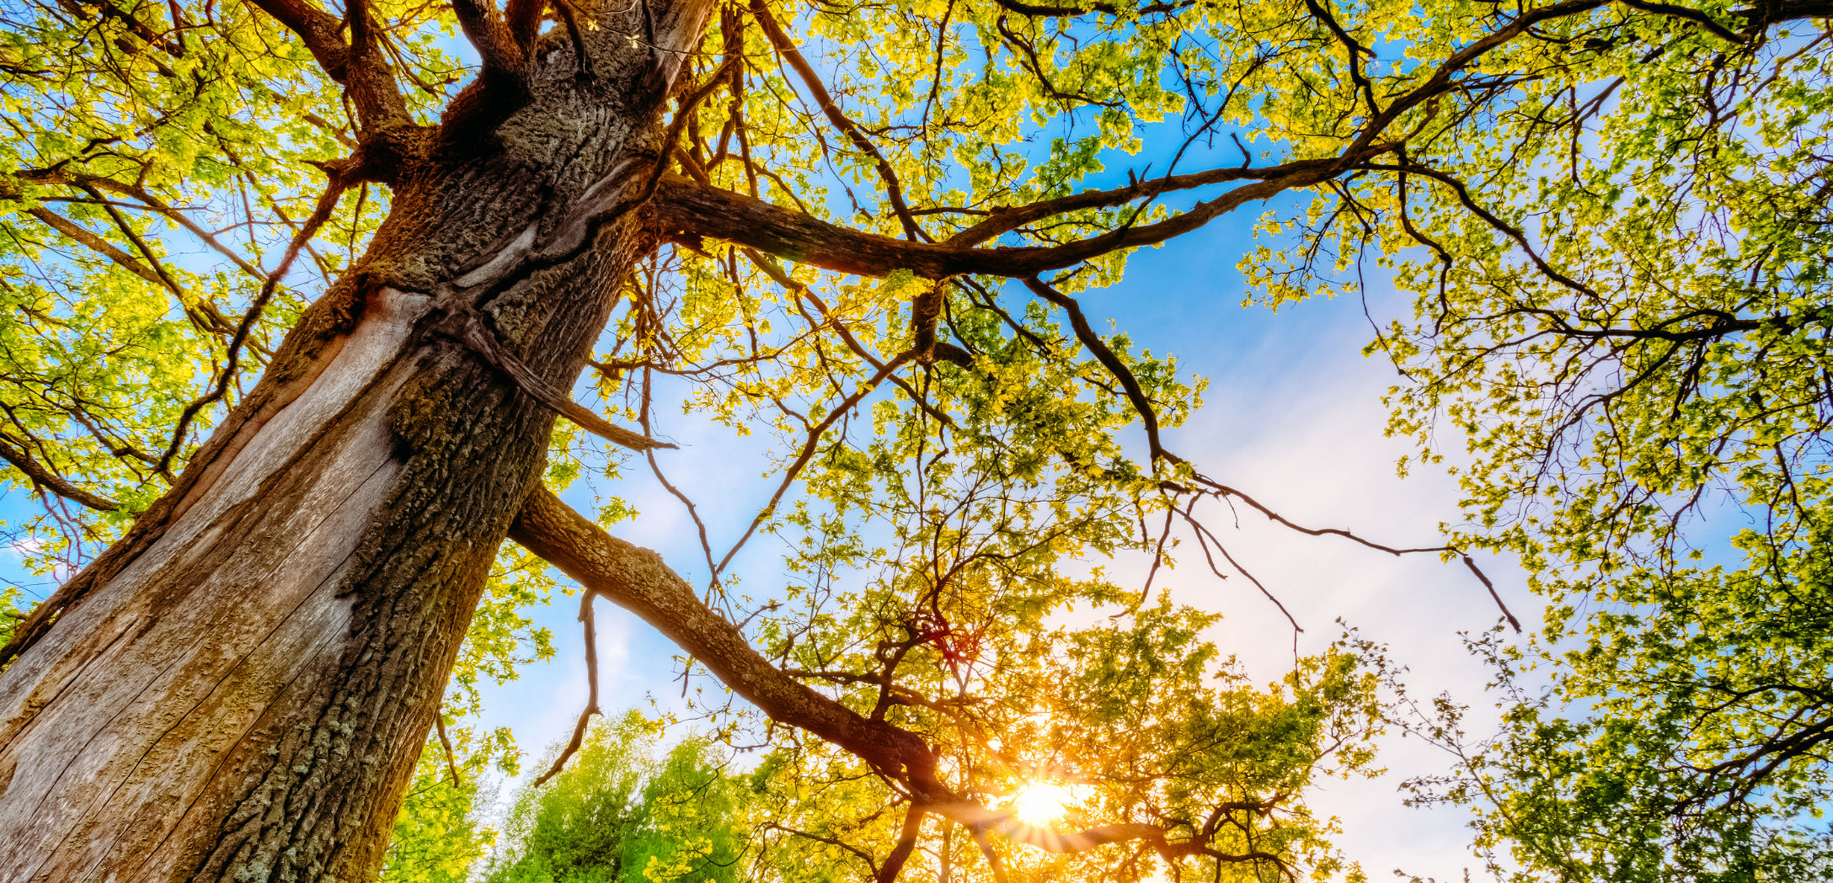
The Root of the Problem
www.delighting.org
Notes:
Copyright ©2016, Michael Dant, All Rights Reserved

Slide 3
The Root of the Problem
www.delighting.org
Notes:
[Recap]
Scripture: Isaiah 30:18
Hymn #1: 567 Have Thine Own Way
Hymn #2: 322 Nothing Between
mdant@southern.edu
No unlicensed images

Slide 4
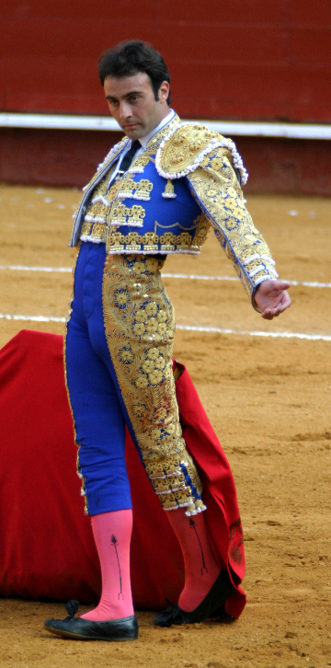
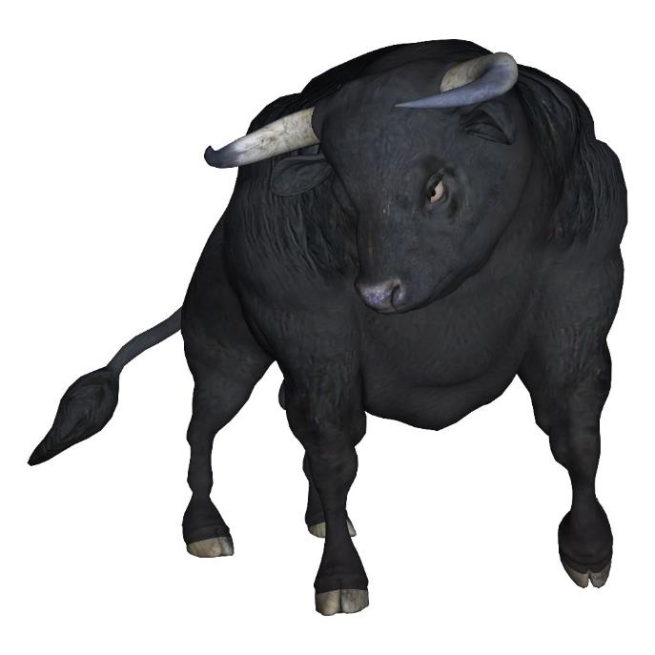
Weight: 180 pounds
Max. Speed: 20 mph
Weight: 1,300 lbs.
Max. Speed: 40 mph
Notes:
On one side [click]
--On the other side [click]
Bull is faster, bigger, stronger
--Who wins? Why?
-------------------------------
[NOTE: Points to Ponder – Contact me with comments and questions ]
On one side: skinny man in funny costume, weight around 180 lbs., maximum speed of 20mph [click]
On the other side is 1300 pounds of barely restrained fury about to unleash itself that can run twice as fast [click]
The bull is much bigger, stronger and faster…and yet the matador almost always wins
What’s wrong with this picture
How does the out-gunned Matador win…almost every time?

Slide 5
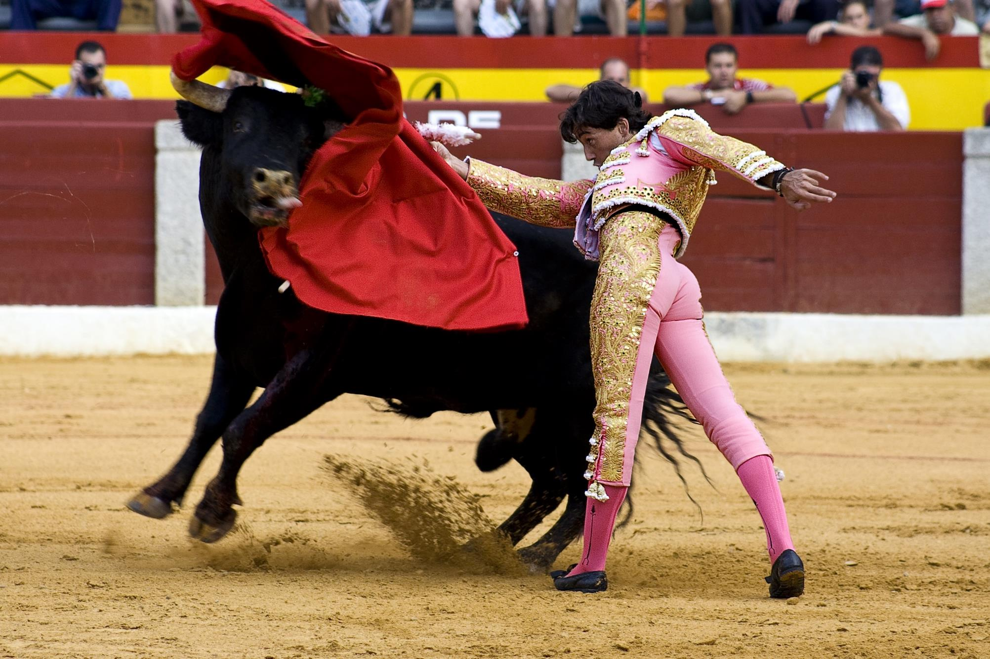
Notes:
The secret is the Red Cape
The cape cannot be hurt
--------------------------
The secret is the Red Cape
A skillful bullfighter uses this simple piece of cloth to distract the bull from its true target
The cape cannot be hurt
No matter how many times the bull skewers the cape with its deadly horns, the cape never dies
Even if the bull succeeded in tearing the cape to shreds, he would be no closer to winning the battle
In the end, the matador easily wins because the bull is too exhausted to fight its true enemy

Slide 6
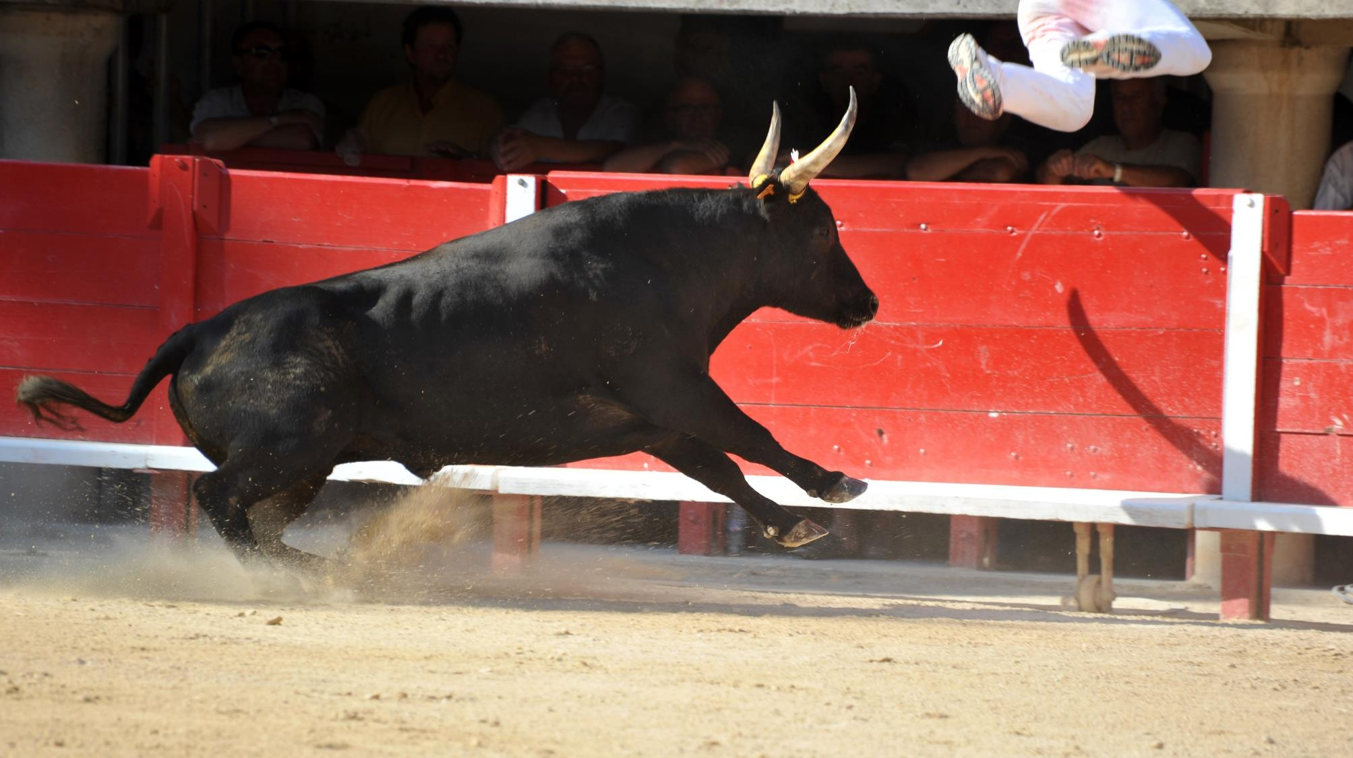
Notes:
What would happen…[click]
Lesson - pays to recognize our enemy
To conquer the cape-attack the mata.
----------------------------------------
But what would happen if the bull ignored the distracting cape and attacked the matador directly?
[click]
The contest would be quickly won and it would be the matador’s crushed and lifeless body that is pulled from the ring
The lesson that we can learn is that it pays to recognize our enemy
In the spiritual realm this is especially important. It is easy to fight the wrong enemy and lose battles when we should be more than conquerors

Slide 7
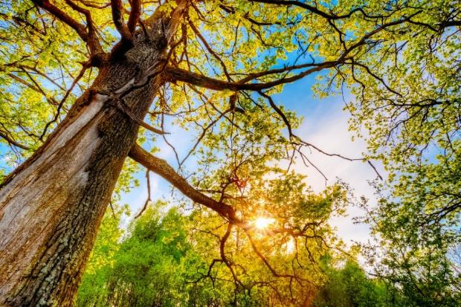
Recognizing the true enemy
“It is only labor in vain to pick leaves off a living tree…The ax must be laid at the root of the
tree and then the
leaves will fall off,
never to return”
Evangelism p. 272
Notes:
True in Christian life as well
[click]
We should be “more than conquerors”
-----------------------
Just like the bull in the bull-fighting illustration, we must recognize our true enemy. If we fail to do so, we will fight the wrong battles and suffer defeat no matter how victorious we are. The red cape can be torn to shreds, but it cannot be hurt. We must target the matador.
Sometimes as Christians it is easy to look at all our faults, failures, and sins and say, “I need to do better.” And, of course, we do need to do better. But not by attacking the faults, failures, and sins directly. They are the red cape. They cannot be hurt. If we desire to conquer the red cape, we must destroy the matador. Then the cape will fall lifeless to the ground, never to rise again.
Ellen White nails it on the head when she writes, [click – read]

Slide 8
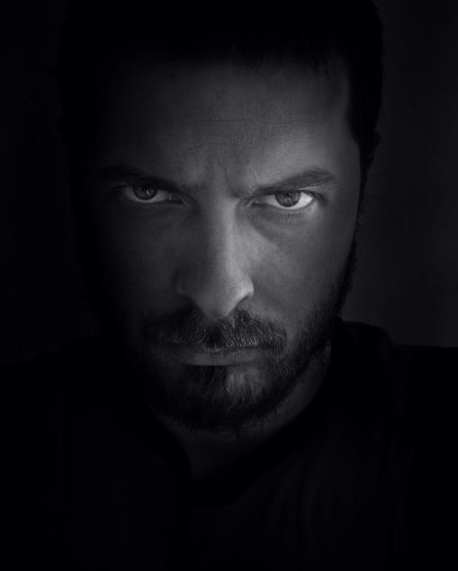
Who is my true enemy?
“our struggle is not against flesh and blood, but against the rulers, against the powers, against the world forces of this darkness, against the spiritual forces of wickedness in the heavenly places.”
Ephesians 6:12
“that through death He might render powerless him who had the power of death, that is, the devil”
Hebrews 2:14
Defeated!
Notes:
Devil [click – read]
Two things we should know…
1. much too strong for us
2. Defeated [click – read]
------------------------------
The devil clearly fits that description [click photo]
He started the war in heaven and has continued it to this day
Paul clearly teaches that the devil is an enemy of ours [click – read verse]
But the good news is that Jesus died [click – read verse]
[click] So that makes 1 foe down.

Slide 9
Who ELSE is my enemy?
“For we know that the Law is spiritual, but I am of flesh, sold into bondage to sin.”
Romans 7:14
Notes:
Does God have other enemies?
Yes, worse, in some ways, than devil
Over 7 billion [click – read]
-------------------------------
But does God have any other enemies?
The answer is yes, over 6 billion of them.
And these enemies are more difficult to conquer than the devil
Whether we like it or not, you and I are, by nature, enemies of God.
Paul asserts that [click]

Slide 10
Who ELSE is my enemy?
“…the mind set on the flesh is hostile toward God; for it does not subject itself to the law of God, for it is not even able to do so, and those who are in the flesh cannot please God.”
Romans 8:8
Notes:
Paul calls this sinful nature “flesh” and proclaims [click]

Slide 11
Who ELSE is my enemy?
“As soon as Adam sinned, he was in harmony with the first great apostate and at war with God.”
Youth Instructor, October 11, 1894
Notes:
When Adam sinned-bent & broken
We have become like Adam
Ellen White [click – read]
Stay enemies until we reconcile [next slide]
--------------------------
You and I are born with Adam’s sinful nature, “in harmony with the first great apostate and at war with God.”
And we stay His enemy until we choose to be reconciled. [continued on next slide]

Slide 12
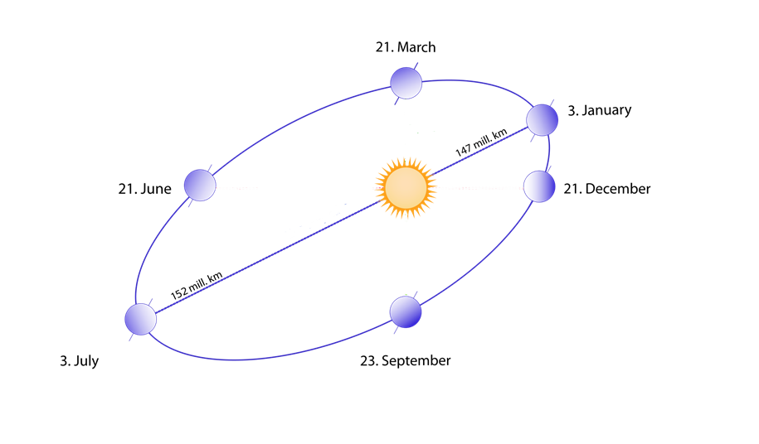
Notes:
Cause of winter
Sinful nature – tilted away
Unlike the earth, we can choose tilt
Lukewarm – not tilted away, but
Google images: https://en.wikipedia.org/wiki/Earth%27s_orbit

Slide 13
Who ELSE is my enemy?
“For if while we were enemies we were reconciled to God through the death of His Son, much more, having been reconciled, we shall be saved by His life.”
Romans 5:10
Notes:
[read]

Slide 14
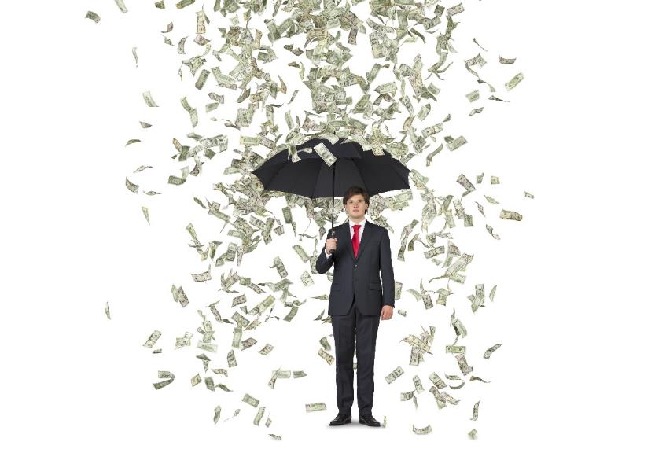
What is God’s battle?
“Therefore the Lord longs to be gracious to you, And therefore He waits on high to have compassion on you…How blessed are all those who long for Him.”
Isaiah 30:18
Notes:
We are natural enemies to God
But what is God’s battle?
To bless us [click - read] [continued]
------------------------------
God’s battle with mankind is to bless us. Isaiah proclaims, [click]
But, by nature, we are unwilling to be blessed. Before Adam sinned mankind was aligned with God and at enmity with the devil; we naturally leaned toward God’s blessings. But after the fall, our nature became broken and twisted; we came into “harmony” with the devil and we naturally lean away from God’s goodness.

Slide 15
What is God’s battle?
“Therefore the Lord longs to be gracious to you, And therefore He waits on high to have compassion on you…How blessed are all those who long for Him.”
Isaiah 30:18
Notes:
Can’t you just see a God…
[continued]
------------------------------
God’s battle with mankind is to bless us. Isaiah proclaims, [click]
But, by nature, we are unwilling to be blessed. Before Adam sinned mankind was aligned with God and at enmity with the devil; we naturally leaned toward God’s blessings. But after the fall, our nature became broken and twisted; we came into “harmony” with the devil and we naturally lean away from God’s goodness.

Slide 16
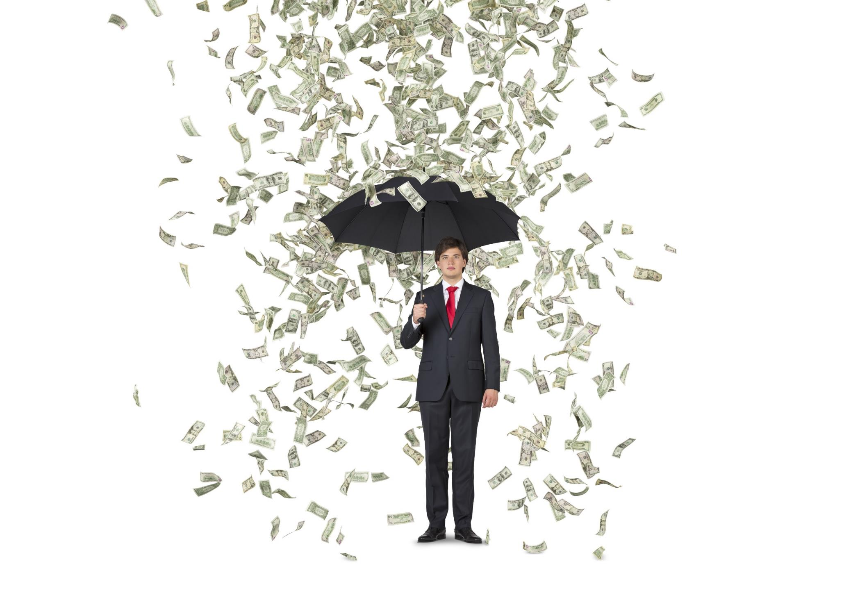
Notes:
We are our own worst enemies
Showers of blessings
We fight God
------------------------------
The bad news is that as enemies of God, we are in one way more powerful than the devil. God can easily vanquish the devil but He cannot conquer us against our will. That is because the Lord has given us the power of choice. He has taken that power away from Himself and has lovingly bestowed it upon us. Because of this transfer of power, God cannot (will not, if you prefer) bend us to His will. He cannot force His goodness upon us.
The weakest human being can stop the Almighty God in His tracks in His battle to bless us. We are by nature at war with God—and we win—at least in terms of our own lives. The only way that God can conquer us is if we choose to be conquered—to surrender.

Slide 17
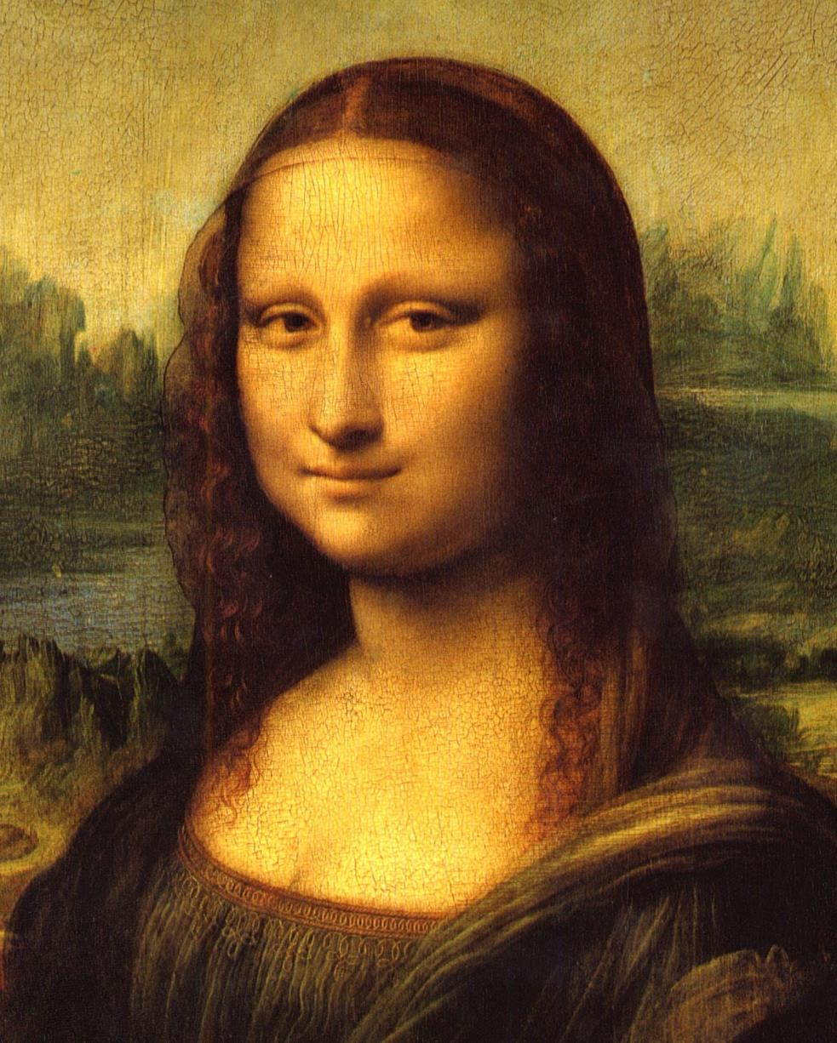
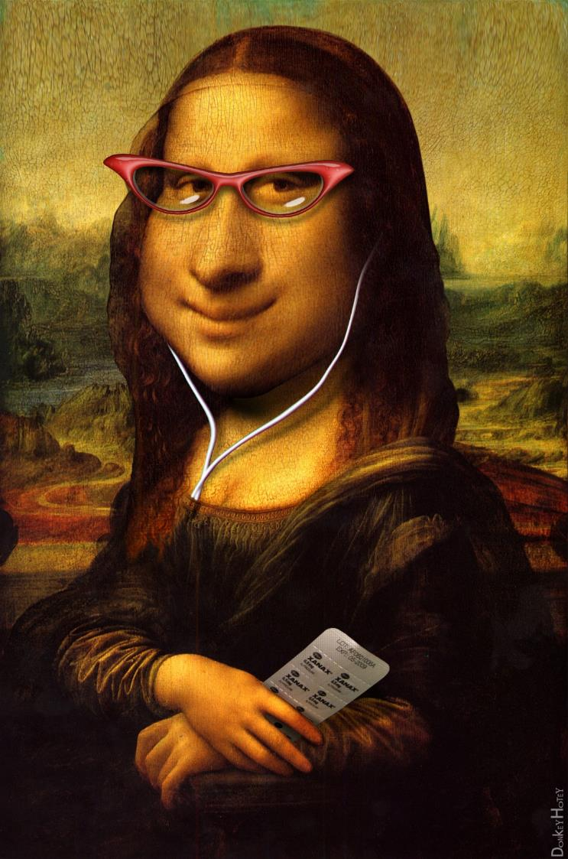
Notes:
You and I are like a paintbrush in the hand of the Master painter—that has a mind of its own

Slide 18

Why we fight God
Not all of God’s blessings are attractive to us
We are not always willing to pay the price for them.
Notes:
Do we really fight God’s blessings?
That doesn’t make sense?
Yes, we do, for two reasons [2 clicks]

Slide 19
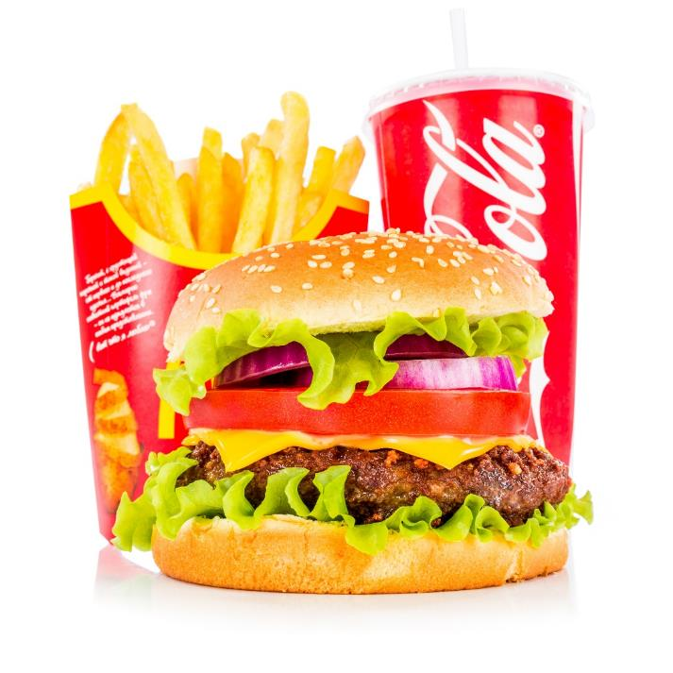
Unwilling to be blessed
Notes:
Unwilling to be blessed-want vs willing
[click]McDonalds, weight, energy, cholesterol, blood sugar, blood pressure?”
----------------------------
Perhaps an illustration would be helpful in understanding this natural unwillingness to accept God’s blessings. We may WANT His goodness but at the same time be UNWILLING to receive it.
Health survey illustration

Slide 20
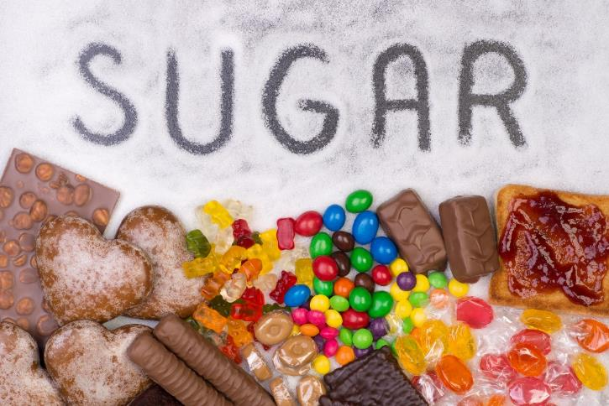

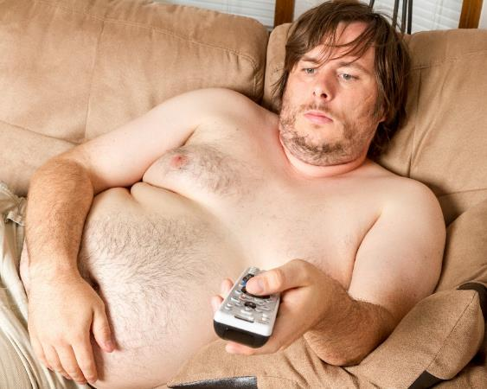
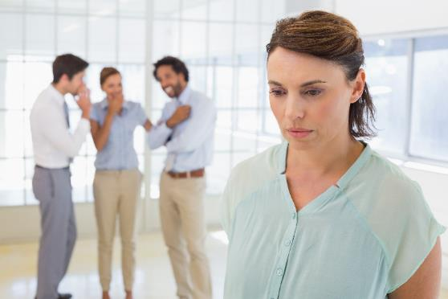
Notes:
Want to be blessed, but not willing
Energy – exercise
Healthy friendships – gossip
out of debt – resist buying
A thousand different ways
---------------------------------
Here is a man who truly desires to be blessed with good health, but despite that desire, is unwilling to pay the cost of good health. He wants the benefits of health, but his sinful nature craves the unhealthy food.
Before we give this poor guy a hard time because of his lack of self-control, we should remember that we, too, can easily do the same thing—in some area of our life. It is our nature to do so. We may, for example, desire energy and fit bodies, but be unwilling to “feel the burn” of exercise in order to achieve it. We may desire good relationships with those around us, but be unwilling to forgo the pleasure of juicy gossip. We may long to be out of debt but be unwilling to curb our spending. In a multitude of ways we may desire God’s blessings but still be unwilling to deny our natural desires, cravings, aspirations, values, and pleasures in order to receive them.

Slide 21
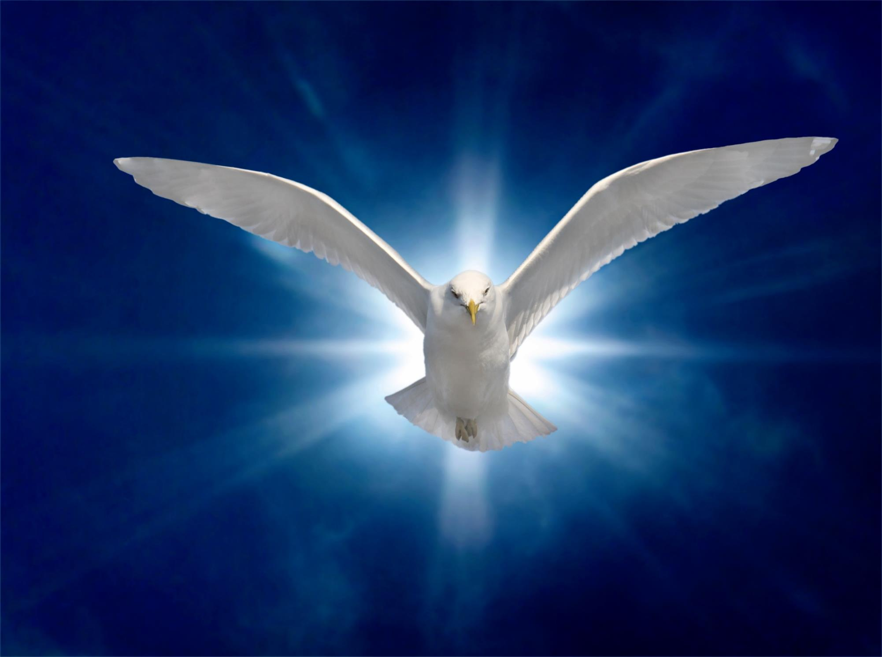
“If all were willing, all would be filled with the Spirit.”
Acts of the Apostles, p. 50
Notes:
Doubly true in spiritual realm
We need revival and reformation
Need Holy Spirit [click – read]
----------------------------------------------
And this unwillingness to be blessed is doubly true in the spiritual realm. We are, for example, a people who are in desperate need of revival and reformation. We recognize that need and we know that the Holy Spirit is the only source of true revival and reformation.
And yet the pen of inspiration tells us that [click-read]
The fact of the matter is that although we may want revival and reformation, we are not always willing to pay the price.

Slide 22
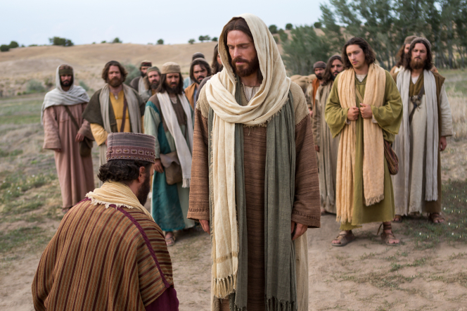
Unwilling to be Blessed
Notes:
RYR – Unwilling to be blessed
It’s the same way with us [next slide]
---------------------------
This unwillingness to be blessed is starkly illustrated in the experience of the Rich, Young ruler. He came to Jesus truly desiring the blessing of eternal life. He took the time and effort to find Jesus and to discover exactly what it was that he was missing. He was willing to do almost anything to “inherit eternal life.” But, in the end, he walked away sad, because He was unwilling to pay the cost.
And it is often the same with us. We may want a closer relationship with Jesus but be unwilling to make the radical commitment. We may desire, for example, to spend more time with Him each day, but be unwilling to go to bed earlier so that we can get up earlier. We may long to enjoy scripture, but be unwilling to deny ourselves the stimulating worldly entertainment that makes the Bible seem bland by comparison. We may want to soar with God on the heights, but be unwilling to remove every worldly weight that holds us down. We may truly desire to be on fire for God and yet be unwilling to let Him turn off the cold water faucet of worldliness that is making us lukewarm.
Our nature is broken. We crave the things that are unhealthy for us and shun the blessings that God longs to lavish upon all who are willing.

Slide 23
Unwilling to be Blessed
Notes:
We may want a closer relationship with Jesus but be unwilling to make the radical commitment.

Slide 24
Unwilling to be Blessed
Notes:
We may desire, for example, to spend more time with Him each day, but be unwilling to go to bed earlier so that we can get up earlier.

Slide 25
Unwilling to be Blessed
Notes:
We may long to enjoy scripture, but be unwilling to deny ourselves the stimulating worldly entertainment that makes the Bible seem bland by comparison.

Slide 26
Unwilling to be Blessed
Notes:
We may want to soar with God on the heights, but be unwilling to remove every worldly weight that holds us down.

Slide 27
Unwilling to be Blessed
Notes:
We may truly desire to be on fire for God and yet be unwilling to let Him turn off the cold water faucet of worldliness that is making us lukewarm.

Slide 28
Unwilling to be Blessed
Notes:
Our nature is broken. We crave the things that are unhealthy, and shun the blessings that God longs to lavish upon all who are willing.

Slide 29
Unwilling to be Blessed
“For thus the Lord God, the Holy One of Israel, has said, ‘In repentance and rest you will be saved, In quietness and trust is your strength.’ But you were not willing,”
Isaiah 30:15
“Jerusalem, Jerusalem, … How often I wanted to gather your children together, the way a hen gathers her chicks under her wings, and you were unwilling”
Matthew 23:37
Notes:
Throughout history God - figthing
[click –read]
Jesus cries out to US as Jerusalem
[click – read]
---------------------
God’s says to Israel as He often says to you and me, [click – read]
Jesus cries out to us as He did for the Jews, [click – read]

Slide 30
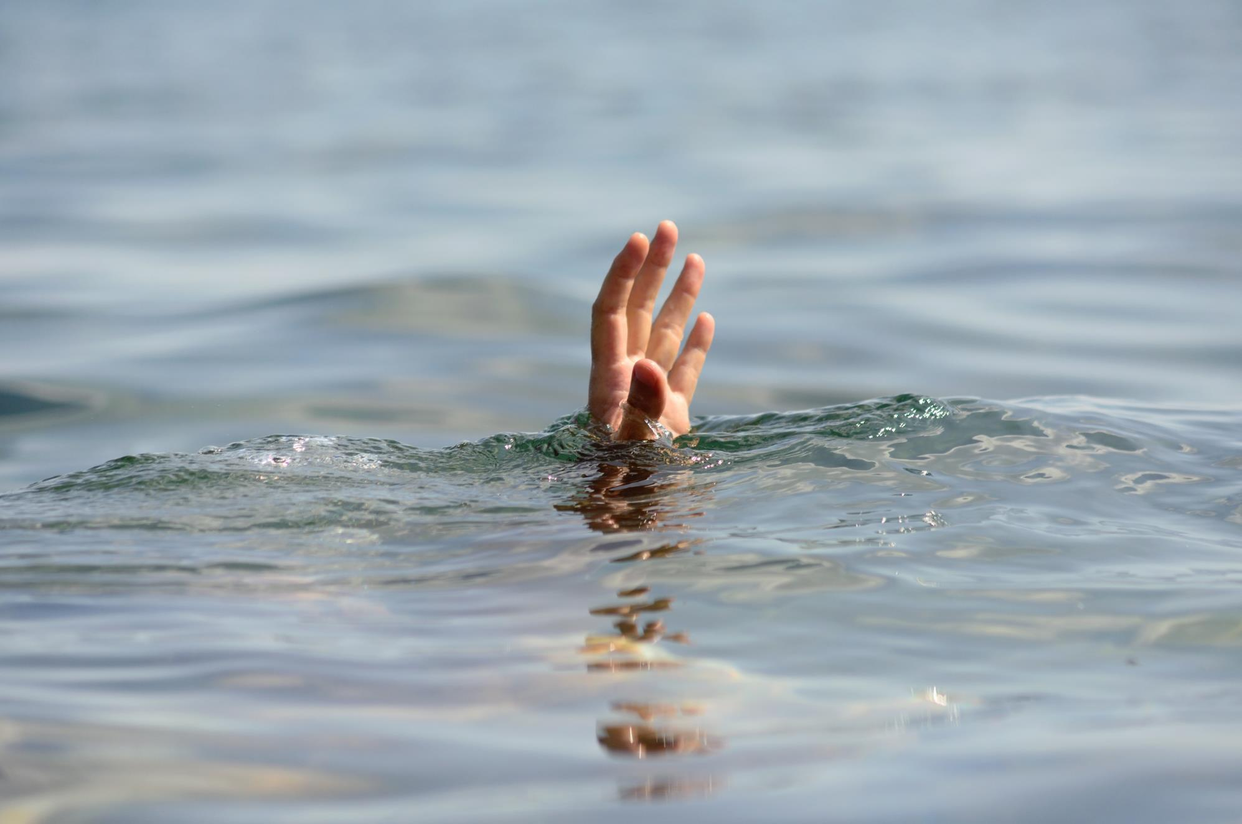
Notes:
Unwilling to be bessed-at war-God
Lt. Col Ahmed Burqibah, Deputy Director of Dubai Police’s Search and Rescue Department

Slide 31
Notes:
We don’t understand-father fight rescue
But we do this almost every day to God

Slide 32
At war with our self
“Self is the enemy we most need to fear…No other victory we can gain will be so precious as the victory gained over self”
-- Ministry of Healing, p. 485
Notes:
We are at war with ourselves
That is why-EGW tells us that [click – read]
-------------------------------------
God does have other enemies besides the devil: you and I. We fight God. And, as Christians, anyone or anything that fights God is also our enemy.
That makes us at war with ourselves.
“It's purported that Socrates was once asked why Alcibiades, a brilliant world traveler, was such an unhappy man. ‘Because,’ replied Socrates, ‘wherever he goes, Alcibiades takes himself with him.’” (Illustration Exchange, Published: various)
And that continues to be the source of all our unhappiness today. We are addicted to self. We take self with us wherever we go. Self fights God—and wins. But winning battles against God means ultimately losing the war.
Ellen White tells us that [click – read]
In another place she writes [click –read ]

Slide 33
At war with our self
“Self is the enemy we most need to fear…No other victory we can gain will be so precious as the victory gained over self”
-- Ministry of Healing, p. 485
“We have no enemy without [outside of ourselves] that we need to fear. Our great conflict is with unconsecrated self. When we conquer self, we are more than conquerors through Him who has loved us…”
-- R. & H., March 5, 1908
Notes:
In another place she writes [read ]
Now we know who our true enemy is
Root of the problem
-------------------------------------
God does have other enemies besides the devil: you and I. We fight God. And, as Christians, anyone or anything that fights God is also our enemy.
That makes us at war with ourselves.
“It's purported that Socrates was once asked why Alcibiades, a brilliant world traveler, was such an unhappy man. ‘Because,’ replied Socrates, ‘wherever he goes, Alcibiades takes himself with him.’” (Illustration Exchange, Published: various)
And that continues to be the source of all our unhappiness today. We are addicted to self. We take self with us wherever we go. Self fights God—and wins. But winning battles against God means ultimately losing the war.
Ellen White tells us that [click – read]
In another place she writes [click –read ]

Slide 34

Key Phrase
My natural self fights God. Self is the enemy I most need to fear.
Notes:
[Key Phrase]

Slide 35
At war with our self
“…the deeds of the flesh are evident, which are: immorality, impurity, sensuality, idolatry, sorcery, enmities, strife, jealousy, outbursts of anger, disputes, dissensions, factions, envying, drunkenness, carousing, and things like these, of which I forewarn you, just as I have forewarned you, that those who practice such things will not inherit the kingdom of God”
Galatians 5:20-21
Notes:
Self is our #1 enemy. Self is the root cause of every evil. [click – read]
Impressive list – not comprehensive

Slide 36
At war with our self
“Another book was opened, wherein were recorded the sins of those who profess the truth. Under the general heading of selfishness came every other sin…”
The Faith I Live By, p. 214
Notes:
Ellen White had vision… [click – read]
----------------------------
This list of self-ish traits is pretty impressive but it is not comprehensive. Ellen White once had a vision in which she saw the record of our sins. She writes, [click – read]
“Every other sin!” Self-ishness is the “general heading” for every other bad thing in our lives—even for “those who profess the truth.”.

Slide 37
At war with our self
“Another book was opened, wherein were recorded the sins of those who profess the truth. Under the general heading of selfishness came every other sin…”
The Faith I Live By, p. 214
Notes:
Self is why our feathers get ruffled when the car behind us honks at us—even when it is our fault

Slide 38
At war with our self
“Another book was opened, wherein were recorded the sins of those who profess the truth. Under the general heading of selfishness came every other sin…”
The Faith I Live By, p. 214
Notes:
Self is why we eat unhealthy food even though we know it is unhealthy.

Slide 39
At war with our self
“Another book was opened, wherein were recorded the sins of those who profess the truth. Under the general heading of selfishness came every other sin…”
The Faith I Live By, p. 214
Notes:
Self is why we spend money and time wastefully.

Slide 40
At war with our self
“Another book was opened, wherein were recorded the sins of those who profess the truth. Under the general heading of selfishness came every other sin…”
The Faith I Live By, p. 214
Notes:
Self is why we say hurtful things to people we love.

Slide 41
At war with our self
“Another book was opened, wherein were recorded the sins of those who profess the truth. Under the general heading of selfishness came every other sin…”
The Faith I Live By, p. 214
Notes:
Self is why we criticize others.
Self is why we are jealous of others.

Slide 42
At war with our self
“Another book was opened, wherein were recorded the sins of those who profess the truth. Under the general heading of selfishness came every other sin…”
The Faith I Live By, p. 214
Notes:
Self is why we are attracted to comfort at the expense of exercise.

Slide 43
At war with our self
“Another book was opened, wherein were recorded the sins of those who profess the truth. Under the general heading of selfishness came every other sin…”
The Faith I Live By, p. 214
Notes:
Self is why we do not love God as we might.
Self is why ________________ (fill in the blank).

Slide 44

Notes:
By nature we are at war with God
That’s bad news
But the really bad news is that we win!

Slide 45
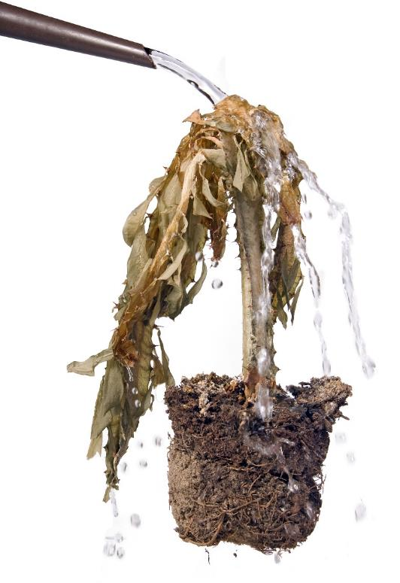
What more could God do?
“What more was there to do for My vineyard that I have not done in it? Why, when I expected it to produce good grapes did it produce worthless ones?”
Isaiah 5:4
Notes:
Perhaps the saddest words[click]
What more can God do?

Slide 46
7 wonderful things about God
God loves me more than I can imagine
His patience with me is supernatural
God is actively doing everything that He possibly can for me
God never gets tired
He never gets discouraged
God does not makes mistakes…ever!
He will succeed in blessing me…if I let Him
Notes:
[7 clicks]
The Almighty God is actively doing…
Limited by our will

Slide 47
If I let Him
“The tempted one needs to understand the true force of the will. This is the governing power in the nature of man-- the power of decision, of choice. Everything depends on the right action of the will. Desires for goodness and purity are right, as far as they go; but if we stop here, they avail nothing. Many will go down to ruin while hoping and desiring to overcome their evil propensities. They do not yield the will to God.”
-- Ministry of Healing, p.176
Notes:
We are told that [click – read]
Everything depends-what right action?
Power of choice – given by God

Slide 48
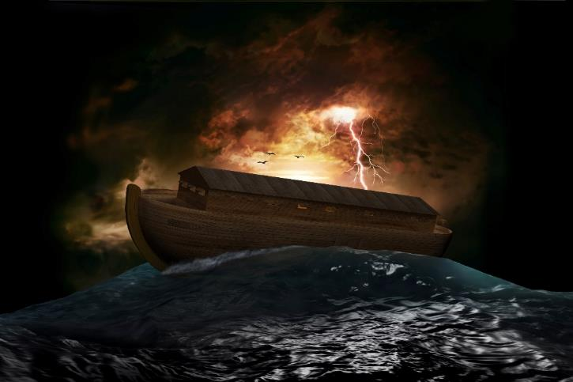
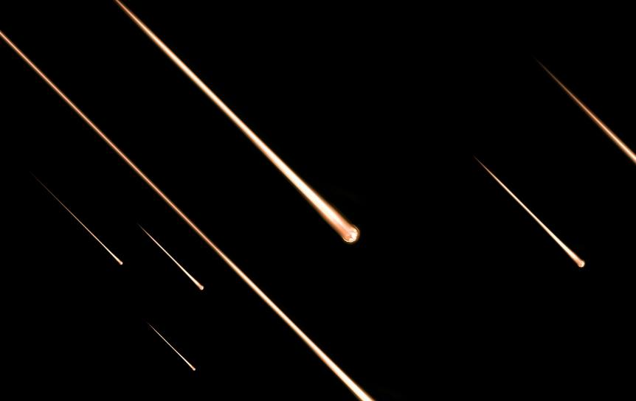
When we fight God
Notes:
When we fight God – we win
How many – flood – how only 8?
How many Sodom/Gomorrah?
How only 3

Slide 49
The Gentle God
“Behold, my servant whom I have chosen; my beloved in whom my soul is well-pleased; I will put my spirit upon Him, and He shall proclaim justice to the gentiles. He will not quarrel, nor cry out; nor will anyone hear His voice in the streets. A battered reed He will not break off, and a smoldering wick He will not put out, until He leads justice to victory”
Matthew 12:18-20
Notes:
The Almighty is the Gentle God
Like giant/ants - bull in china shop
[click] not much more delicate than…

Slide 50
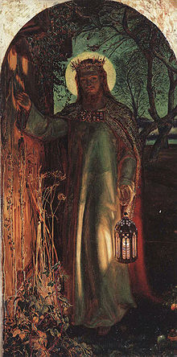
Notes:
Saddest word pictures
“Behold, I stand at the door…”
Can’t you just feel the pathos?

Slide 51
Notes:
This painting is called “Light of the World”
St. Paul’s cathedral in London, England
[continued]

Slide 52
Notes:
Two fascinating things
God doesn’t need a handle – flick of finger
What about the tall weeds? [next slide]

Slide 53

The Knocking God
“I saw that many had so much rubbish piled up at the door of their heart that they could not get the door open. Some have difficulties between themselves and their brethren to remove. Others have evil tempers, selfish covetousness, to remove, before they can open the door
Notes:
Ellen White tells us [click]
[continued on next slide]

Slide 54
The Knocking God
Others have rolled the world before the door of their heart, which bars the door. All this rubbish must be taken away from the door, and then can they open the door, and welcome the Saviour in.”
Testimonies, vol. 1 p. 143
Notes:
[read]
Jesus, the Gentle God knocks

Slide 55

Only God can do it—Only I can let Him
“Self is the enemy we most need to fear…No other victory we can gain will be so precious as the victory gained over self”
-- Ministry of Healing, p. 485
Notes:
Self keeps us from opening the door
Self keeps us from tilting toward-Son
That is why [click]
Self must go – no matter the cost

Slide 56
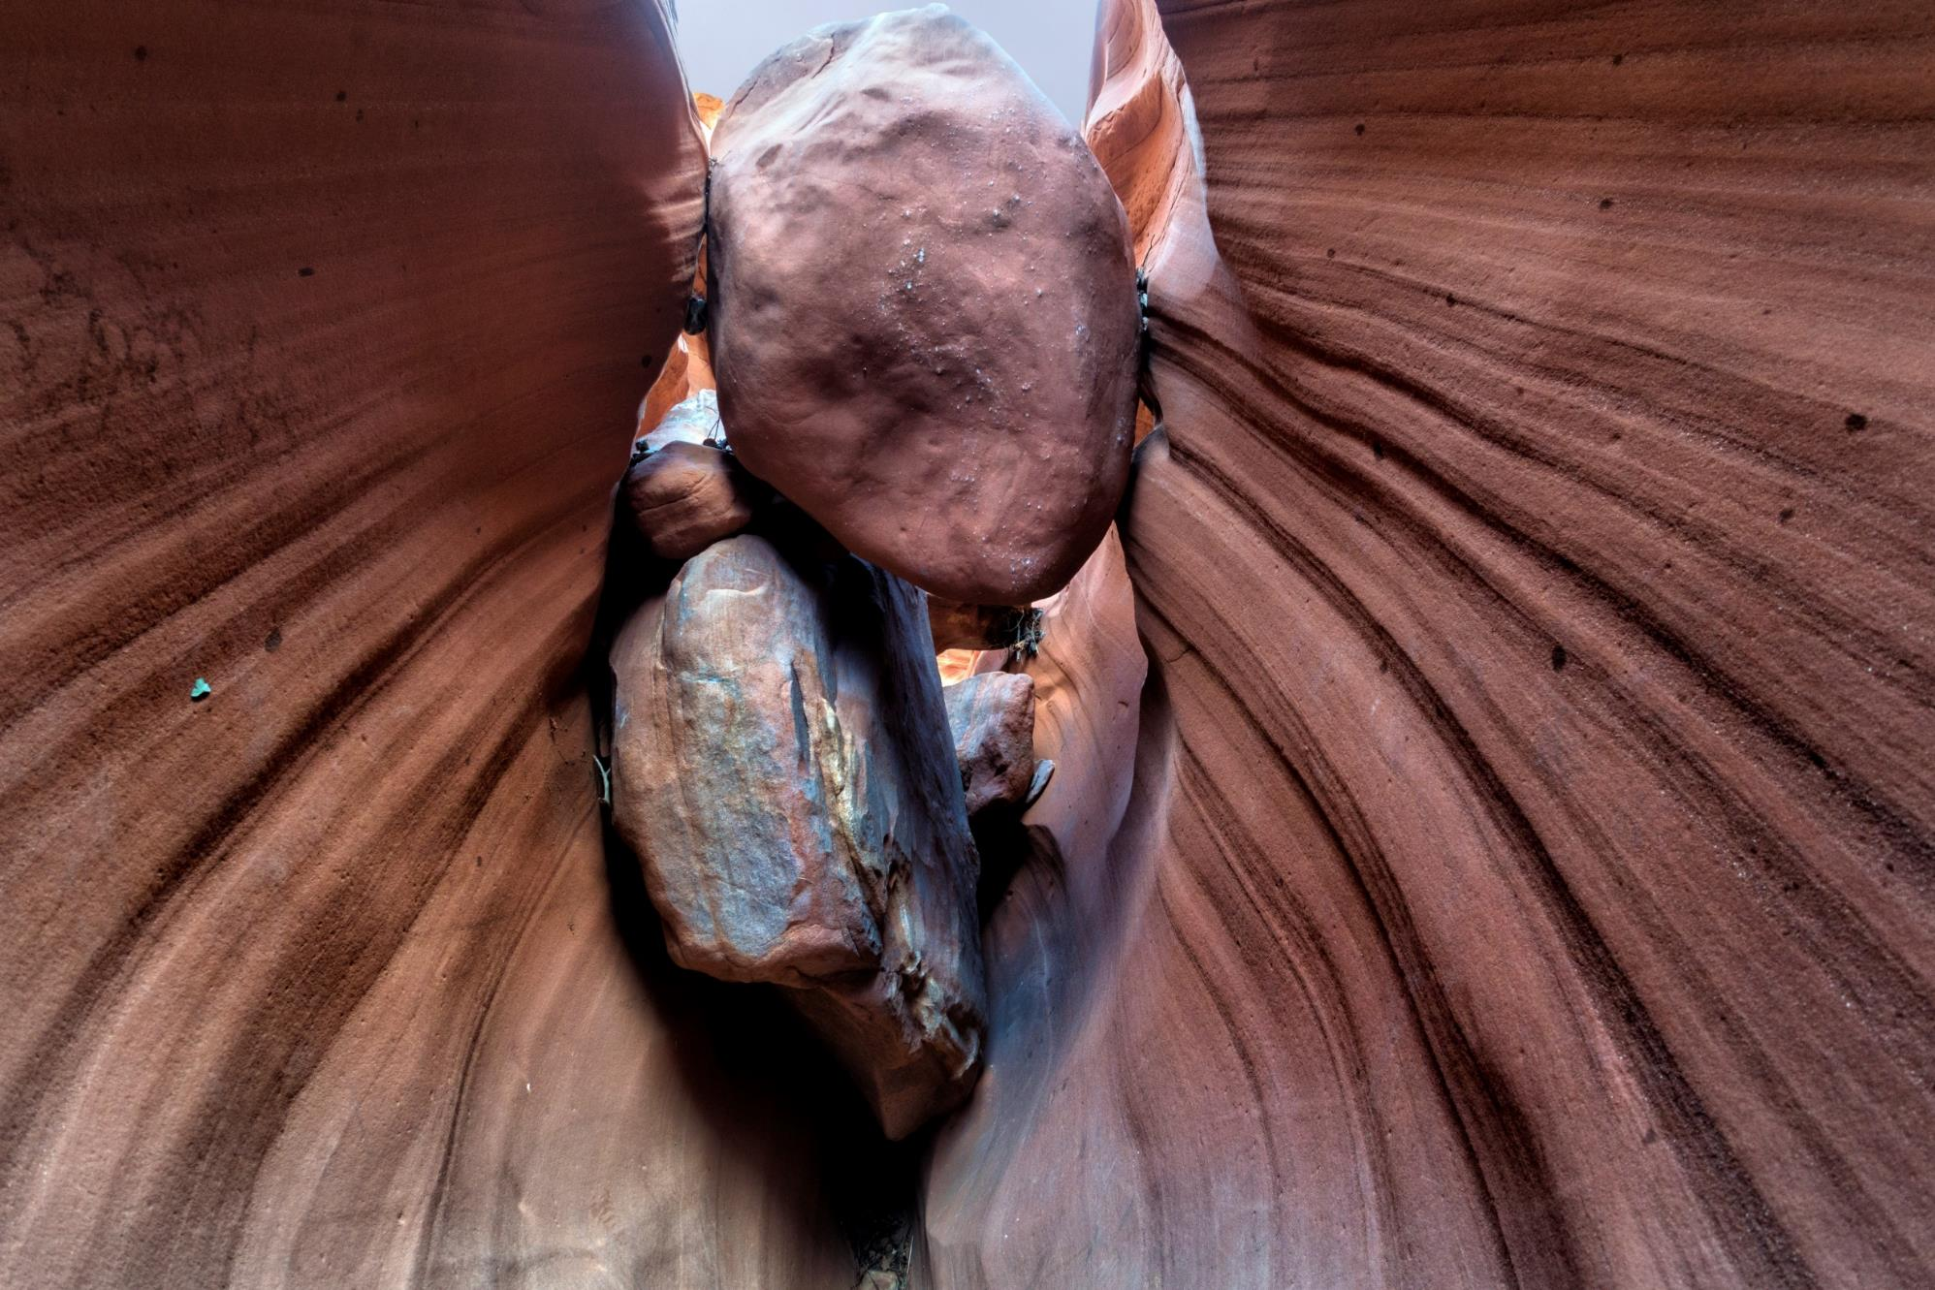
Surrender is radical
Notes:
April 26, 2003 Aron Ralston
Blue John Canyon, Utah
3 days
Prepared to die-did not die - agony
On April 26, 2003, Aron Ralston’s right hand became trapped by a large boulder while he was scrambling alone through a narrow crack called Blue John Canyon in Wayne County, Utah. For three days Aron tried desperately to free himself from his deadly predicament, but the boulder could not be budged and his hand remained tightly pinned to the canyon wall. With little food and water and with no hope of rescue, he eventually documented his plight and his last will and testament on his pocket video camera and prepared to die.
But Aron did not die. Instead desperation drove him to do something unthinkable in order to free himself from the boulder that pinned him helplessly to this world. After purposefully snapping the wrist bones in his trapped hand, Aron used a dull knife, to cut the hand off. Throughout the agony of that hour-long amputation, it was the thought of his up-coming freedom that kept him going. He writes, “It was both extremes of pain and absolute elation. I had to keep myself from passing out from that pain – that most incinerating, excruciating sensation of cutting the nerve. And that was the crux of it because as that sensation subsided, I was still there – and closer than I'd ever been to being free.” ( http://www.wide$#?!@QA1worldmag.com/features/127-hours-in-the-life-of-aron-ralston)

Slide 57
Surrender is radical
Notes:
You and I have part of our flesh
pinning us to this world
Radical action needed
Matt 5:30 – hand causes you-stumble
On April 26, 2003, Aron Ralston’s right hand became trapped by a large boulder while he was scrambling alone through a narrow crack called Blue John Canyon in Wayne County, Utah. For three days Aron tried desperately to free himself from his deadly predicament, but the boulder could not be budged and his hand remained tightly pinned to the canyon wall. With little food and water and with no hope of rescue, he eventually documented his plight and his last will and testament on his pocket video camera and prepared to die.
But Aron did not die. Instead desperation drove him to do something unthinkable in order to free himself from the boulder that pinned him helplessly to this world. After purposefully snapping the wrist bones in his trapped hand, Aron used a dull knife, to cut the hand off. Throughout the agony of that hour-long amputation, it was the thought of his up-coming freedom that kept him going. He writes, “It was both extremes of pain and absolute elation. I had to keep myself from passing out from that pain – that most incinerating, excruciating sensation of cutting the nerve. And that was the crux of it because as that sensation subsided, I was still there – and closer than I'd ever been to being free.” ( http://www.wide$#?!@QA1worldmag.com/features/127-hours-in-the-life-of-aron-ralston)

Slide 58
Key Phrase
My natural self fights God. Self is the enemy I most need to fear.
Notes:
[Key Phrase]
[call] – only God, but we must let
Next time- the cure, our part
[pray]

