Slide 1
Notes:
11111111111111111111111111111111
22222222222222222222222222222222
33333333333333333333333333333333

Slide 2
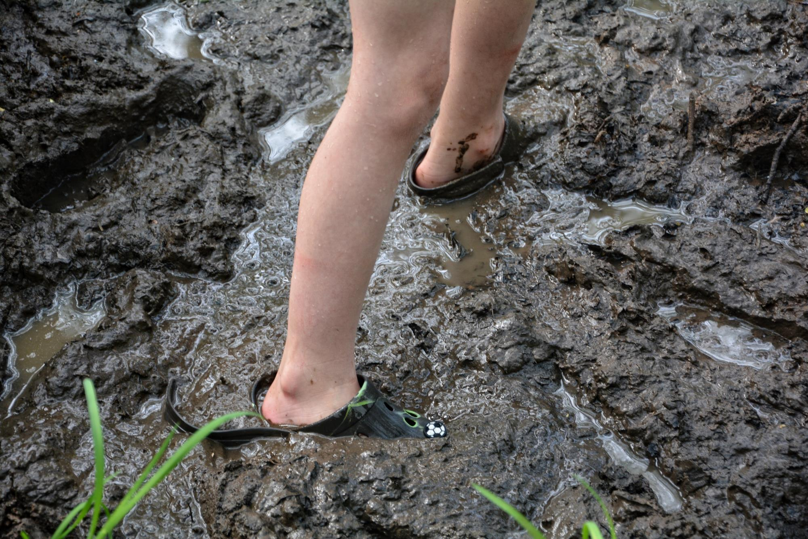
How does a Christian sin?
www.delighting.org
Notes:
Copyright ©2016, Michael Dant, All Rights Reserved

Slide 3
How does a Christian sin?
www.delighting.org

Slide 4
How does a Christian sin?
www.delighting.org
Notes:
Recap past discussions

Slide 5
How does a Christian sin?
www.delighting.org
Notes:
Basic question – crucified with Christ
Why question is important?
-----------------------------------
How does a Christian sin? This is a basic question and yet it is not one that I thought much about for most of my Christian life. How does a Christian sin? If “I have been crucified with Christ; and it is no longer I who live, but Christ lives in me;…” (Galatians 2:20) then what role does sin play in my life?
Why is this an important question? Because Jesus tells us that when He comes again, there will be “many,” “Lord, Lord” Christians who are evil-doers and don’t know it. Unless we recognize clearly what sin is and how we must relate to it, we may end up believing that Jesus will welcome us with open arms and say, “Well, done good and faithful servant,” when in reality He will have to sadly say, “I never knew you, depart from me, you who practice lawlessness.”

Slide 6
The secret
“The nature and the importance of the law of God have been, to a great extent, lost sight of. A wrong conception of the character, the perpetuity, and the obligation of the divine law has led to errors in relation to conversion and sanctification, and has resulted in lowering the standard of piety in the church.
Notes:
One of my Favorite authors– [click-cont]
----------------------------------------
How does a Christian sin? This is an important question because it is often misunderstood in the church today. That was certainly the case in my own life. And this misunderstanding kept me frustrated and spiritually impoverished for many years.
Ellen White tells us that, [click – read]
We all know that we are a church in desperate need of revival and reformation. Could it be that our misunderstanding of God’s law is the “secret of the lack of the Spirit and power of God in the revivals of our time?” Is this misunderstanding of God’s law leading us to “errors in relation to conversion and sanctification?”

Slide 7
The secret
“Here is to be found the secret of the lack of the Spirit and power of God in the revivals of our time”
The Great Controversy, p. 465
Notes:
EGW – [click]
Secret to revival and reformation
----------------------------------------
How does a Christian sin? This is an important question because it is often misunderstood in the church today. That was certainly the case in my own life. And this misunderstanding kept me frustrated and spiritually impoverished for many years.
Ellen White tells us that, [click – read]
We all know that we are a church in desperate need of revival and reformation. Could it be that our misunderstanding of God’s law is the “secret of the lack of the Spirit and power of God in the revivals of our time?” Is this misunderstanding of God’s law leading us to “errors in relation to conversion and sanctification?”

Slide 8
How Does a Christian Sin?
Does a Christian Sin?
Notes:
How does a Christian sin?
--Where start?
--Does a Christian sin? [click]
-------------------------------------------
How does a Christian sin? Where do we even begin answering such a question? Perhaps the best place to start is with a related, but simpler question: “Does a Christian sin?” Here we are on firmer ground. This questions has only two possible answers, and we may already feel that we know the correct one. “Of course a Christian sins,” we may say, “We are all sinners standing in the need of grace. ‘All have sinned and fallen short of the glory of God’” (Romans 3:23). In fact the question “Does a Christian sin?” may seem so trivial as to need no further consideration.
And yet, as we allow God to get us radically out of His way and He becomes all-powerful in our lives, do we continue to lose daily battles to the devil? If it is no longer I who lives, but Christ who lives in me, then does Christ sin in me? The question, “Does a Christian sin,” seems simple, but it may not be as easy to answer as we, at first, believed.

Slide 9

We sin
“There is not a righteous man on earth who does what is right and never sins”
Ecclesiastes 7:20
“If You, Lord, should mark iniquities, O Lord, who could stand?”
Psalms 130:3
Notes:
Does a Christian sin?
“All have sinned and fallen short of…”
Yes [click 2]
------------------------
The Bible is our only hope of discovering the truth in this matter, and perhaps Solomon is a good place to begin. He clearly proclaims, [click – read]
Solomon makes a pretty powerful case in favor of proclaiming “yes, even Christians sin.”
And the Psalmist agrees with him when he asserts, [click – read]
The Psalmist knew what we all know, not one of us can stand innocent before God. We are all sinners.

Slide 10

We don’t have to sin
“No temptation has overtaken you but such as is common to man; and God is faithful, who will not allow you to be tempted beyond what you are able, but with the temptation will provide the way of escape also, so that you will be able to endure it”
1 Corinthians 10:13
Notes:
Enough evidence?
Paul proclaims [click]
Don’t have to sin-ideal?
--------------------------
Surely we have enough evidence to say with conviction that even fully-surrendered Christians continue to sin. But the Bible doesn’t stop there. Paul tells us that, [click – read]
This powerful promise seems to indicate that Christians have at least a means of escaping from every sin. Christians need not sin. But does it really happen that way in practice? Or is that just the ideal?

Slide 11

We don’t sin
“Truly, truly, I say to you, everyone who commits sin is the slave of sin”
John 8:34
“our old self was crucified with Him, in order that our body of sin might be done away with, so that we would no longer be slaves to sin”
  Romans 6:6
Notes:
Jesus proclaims, [click]
Add to that Paul’s assertion... [click]
-----------------------------------------
Jesus proclaims, [click – read]
Add to that Paul’s assertion that surrender frees us from slavery to sin in that [click – read]
and we begin to wonder if a true follower of Christ does continue to sin.
Peter joins in with [next slide]

Slide 12
We don’t sin
“Therefore, since Christ has suffered in the flesh, arm yourselves also with the same purpose, because he who has suffered in the flesh has ceased from sin, so as to live the rest of the time in the flesh no longer for the lusts of men, but for the will of God”
1 Peter 4:1-2
Notes:
Peter joins in [read]
---------------------------------
Wow, Peter, really? When we experience the circumcision of the flesh “made without hands” that Christ promises (Colossians 2:11)—do we really cease from sin?

Slide 13
We sin
“If we say that we have no sin, we are deceiving ourselves and the truth is not in us.”
1 John 1:8
“If we say that we have not sinned, we make Him a liar and His word is not in us.”
1 John 1:10
Notes:
So Christians don’t sin?
But, we’re not done yet – John [click]
A couple of verses later [click]
-----------------------------------
But, we are not done yet; we have not heard from the beloved apostle John. He clearly states that [click – read]
A couple of verses later, he goes on to say, [click – read]
Okay, then. Let’s not call God a liar. Let us admit that we are all sinners and that even true Christians sin, and move on.

Slide 14
We don’t sin
“Little children, make sure no one deceives you; the one who practices righteousness is righteous, just as He is righteous; the one who practices sin is of the devil;…No one who is born of God practices sin, because His seed abides in him; and he cannot sin, because he is born of God” 1 John 3:7-9
Notes:
Except that this same apostle John writes, [click]
John explosive assertion [next]
----------------------
Wow, just a couple of chapters earlier John loudly proclaims that anyone who claims to be without sin calls God a liar and now he is just as forcefully stating that “No one who is born of God practices sin” and that the “one who practices sin is of the devil.”
This same beloved apostle also makes the explosive assertion that, [next slide]

Slide 15

“No one who abides in Him sins; no one who sins has seen Him or knows Him.”
1 John 3:6
Notes:
[read slide]
Question harder than we thought
Many verses say…
Contradiction?

Slide 16


Two types of flowers
Notes:
If I told you…flowers [click]
Same with sin-two types
One of the best places-learn about sin
Sanctuary services
4 types of sin
------------------------------
If I told you that flowers grow best in sunshine and then I told you that flowers grow best in shade, what would you think? You would say that either I am hopelessly confused or that there are at least two types of flowers.
[click to show all flowers and titles]
And that is exactly the way it is with sin. One set of passages tells us that we do sin, and another set proclaims that we do not. To understand these seemingly conflicting passages we must recognize that there are at least two types of sin. In other words, there is a sense in which we, as true disciples, do continue to sin, and there is another sense in which we receive constant and consistent, supernatural victory over sin.

Slide 17
Learning about Sin from the Sanctuary
Unintentional
Intentional
Faithful
Unfaithful
Notes:
4 types –summarized in this table

Slide 18
Learning about Sin from the Sanctuary
Unintentional
Intentional
Passage: Leviticus 4 Sacrifice: female goat
Faithful
Unfaithful
Notes:
The first type is faithful, unintentional
Leviticus 4
Sacrifice: female goat

Slide 19
Unintentional Sin
Now if anyone of the common people sins unintentionally in doing any of the things which the LORD has commanded not to be done, and becomes guilty, if his sin which he has committed is made known to him, then he shall bring for his offering a goat, a female without defect, for his sin which he has committed.
Leviticus 4:27-28 NAU
Notes:
First type of sin is UNINTENTIONAL
Leviticus chapter 4

Slide 20
Unintentional Sin
“If a person sins unintentionally…(Leviticus 4:2)
“When a leader sins and unintentionally…(Leviticus 4:22)
"If a person acts unfaithfully and sins unintentionally…(Leviticus 5:15)
“if one person sins unintentionally…(Numbers 15:27-28)
then you shall select for yourselves cities to be your cities of refuge, that the manslayer who has killed any person unintentionally may flee there. (Numbers 35:11)
But Jesus was saying, "Father, forgive them; for they do not know what they are doing." (Luke 23:34)
Notes:
The Bible talks a lot about unintentional sin

Slide 21
Learning about Sin from the Sanctuary
Unintentional
Intentional
Passage: Leviticus 4 Sacrifice: female goat
Passage: Leviticus 5 Sacrifice: ram
Faithful
Unfaithful
Notes:
2nd type: unfaithful, unintentional
Leviticus 5
sacrifice: RAM

Slide 22
"If a person acts unfaithfully and sins unintentionally against the LORD'S holy things, then he shall bring his guilt offering to the LORD: a ram without defect from the flock…”
Leviticus 5:15

Slide 23
Learning about Sin from the Sanctuary
Unintentional
Intentional
Passage: Leviticus 4 Sacrifice: female goat
Passage: Leviticus 5 Sacrifice: ram | Passage: Leviticus 6 Sacrifice: restitution & ram
Faithful
Unfaithful
Notes:
3rd type: unfaithful, intentional
Leviticus 6
sacrifice: restitution & ram
Notice sacrifice increases

Slide 24
“Then the LORD spoke to Moses, saying, ‘When a person sins and acts unfaithfully against the LORD, and deceives his companion in regard to a deposit or a security entrusted to him, or through robbery, or if he has extorted from his companion, or has found what was lost and lied about it and sworn falsely, so that he sins in regard to any one of the things a man may do;…

Slide 25
“he shall make restitution for it in full and add to it one-fifth more. He shall give it to the one to whom it belongs on the day he presents his guilt offering. Then he shall bring to the priest his guilt offering to the LORD, a ram without defect from the flock, according to your valuation, for a guilt offering,”
Leviticus 6:2-6

Slide 26
Learning about Sin from the Sanctuary
Unintentional
Intentional
Passage: Leviticus 4 Sacrifice: female goat
Passage: Leviticus 5 Sacrifice: ram | Passage: Leviticus 6 Sacrifice: restitution & ram
Faithful
Intentional-Defiant
Passage: Num. 15
Sacrfice: None
Unfaithful
Notes:
What do you think 4th type of sin is?
[click] intentional-defiant sin
Numbers 15
No sacrifice

Slide 27
Defiant Sin
“You shall have one law for him who does anything unintentionally, for him who is native among the sons of Israel and for the alien who sojourns among them. But the person who does anything defiantly, whether he is native or an alien, that one is blaspheming the Lord; and that person shall be cut off from among his people.”
Numbers 15:29-30 NAU
Notes:
Example: man gathering wood on the Sabbath

Slide 28
Learning about Sin from the Sanctuary
Unintentional
Intentional
Passage: Leviticus 4 Sacrifice: female goat
Passage: Leviticus 5 Sacrifice: ram | Passage: Leviticus 6 Sacrifice: restitution & ram
Faithful
Intentional-Defiant
Passage: Num. 15
Sacrfice: None
Unfaithful
Notes:
What about empty slot?
Faithful-Intentional
Doesn’t exist
“No one who abides in Him sins”

Slide 29
What type of sin?
“There is not a righteous man on earth who does what is right and never sins”
Ecclesiastes 7:20
“If You, Lord, should mark iniquities, O Lord, who could stand?”
Psalms 130:3
Notes:
David & Solomon – What type of sin?
Unintentional

Slide 30
Unintentional sin
“All unrighteousness is sin…”
1 John 5:17
“There is none righteous, not even one;”
Romans 3:10
Notes:
Unintentional sin
[click 2 - continued]
In that sense, everyone sins

Slide 31
Unintentional sin
“The heart is deceitful above all things, and desperately wicked: who can know it?”
Jeremiah 17:9
“We need to understand that imperfection of character is sin.”
  Christ Object Lessons, p. 330
Notes:
[click 2]
Cannot force myself to love, humble

Slide 32
“Can” and “Cannot”
“God has given us the power of choice; it is ours to exercise. We cannot change our hearts, we cannot control our thoughts, our impulses, our affections. We cannot make ourselves pure, fit for God's service.
Notes:
CAN and CANNOT do [click-cont]

Slide 33
“Can” and “Cannot”
“But we can choose to serve God, we can give Him our will; then He will work in us to will and to do according to His good pleasure. Thus our whole nature will be brought under the control of Christ”
Ministry of Healing, p.176
Notes:
[read]

Slide 34
Unintentional Sin
“There are those who have known the pardoning love of Christ and who really desire to be children of God, yet they realize that their character is imperfect, their life faulty,…We shall often have to bow down and weep at the feet of Jesus because of our shortcomings and mistakes, but we are not to be discouraged. “
  Steps to Christ, p. 64
Notes:
Speaking of unintentional sin [click]

Slide 35

3 Types of unintentional sin
Mistakes
Notes:
3 types of unintentional sin
First is mistakes
Example: Saul persecuting Christians

Slide 36

3 Types of unintentional sin
Mistakes
Shortcomings
Notes:
2nd type of unintentional sin
shortcomings
Example: Love for God

Slide 37

3 Types of unintentional sin
Mistakes
Shortcomings
Character flaws
Notes:
3rd type of unintentional sin
Character flaws
Example: Impulsive: Pride, fear, jealousy, anger

Slide 38
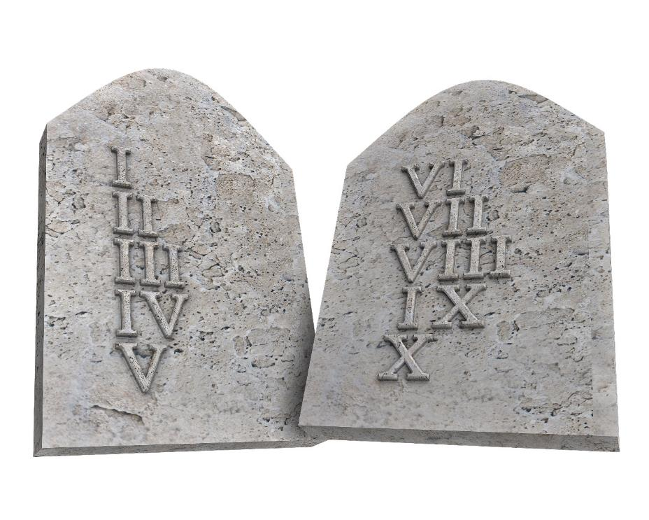
Intentional Sin
“Therefore, to one who knows the right thing to do and does not do it, to him it is sin”
James 4:17
Notes:
Intentional sin vs. unintentional
[click]
----------------------------
The two major types of sin taught by the scriptures are chosen sin and unchosen sin. Chosen sin consists of choices that we know—or even highly suspect—are not God’s choices, but we do them anyway. James tells us plainly that, [click – read]
When we know God’s will, but go contrary to that will, we commit chosen sin. Chosen sins are by definition anti-surrender because surrender says, “Lord, I will deny my self and choose your choices over my own—in everything—all the time.” Chosen sin, says instead, “Thanks anyway, Lord, but I’m going to go my own way on this one.”

Slide 39
Intentional Sin
“Therefore, to one who knows the right thing to do and does not do it, to him it is sin”
James 4:17
Notes:
Sometimes starkly obvious
-- 10 commands

Slide 40
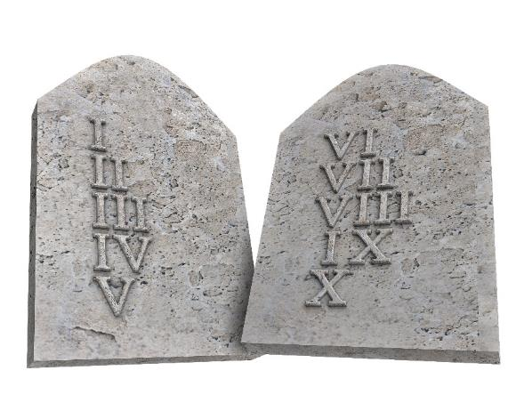
Intentional Sin
“Anything which tends to abate our love for God, or to interfere with the service due him, becomes thereby
an idol.”
Signs of the Times, January 26, 1882
Notes:
Jesus – sermon mount
angry, looking with lust
Idolatry – [click][read]
Intentional-not always easy to see
-- Jesus - love

Slide 41
Intentional Sins – 5 things to know
Unintentional sins can become intentional
“But each one is tempted when he is carried away and enticed by his own lust. Then when lust has conceived, it gives birth to sin; and when sin is accomplished, it brings forth death”
James 1:14-15
Notes:
5 Things we should know about intent…
#1Unintentional can become intentional
Spontaneous prideful thought
James [click]

Slide 42
Intentional Sins – 5 things to know
Unintentional sins can become intentional
Willful ignorance of God’s will is intentional sin
Notes:
Willful ignorance, Don’t tell me!!
Versus love to know God’s will
Counsels on Diets and Foods

Slide 43
“Those who have an opportunity to hear the truth and yet take no pains to hear or understand it, thinking that if they do not hear they will not be accountable, will be judged guilty before God the same as if they had heard and rejected. There will be no excuse for those who choose to go in error when they might understand what is truth. In His sufferings and death Jesus has made atonement for all sins of ignorance, but there is no provision made for willful blindness”
Last Day Events, p. 218
Notes:
[read]

Slide 44
Intentional Sins – 5 things to know
Unintentional sins can become intentional
Willful ignorance of God’s will is intentional sin
Christ’s Robe of Righteousness does not cover it
“For if we go on sinning willfully after receiving the knowledge of the truth, there no longer remains a sacrifice for sins”
Hebrews 10:26
Notes:
Christ’s Robe of Rigtheousness
Paul clearly tells us [click]

Slide 45
Christ’s Robe does not cover intentional sin
“…while God can be just, and yet justify the sinner through the merits of Christ, no man can cover his soul with the garments of Christ's righteousness while practicing known sins, or neglecting known duties.
Notes:
[read-cont]

Slide 46
Christ’s Robe does not cover intentional sin
“God requires the entire surrender of the heart, before justification can take place; and in order for man to retain justification, there must be continual obedience, through active, living faith that works by love and purifies the soul”
Selected Messages Vol. 1, p. 366

Slide 47
Intentional Sins – 5 things to know
Unintentional sins can become intentional
Willful ignorance of God’s will is intentional sin
Christ’s Robe of Righteousness does not cover it
Notes:
[recap]

Slide 48
Intentional Sins – 5 things to know
Unintentional sins can become intentional
Willful ignorance of God’s will is intentional sin
Christ’s Robe of Righteousness does not cover it
There is no such thing as a “little” intentional sin

Slide 49
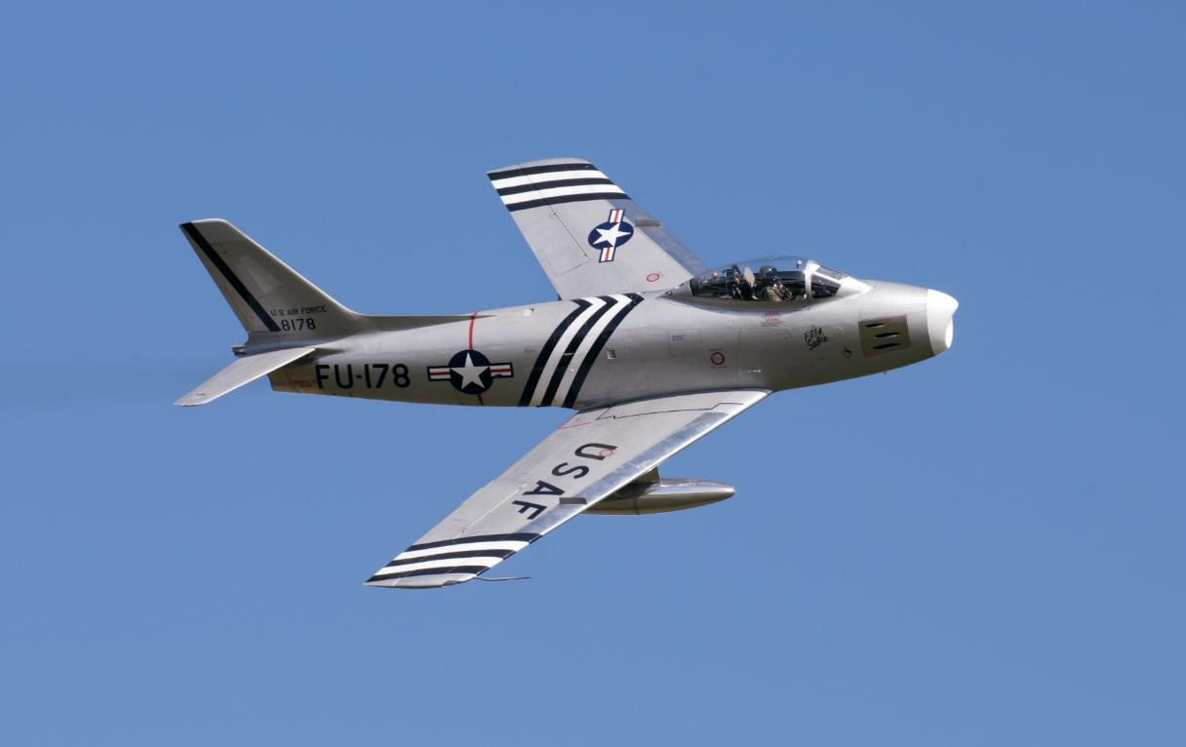
“Little” things matter
Notes:
Chuck Yeager, F86 Sabre
No such thing as a “little” sin
----------------------------------
“Chuck Yeager, the famed test pilot, was flying an F-86 Sabre over a lake in the Sierras when he decided to buzz a friend's house near the edge of the lake. During a slow roll, he suddenly felt his aileron lock. Says Yeager, ‘It was a hairy moment, flying about 150 feet off the ground and upside down.’
“A lesser pilot might have panicked with fatal results, but Yeager let off on the G's, pushed up the nose, and sure enough, the aileron unlocked. Climbing to 15,000 feet, where it was safer, Yeager tried the maneuver again. Every time that he rolled, the problem reoccurred.
“Yeager knew three or four pilots had died under similar circumstances, but to date, investigators were puzzled as to the source of the Sabre's fatal flaw. Yeager went to his superior with a report, and the inspectors went to work. They found that a bolt on the aileron cylinder was installed upside down.
“Eventually, the culprit was found in a North American plant. He was an older man on the assembly line who ignored instructions about how to insert that bolt, because, by golly, he knew that bolts were supposed to be placed head up, not head down. In a sad commentary, Yeager says that nobody ever told the man how many pilots he had killed.” (Author: Matt Friedeman, Published: The Accountability Connection (Victor Books, 1992)
The mechanic who installed the bolt incorrectly did not think that it made much difference how he did it. He felt that he did not need to follow the instructions carefully. It seemed like such a “little” thing. But the consequences were deadly.

Slide 50
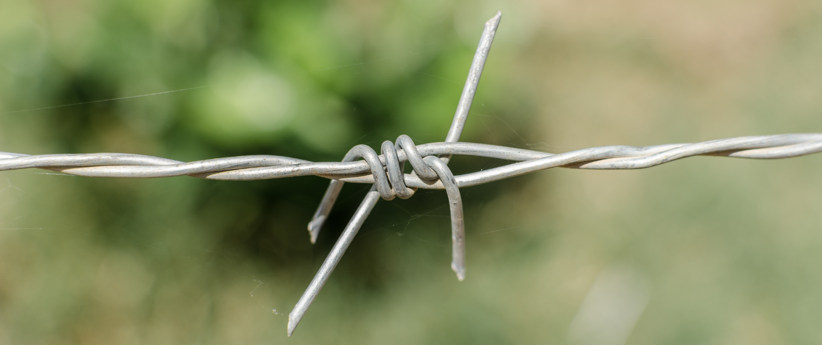
“…lay aside every encumbrance and the sin which so easily entangles us…”
Hebrews 12:1
Notes:
Laodicean’s say, It’s not THAT bad
Paul exhorts us [click]
---------------------------------
In the same way, we are often tempted as Laodicean Christians to minimize some bad choices. We are tempted to say, “well, it isn’t really THAT bad,” and “besides, God isn’t finished with me yet.” But “little” sins are not little in the eyes of God and Paul exhorts us strongly to, [click]

Slide 51
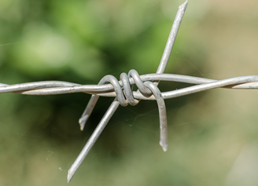
“Little” things matter
“Every act of life, however small, has its bearing for good or for evil…It is little things that test the character.”
CC 52.4
“The commission of a known sin
silences the witnessing voice of the
Spirit, and separates the soul from
God” GC p. 472
Notes:
Attracted to chosen sin
No chinks in our armor [click 2]
No such thing as “little” sins

Slide 52
Intentional Sins – 5 things to know
Unintentional sins can become intentional
Willful ignorance of God’s will is intentional sin
Christ’s Robe of Righteousness does not cover it
There is no such thing as a “little” intentional sin
God can give us consistent victory over intentional sins!
Notes:
#5 Consistent victory!!

Slide 53

We can have consistent victory!
“Submit therefore to God. Resist the devil and he will flee from you.”
James 4:7
“We know that no one who is born of God sins; but He who was born of God keeps him, and the evil one does not touch him.” 1 John 5:18
Notes:
#5 consistent victory
[click 3]
--------------------------------
And that leads us to the last thing that we should know about chosen sin: God promises total victory over it! [click – read]
Paul happily chimes in with the incredible promise that [click – read]
And my personal favorite is James’ proclamation, [click – read]

Slide 54
We can have consistent victory!
“Feeling the terrible power of temptation, the drawing of desire that leads to indulgence, many a man cries in despair, ‘I cannot resist evil.’ Tell him that he can, that he must resist. He may have been overcome again and again, but it need not be always thus. He is weak in moral power, controlled by the habits of a life of sin. His promises and resolutions are like ropes of sand…
Notes:
[read]
[continued]
-------------------------------
Ellen White tells us that, [click – read]
Isn’t that last sentence a wonderful thought? “Those who put their trust in Christ are not to be enslaved by any hereditary or cultivated habit or tendency.” That does not leave much wiggle room does it? Even the most powerful hereditary addictions fall helplessly before the onslaught of omnipotence. God promises—and He expects—constant victory over known, chosen sins in our lives.
And He has every right to expect such victory because when we submit ourselves fully to God a wonderful thing happens. Before surrender, we walked the broad road—the devil’s ground—and God had limited access to us. After surrender we walk the narrow way—God’s ground—and it is the devil has limited access to us. Glorious thought!
Whereas before surrender, the Holy Spirit could only work ON us, after surrender He dwells and works IN us. The difference is transformational. Surrender will make a marked difference in almost every aspect of our lives. We must never underestimate the power of God working in the life of an unreservedly committed soul.

Slide 55
We can have consistent victory!
“The knowledge of his broken promises and forfeited pledges weakens his confidence in his own sincerity and causes him to feel that God cannot accept him or work with his efforts. But he need not despair. Those who put their trust in Christ are not to be enslaved by any hereditary or cultivated habit or tendency”
Councils on Health, p. 440
Notes:
Reread last sentence
-------------------------------
Ellen White tells us that, [click – read]
Isn’t that last sentence a wonderful thought? “Those who put their trust in Christ are not to be enslaved by any hereditary or cultivated habit or tendency.” That does not leave much wiggle room does it? Even the most powerful hereditary addictions fall helplessly before the onslaught of omnipotence. God promises—and He expects—constant victory over known, chosen sins in our lives.
And He has every right to expect such victory because when we submit ourselves fully to God a wonderful thing happens. Before surrender, we walked the broad road—the devil’s ground—and God had limited access to us. After surrender we walk the narrow way—God’s ground—and it is the devil has limited access to us. Glorious thought!
Whereas before surrender, the Holy Spirit could only work ON us, after surrender He dwells and works IN us. The difference is transformational. Surrender will make a marked difference in almost every aspect of our lives. We must never underestimate the power of God working in the life of an unreservedly committed soul.

Slide 56
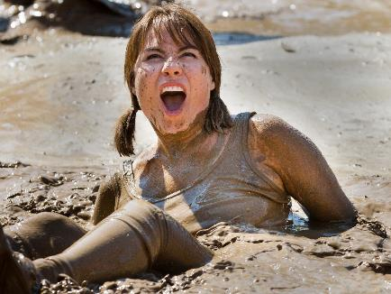
Staying out of the mud
“Do not think that God will work a miracle to save those weak souls who cherish evil, who practice sin; or that some supernatural element will be brought into their lives, lifting them out of self into a higher sphere, where it will be comparatively easy work, without any
special effort, any special fighting, without
any crucifixion of self; because all who dally
on Satan's ground for this to be done will
perish with the evildoers” TM p. 453
Notes:
Many Christians-normal to sin
Story of Facebook post
--Falling is failing [click]
--Baby vs. adult
--grace to keep out of mud
--------------------------
Many Christians today seem to believe that it is normal and even expected to succumb to the devil on a regular basis even after committing our lives fully to God. I have heard some say that “Falling is not failing” and then they glorify God for how often He picks them up out of the mud. While it is true that we should revel in God’s amazing grace to rescue us no matter how low we fall, should we not glory even more in His power to keep us out of the mud in the first place? If we continue to fall prey to the devil after putting ourselves in the hands of Almighty God, then either God’s hands are not as powerful as we thought or else we have failed to fully commit to staying in those hands.
[click – read]
“Falling is not failing” is true…if you are a baby. In fact, it is only by falling that we can learn to walk. But as we grow, such continued falling is a cause for concern and at some point we will seek a diagnosis and a treatment. As mature Christians who have committed ourselves to God, falling is failing. Falling is not the surrendered Christian’s experience. Although on this earth we will always be “sinners” that does not, at all, mean that we will keep on willfully “sinning.”

Slide 57
Does a Christian sin?
Does a fully-surrendered, Christ-focused Christian commit unintentional sin?
  YES “If You, Lord, should mark iniquities, O Lord, who could stand?”
  Psalms 130:3
Notes:
Does a Christian sin?
-- Recap intentional/unintentional
-- 2 questions [click]
-- 2 answers [click 2]
-------------------------
We have looked at two types of sin: chosen sin and unchosen sin. Chosen sin consists of willful, known bad choices. Unchosen sin, on the other hand, is outside of our control, except to give ourselves to God so that He can fix us. Unreserved surrender is the key to victory over both types of sin. Both types are bad, but chosen sin is especially insidious because it is rebellious sin—it is anti-surrender.
We have been seeking to answer the seemingly simple question, “Does a Christian sin?” On that journey, we have recognized that scripture speaks of at least two types of sin: chosen and unchosen. Realizing this, we now see that our original question is fundamentally flawed. Instead of asking the single question, “Does a Christian sin?” We should be asking two questions
[click – read]
The answer to the first question is “yes.” As long as life shall last we will be plagued with unchosen sin and the process of sanctification will continue. In this sense, we can agree with the Psalmist when he says, “If You, Lord, should mark iniquities, O Lord, who could stand?” (Psalms 130:3). And we can also understand better what the apostle John meant when he wrote that, “If we say that we have no sin, we are deceiving ourselves and the truth is not in us” (1 John 1:8).
The second question, however, is a little more difficult. “Does a true Christian commit chosen sin?” The answer according to scripture is: not when they are clinging to Jesus and wholly surrendered to His will.
When God gets us to the place of whole-hearted, unreserved surrender, He empowers our choices and gives us consistent victory over chosen sin. When we submit to God, we can resist the devil and the devil flees—every time. (James 4:7).
This wholly surrendered condition is what John referred to when he proclaimed that “No one who abides in Him sins; no one who sins has seen Him or knows Him” (1 John 3:6).
[click – read]
Abiding in Christ means much more than we sometimes realize. It is not just a loose association with Him as our Savior. Abiding in Christ means accepting Him as Lord and Master and involves a crucifixion of self that results in Him dwelling in us and living through us. “Therefore there is now no condemnation for those who are in Christ Jesus” (Romans 8:1). Notice, in this passage, that little word “in”. It is only those who are whole-heartedly, unreservedly abiding IN Christ who can claim His robe of righteousness.

Slide 58
Does a Christian sin?
Does a fully-surrendered, Christ-focused Christian commit intentional sin?
  NO “No one who abides in Him sins; no one who sins has seen Him or knows Him”
  1 John 3:6
Notes:
-- Recap intentional/unintentional
-- 2 questions [click]
-- 2 answers [click 2]
-------------------------
We have looked at two types of sin: chosen sin and unchosen sin. Chosen sin consists of willful, known bad choices. Unchosen sin, on the other hand, is outside of our control, except to give ourselves to God so that He can fix us. Unreserved surrender is the key to victory over both types of sin. Both types are bad, but chosen sin is especially insidious because it is rebellious sin—it is anti-surrender.
We have been seeking to answer the seemingly simple question, “Does a Christian sin?” On that journey, we have recognized that scripture speaks of at least two types of sin: chosen and unchosen. Realizing this, we now see that our original question is fundamentally flawed. Instead of asking the single question, “Does a Christian sin?” We should be asking two questions
[click – read]
The answer to the first question is “yes.” As long as life shall last we will be plagued with unchosen sin and the process of sanctification will continue. In this sense, we can agree with the Psalmist when he says, “If You, Lord, should mark iniquities, O Lord, who could stand?” (Psalms 130:3). And we can also understand better what the apostle John meant when he wrote that, “If we say that we have no sin, we are deceiving ourselves and the truth is not in us” (1 John 1:8).
The second question, however, is a little more difficult. “Does a true Christian commit chosen sin?” The answer according to scripture is: not when they are clinging to Jesus and wholly surrendered to His will.
When God gets us to the place of whole-hearted, unreserved surrender, He empowers our choices and gives us consistent victory over chosen sin. When we submit to God, we can resist the devil and the devil flees—every time. (James 4:7).
This wholly surrendered condition is what John referred to when he proclaimed that “No one who abides in Him sins; no one who sins has seen Him or knows Him” (1 John 3:6).
[click – read]
Abiding in Christ means much more than we sometimes realize. It is not just a loose association with Him as our Savior. Abiding in Christ means accepting Him as Lord and Master and involves a crucifixion of self that results in Him dwelling in us and living through us. “Therefore there is now no condemnation for those who are in Christ Jesus” (Romans 8:1). Notice, in this passage, that little word “in”. It is only those who are whole-heartedly, unreservedly abiding IN Christ who can claim His robe of righteousness.

Slide 59
How does a Christian sin?
Unintentionally
Intentionally
Less and Less as God sanctifies us
Rarely – walk out of surrender
Notes:
--How does a Christian sin?
--Answers [click 2]
-- Rarely – Elijah, Moses
----------------------------
Are there ever any times when a wholly-surrendered Christian commits chosen sin? Yes, but rarely. There are times as we grow in Christ that we unknowingly let down our guard in one or more areas of our lives. The devil will take advantage of these chinks in our armor to mount a surprise attack. That tactical strike by the devil can lead to an impulsive decision to make a choice that we know is not God’s will.
This is what happened to Elijah after the Mount Carmel experience. Elijah was a wholly committed giant for God. And yet when Jezebel sent a message threatening his life, Elijah, in his weakness and exhaustion, chose to doubt. This choice sent him headlong into the desert in a tailspin of self-preservation.
When the devil attacks us and succeeds, the truly surrendered Christian will immediately repent and plead with the Lord to show him or her how to close that chink in their armor. God will answer this prayer and the follower of Christ will do whatever it takes to prevent a recurrence of chosen sin in their lives.
Chosen sins are rarely committed by the truly surrendered Christian. If we find ourselves frequently falling to such sin, we need to examine our surrender. God’s children are impregnable fortresses as long as they cling to Him in utter submission to His will.

Slide 60
How does a Christian sin?
  “Christ is our personal Saviour; and if we are his disciples, our wrong-doing will cease, unrighteousness will come to an end.” YI, December 8, 1898
  “To every one who surrenders fully to God is given the privilege of living without sin, in obedience to the law of heaven”
  RH, September 27, 1906
Notes:
Quotes [click 2]
----------------------------
Are there ever any times when a wholly-surrendered Christian commits chosen sin? Yes, but rarely. There are times as we grow in Christ that we unknowingly let down our guard in one or more areas of our lives. The devil will take advantage of these chinks in our armor to mount a surprise attack. That tactical strike by the devil can lead to an impulsive decision to make a choice that we know is not God’s will.
This is what happened to Elijah after the Mount Carmel experience. Elijah was a wholly committed giant for God. And yet when Jezebel sent a message threatening his life, Elijah, in his weakness and exhaustion, chose to doubt. This choice sent him headlong into the desert in a tailspin of self-preservation.
When the devil attacks us and succeeds, the truly surrendered Christian will immediately repent and plead with the Lord to show him or her how to close that chink in their armor. God will answer this prayer and the follower of Christ will do whatever it takes to prevent a recurrence of chosen sin in their lives.
Chosen sins are rarely committed by the truly surrendered Christian. If we find ourselves frequently falling to such sin, we need to examine our surrender. God’s children are impregnable fortresses as long as they cling to Him in utter submission to His will.

Slide 61

How does a Christian sin?
“When the soul surrenders itself to Christ, a new power takes possession of the new heart. A change is wrought which man can never accomplish for himself. It is a supernatural work, bringing a supernatural element
into human nature...”
Notes:
--How does a Christian sin?
--Unintentionally
EGW [click]
--------------------------------
Now that we have answered the seemingly simple question, “Does a Christian sin?” we can easily answer the harder question, “How does a Christian sin?” The answer is “unchosenly.” Surrendered Christians who are clinging firmly to Christ do not choose to sin. That is why the Bible can so confidently state that [click – read]
Ellen White agrees when she proclaims, [click – read]
[continued]

Slide 62

How does a Christian sin?
The soul that is yielded to Christ becomes His own fortress, which He holds in a revolted world, and He intends that no authority shall be known in it but His own.
Notes:
[read]
[call]
[pray]

Slide 63

How does a Christian sin?
A soul thus kept in possession by the heavenly agencies is impregnable to the assaults of Satan. But unless we do yield ourselves to the control of Christ, we shall be dominated by the wicked one”
DA p. 324
Notes:
[read]
[call]
[pray]

Slide 64

Delighting in the Almighty
by Michael Dant
For presentation workbooks, audio and
video resources, and contact information,
visit:
delighting.org
Copyright © Michael Dant, 2016. All Rights Reserved.

