Slide 1
Notes:
11111111111111111111111111111111
22222222222222222222222222222222
33333333333333333333333333333333

Slide 2
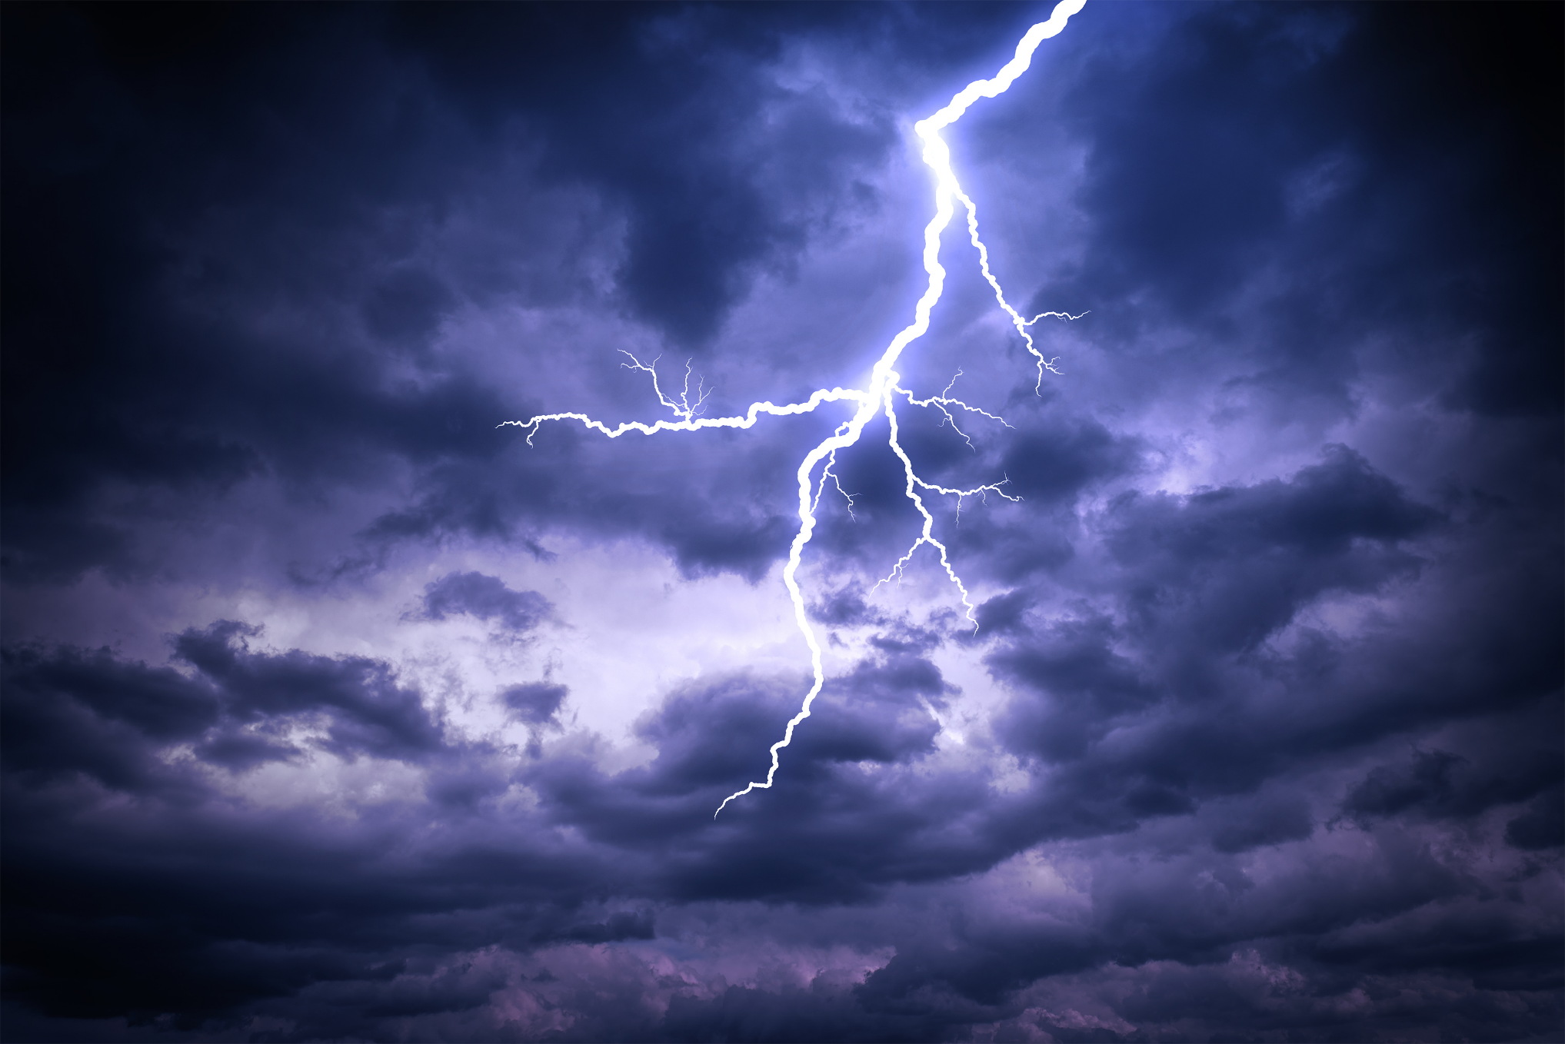
The Great Cosmic Equation
delighting.org
Notes:
Copyright ©2017, Michael Dant, All Rights Reserved

Slide 3
The Great Cosmic Equation
delighting.org
Notes:
Scripture: Psalms 81:10
Hymn #1: 567 Have Thine Own Way, Lord
Hymn #2: 322 Nothing Between

Slide 4
The Great Cosmic Equation

Slide 5



Why must we ask God for His blessings?
Why must we intercede for others?
Why do bad things happen to good people?
Notes:
There is much…Christ. life-little sense
Have you ever wondered [click 3]
Great Controversy
The Great Cosmic Equation
Question image mark source
https://www.google.com/search?q=question+mark&rlz=1C1CHBF_enUS769US769&tbm=isch&source=lnt&tbs=sur:fc&sa=X&ved=0ahUKEwiM1N6L3ajXAhXs7oMKHT-bDVcQpwUIHw&biw=1423&bih=670&dpr=2.25#imgrc=fM43pBU1YkM9HM:

Slide 6

overflowing with love, joy, and peace - Galatians 5:22
filled with the Holy Spirit - Luke 11:13
saved for eternity - 1 Timothy 2:4
Notes:
Astounding paradox – God-not get
no disease, sorrow, pain, or suffering
If God…everyone would be :[click 3]
If God got His way
Earth…like heaven

Slide 7
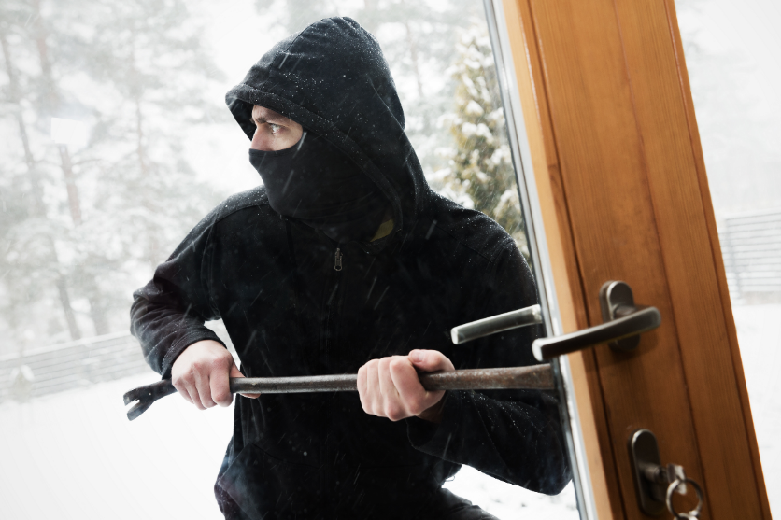
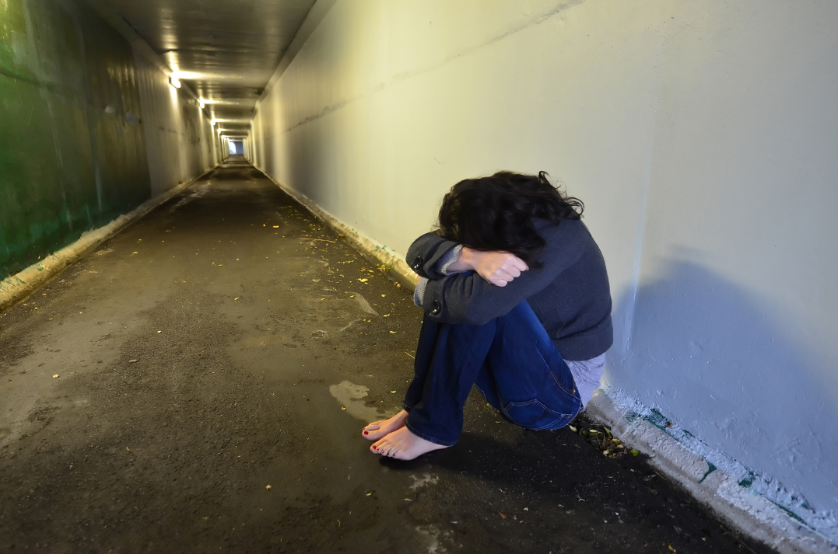

327,374
90,185
15,696
Notes:
But God does not ALWAYS get…
In fact…seems… SELDOM
United States, 2015,None God’s will
[Click 3]
Zero in heaven

Slide 8
“What more was there to do for My vineyard that I have not done in it? Why, when I expected it to produce good grapes did it produce worthless ones?”
Isaiah 5:4
Notes:
Staggering reality-God does not get…
The Almighty God cries out [click]
Can’t you just see…?
What more-God do? Heal, prot., save
God longs to do more than He gets

Slide 9
Notes:
How does Omnip. fail to get his way?
Who/What holds Him back?
No one/nothing stop God
except God Himself

Slide 10
Notes:
Why would God withhold blessings?
Why doesn’t He just bestow…
Free will/power of choice
will not violate

Slide 11
The Great Cosmic Equation
What God Wants
-
What man’s will allows
__________________________
What God Gets
Notes:
Disparity…God wants…God gets
The Great Cosmic Equation
Complex, invisible
[click 3]

Slide 12
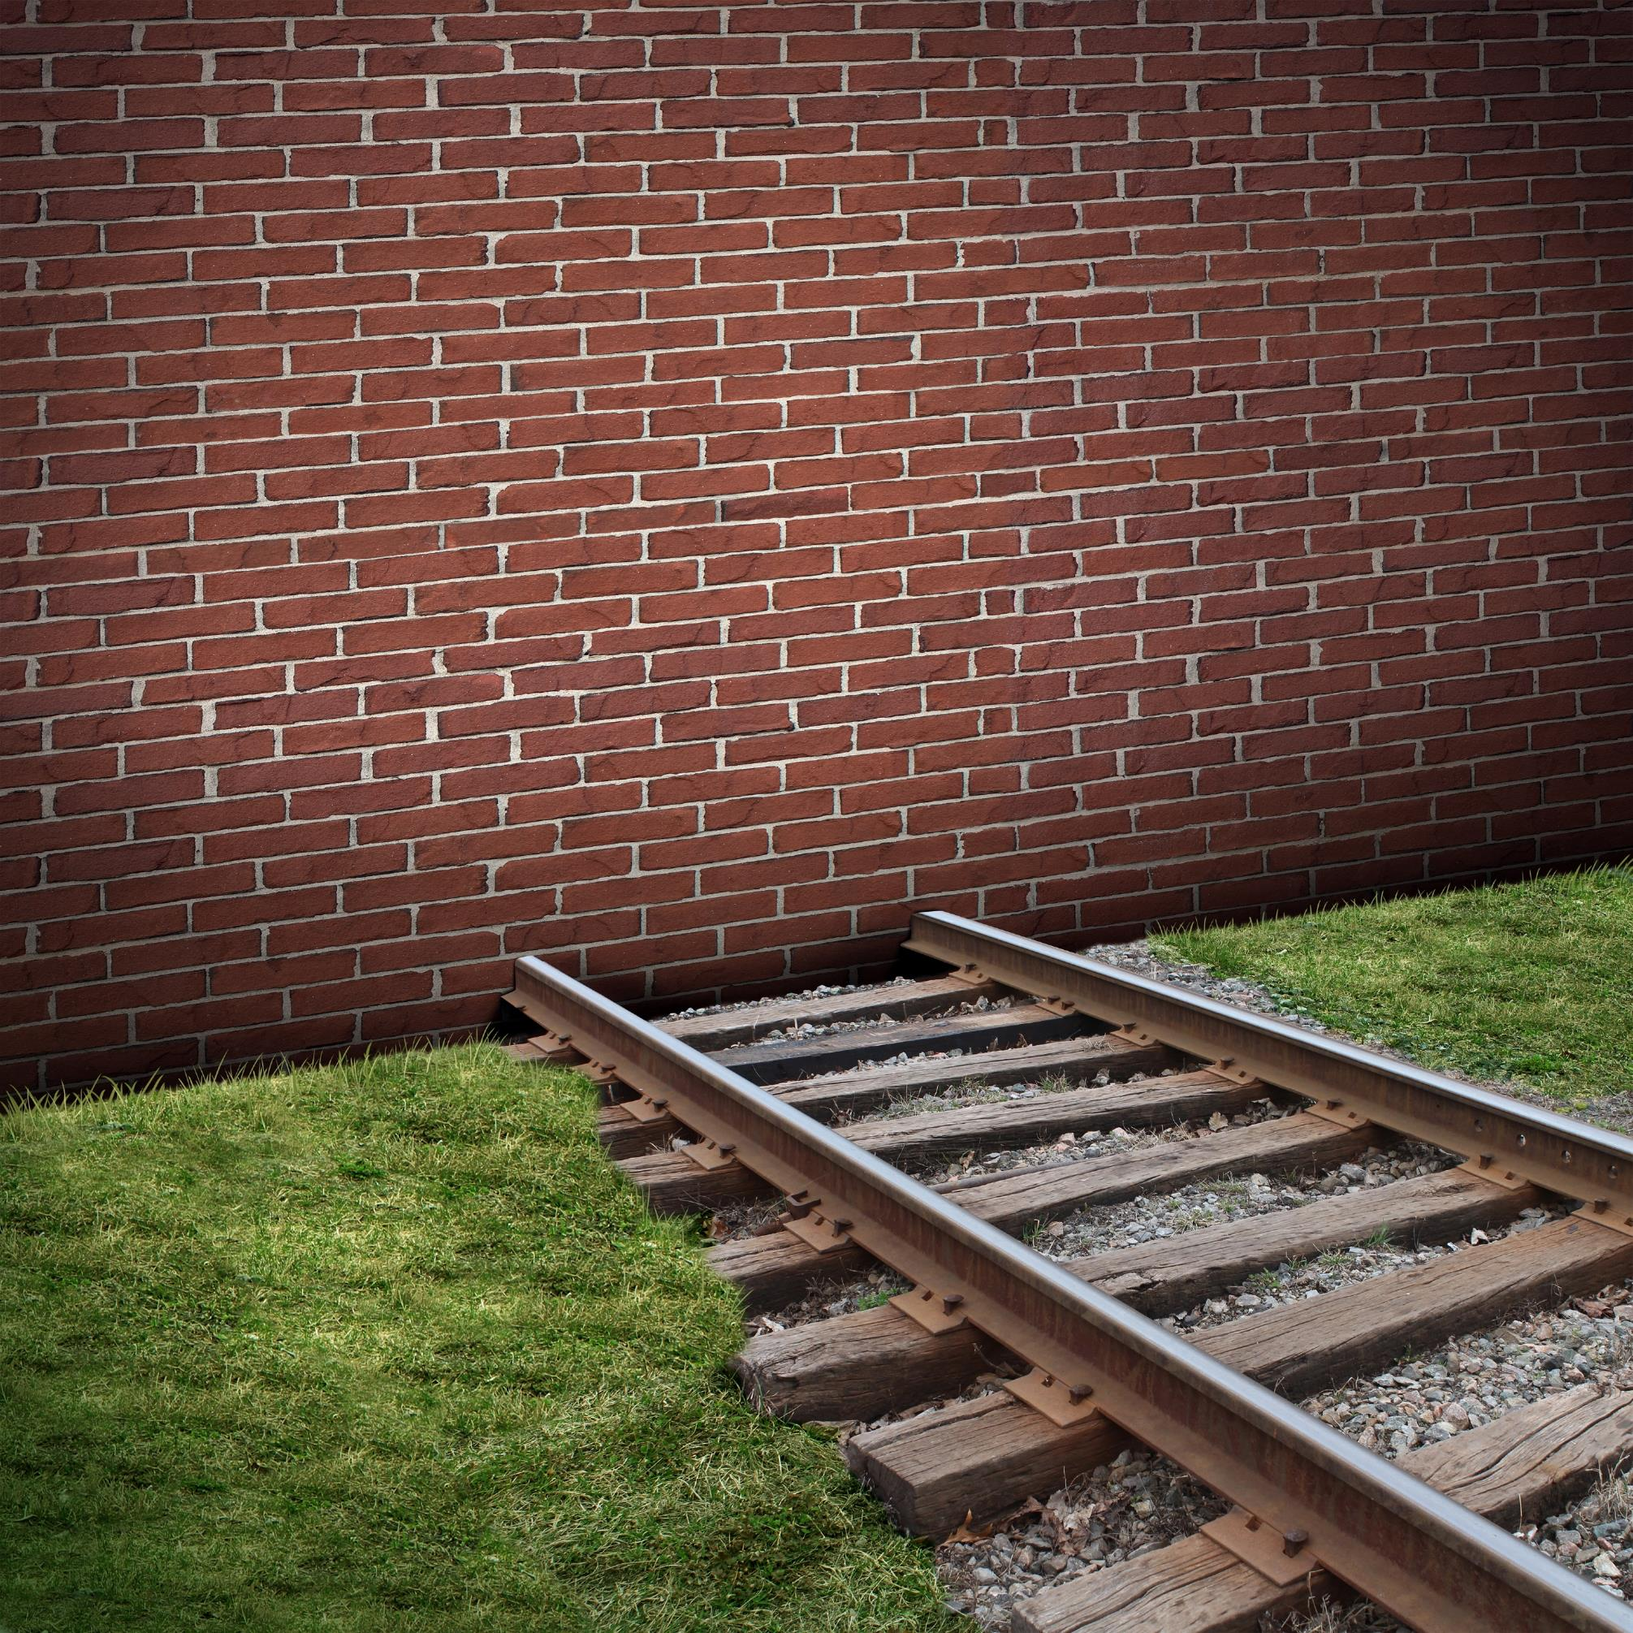
“I, the Lord, am your God, Who brought you up from the land of Egypt; Open your mouth wide and I will fill it…”
Notes:
Mankind’s power of choice
boundaries…God never violate
Ancient Israel for example
The Lord cries out-His people [click]

Slide 13
But My people did not listen to My voice, And Israel did not obey Me. So I gave them over to the stubbornness of their heart, To walk in their own devices. Oh that My people would listen to Me, That Israel would walk in My ways!”
Psalms 81:10-13
Notes:
But God did not get what He wanted
He concludes by proclaiming [click]

Slide 14
“Jerusalem, Jerusalem, who kills the prophets and stones those who are sent to her! How often I wanted to gather your children together, the way a hen gathers her chicks under her wings, and you were unwilling”
Matthew 23:37
Notes:
Jesus wept over God’s chosen… [click]
[continued]

Slide 15
Notes:
God had great plans for Israel
but His people chose-turn their backs
God could only cry out [next slide]

Slide 16
“If only you had paid attention to My commandments! Then your well-being would have been like a river, And your righteousness like the waves of the sea”
Isaiah 48:18
Notes:
[read]
Boundaries
Not just Israel-Since Adam-choose self

Slide 17

Notes:
But if power of choice-fight God
Can also be used for God
Enoch, Noah, Abraham,
Joseph, Mary, Jesus, Paul, Dorcas

Slide 18

Notes:
In beginning-every atom leapt
God spoke – divided, grouped
Everyone/everything perfectly aligned
Lucifer fell – gaping tear in fabric
Adam and Eve fell – gap growing

Slide 19
The Great Controversy Ended
What God Wants
-
0
__________________
What God Gets
Notes:
All is not hopeless
Great Controversy
God working to realign
Soon equation will be [click 3]

Slide 20
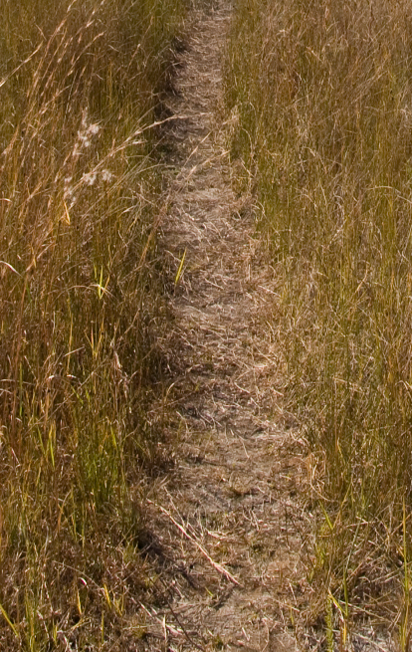
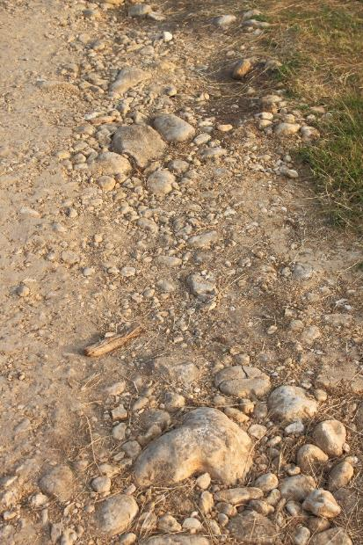
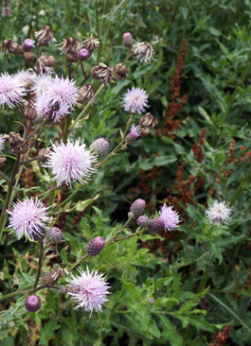
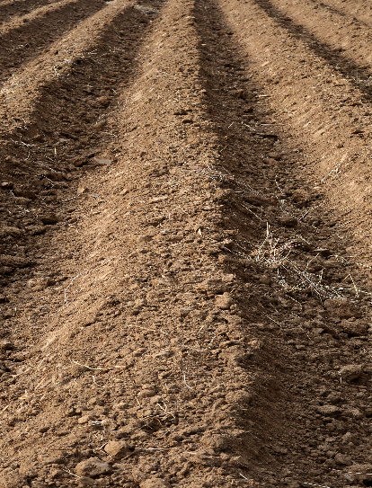
Path – Resist God
Rocky – Let God in part way
Thorny – Let both God and the world in
Good soil – Let God in unreservedly
Notes:
How GCE work in practical terms?
Jesus, parable of sower – 4 soils
[click 4]

Slide 21

Notes:
Hardened path – some blessings
God’s will held back-boundaries

Slide 22
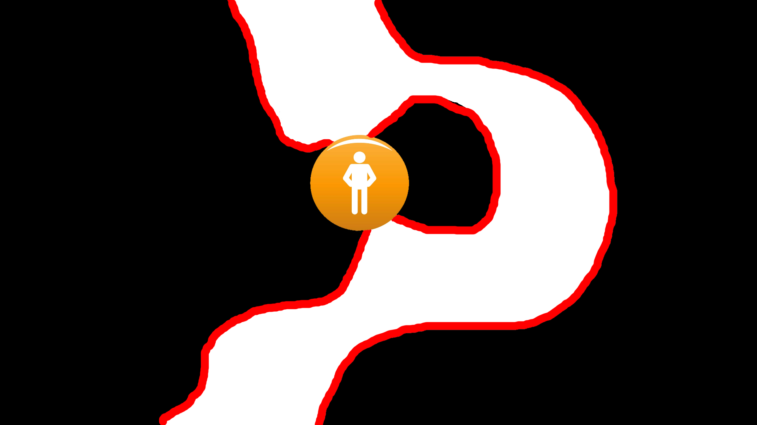
Notes:
Lukewarm Christian
choices allow God more freedom
Rocky soil vs. Thorny soil

Slide 23
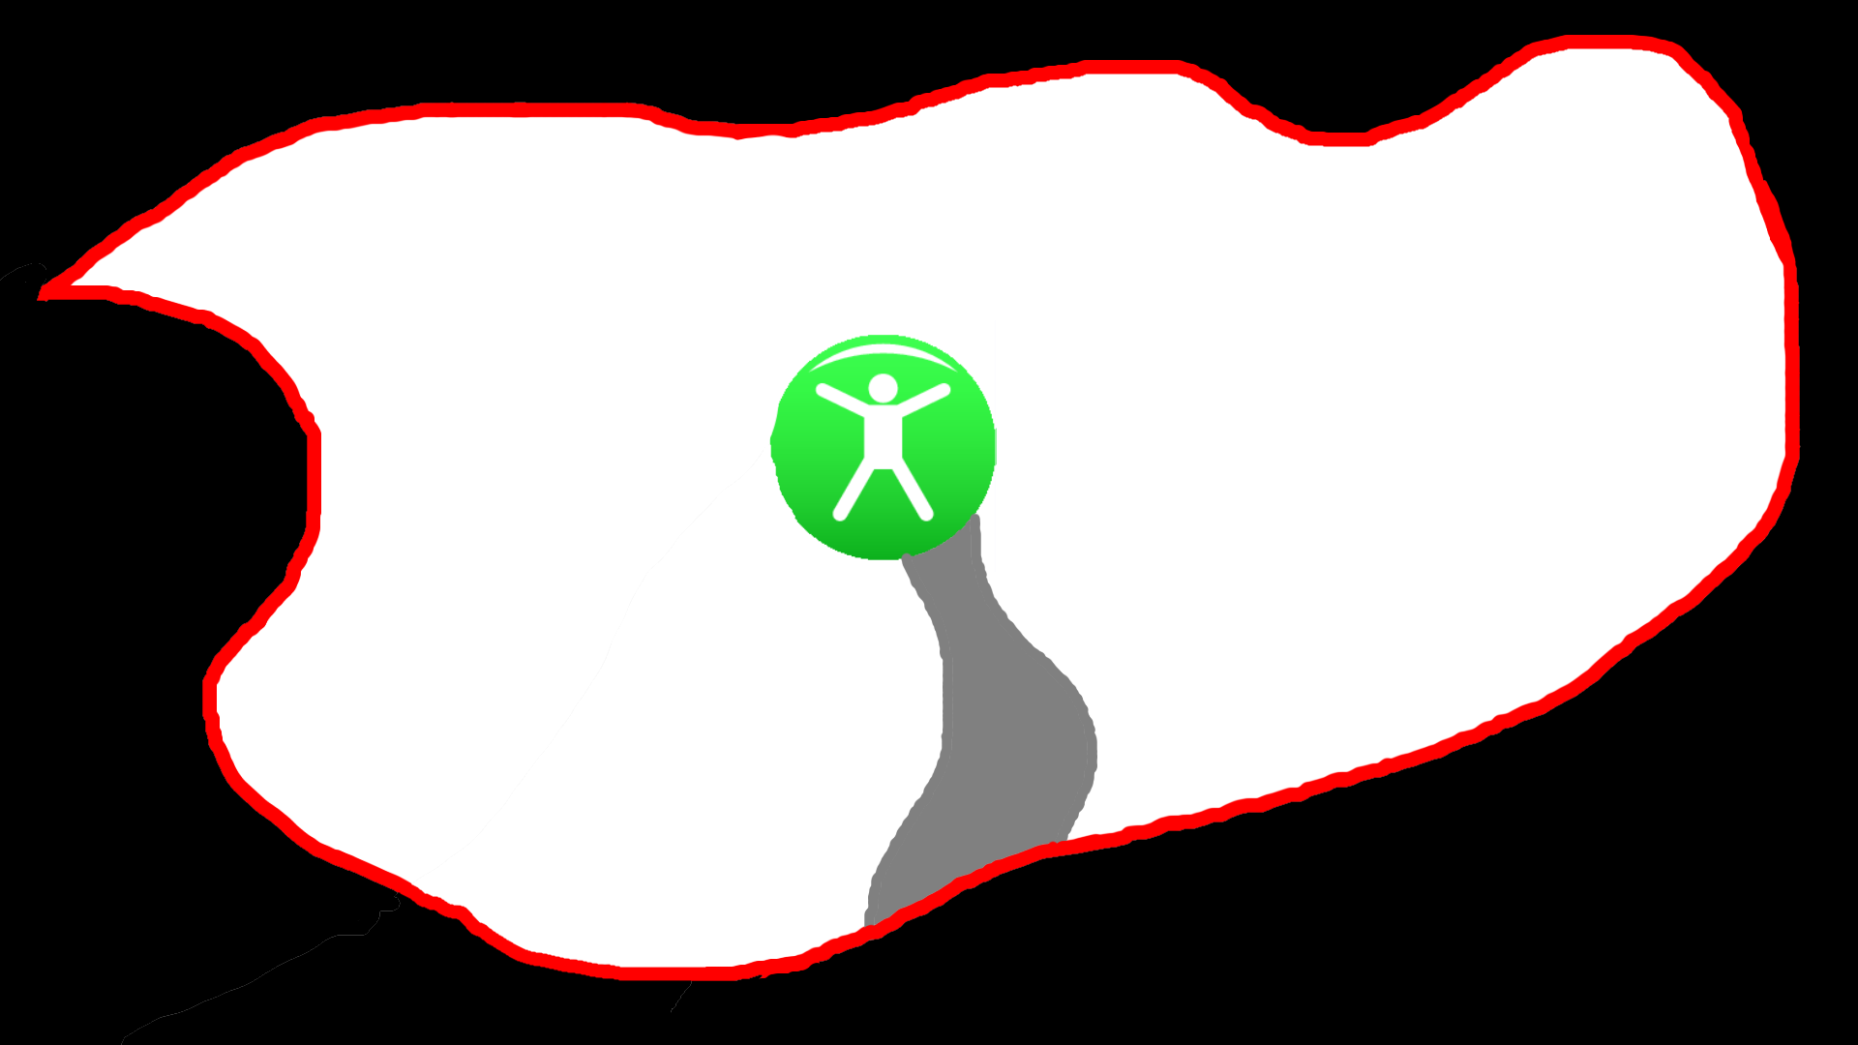
Notes:
Most beautiful picture of GCE is
fully surrendered – good soil
God is able to envelope them…
[continued]

Slide 24
“God causes all things to work together for good to those who love God, to those who are called according to His purpose” Romans 8:28
Notes:
Because of collective free will
Earth’s choice to turn away
Satan is still allowed
Filtered through God’s good
[click]

Slide 25

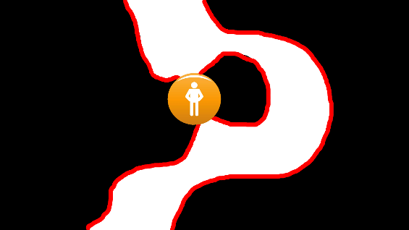
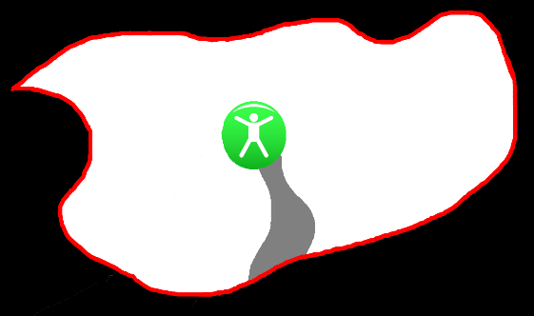
Ungodly Lukewarm Surrendered
Notes:
Only difference…choices
hardened-path ungodly
rocky soil lukewarm
thorny soil lukewarm
good soil surrendered

Slide 26
Ungodly Lukewarm Surrendered
“for it is God who is at work in you, both to will and to work for His good pleasure”
Philippians 2:13
Notes:
God has given us power-choice
Purpose is not to “do”-but “let”
We have no power to “do” [click]

Slide 27
Ungodly Lukewarm Surrendered
“for it is God who is at work in you, both to will and to work for His good pleasure”
Philippians 2:13
Notes:
By our power of choice
allow God to push/reshape bound.
Great Controversy-God wants/gets

Slide 28
Only God can do it
Only you and I can let Him
Notes:
The GCE teaches one-most important
[click] Only God can do it…
No matter what “it” is…
God has given us power of choice
Only difference-four types of soil

Slide 29

“And do not be conformed to this world, but be transformed by the renewing of your mind, so that you may prove what the will of God is, that which is good and acceptable and perfect”
Romans 12:2
Notes:
The scriptures admonish us: [click]
world-misaligned-pushes God away
Only in transformational alignment…
“good and acceptable and perfect”
Romans 12:1 – living & holy sacrifice

Slide 30
Why must we ask God for His blessings?
Why must we intercede for others?
“The effective prayer of a righteous man can accomplish much”
James 5:16
Notes:
GCE helps us understaznd…prayer
Prayers put our will on record
Practical/tangible-put our choices
We know that: [click]

Slide 31
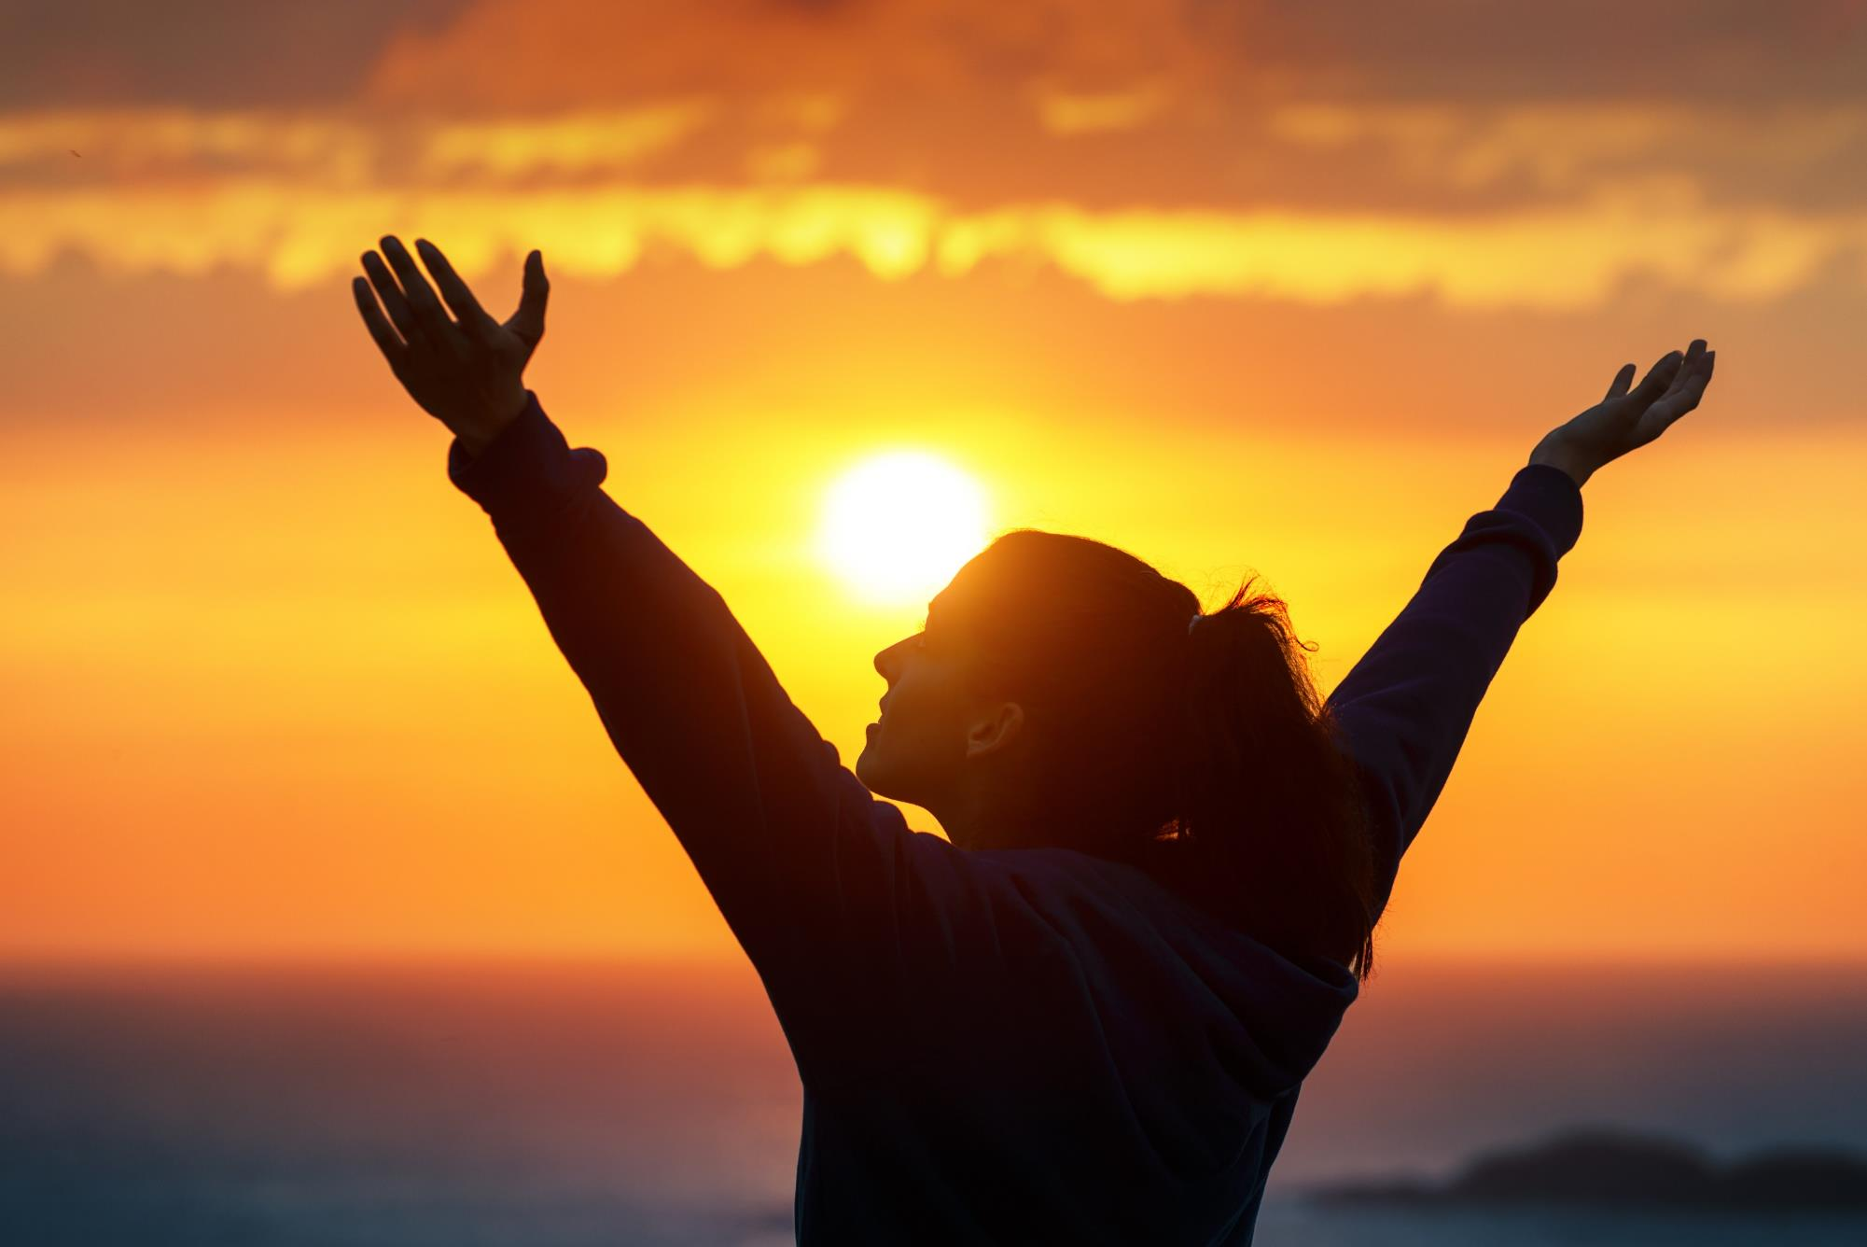
“to show that at all times they ought to pray and not to lose heart”
Luke 18:1
Notes:
Understand woman-unjust judge
Jesus told parable: [click]
Cellphone charger/ sun warming

Slide 32
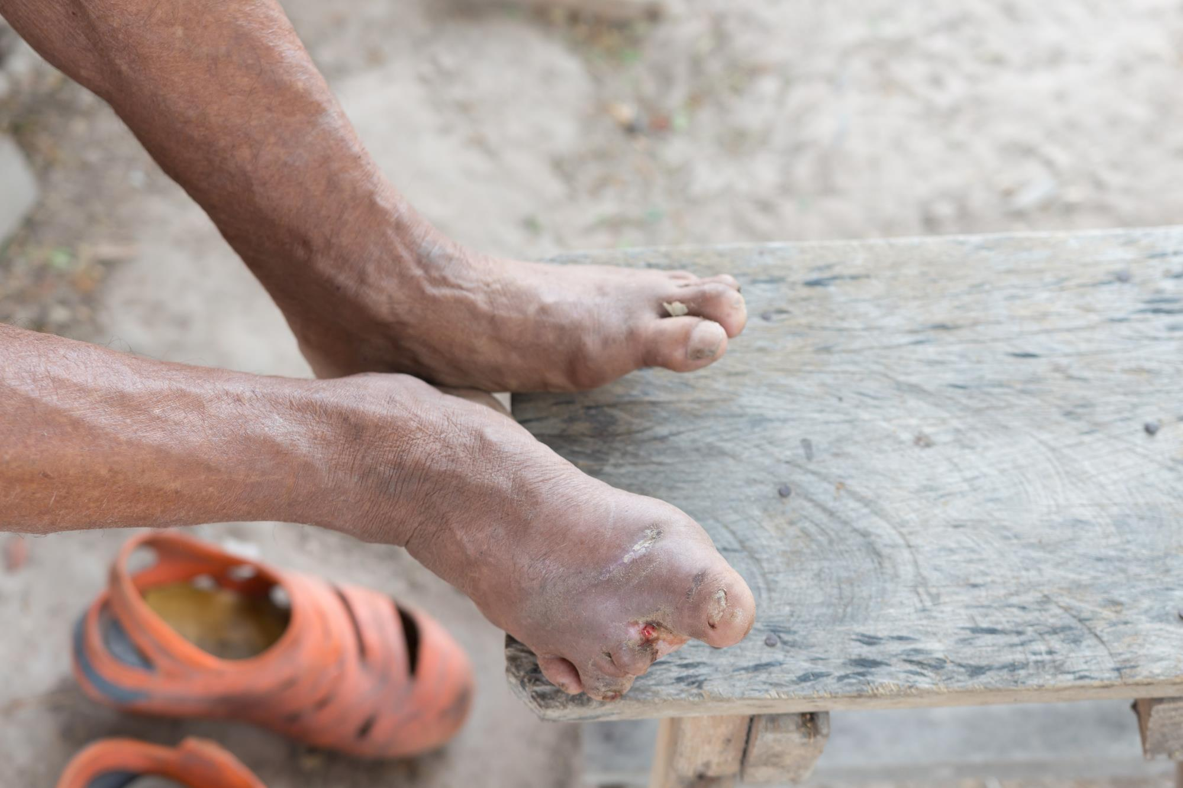
Notes:
Perhaps most powerfuly story
teaching-putting will on side of
Story of mighty general Naaman
Hardened-path-pagan idol worship.

Slide 33
Notes:
God in His mercy withdraws
allows devil to make leper
uncleanest of the unclean
Nothing strike terror-fall apart-die

Slide 34
Notes:
Diagram of Naaman
Blessed a little
Not letting God heal him
How can God possibly get through?

Slide 35
“I wish that my master were with the prophet who is in Samaria! Then he would cure him of his leprosy.”
2 Kings 5:3
Notes:
Act I – Little, no-name girl
Shares her faith [click]
Naaman grasping at straws…
goes to find the mighty prophet

Slide 36

Notes:
Because of the little girl’s faith
and Naaman’s act
God is able to move boundary
Meets King of Israel- faith shrinks

Slide 37

Notes:
Act 2–Goes to Elisha-Great man-faith
Elisha refuses to meet-gives command
Why Jordan? Why 7 times?
Naaman furious – servants humble

Slide 38

Notes:
Act 3 - Dips once in the Jordan

Slide 39

Notes:
Dips again into the Jordan
Seven times – each time closer

Slide 40
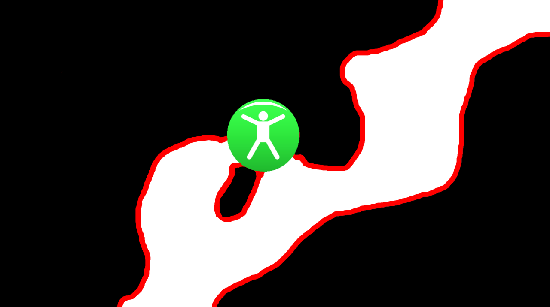
Notes:
Until seventh dip
Cured of physical leprosy
But also cured of spiritual leprosy
[Next slide]

Slide 41

“Behold now, I know that there is no God in all the earth, but in Israel…for your servant will no longer offer burnt offering nor will he sacrifice to other gods, but to the Lord” 2 Kings 5:17
Notes:
Return to Elisha, Naaman procl. [click]
Took choices-girl, prophet, 7 dips
but God succeeded-miraculously
The purpose – not to “do” – to “let”
Only God can do it…

Slide 42
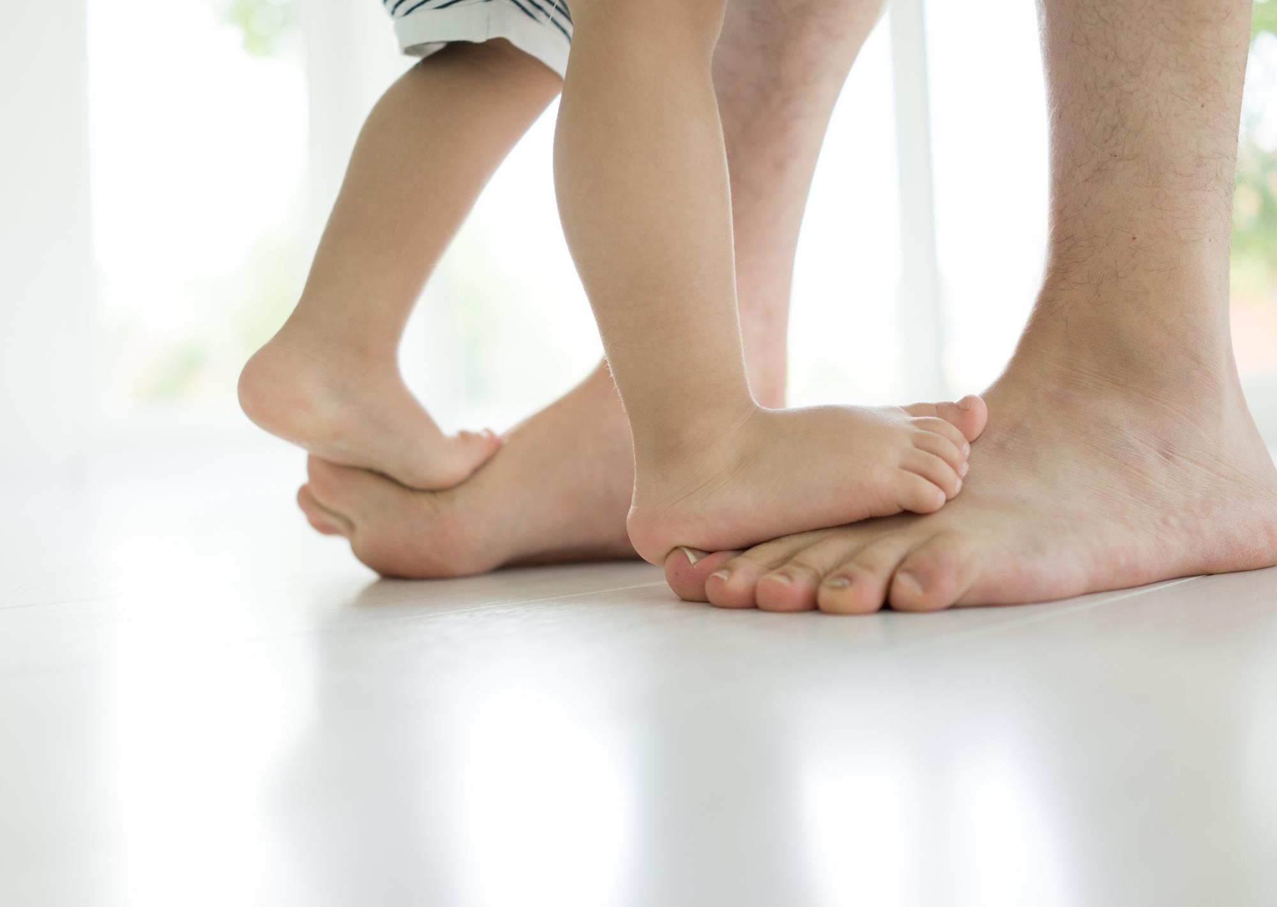
Israel marched around Jericho 13 times
(Joshua 6:3,4)
Blind man washed off mud at the pool of Siloam
(John 9:7)
Diseased woman touched the hem of Christ’s garment (Mark 5:28)
Notes:
Throughout scripture-jobs to do
Putting will on side of God-miracles
[click 3]
There is no intrinsic power…
Power is in the choices

Slide 43
Notes:
Great Controversy all-power-choice
Mankind has collectively-individually
we inhibit God has He battles
Wonderful news-GC coming to end
Once again Get gets to do

Slide 44
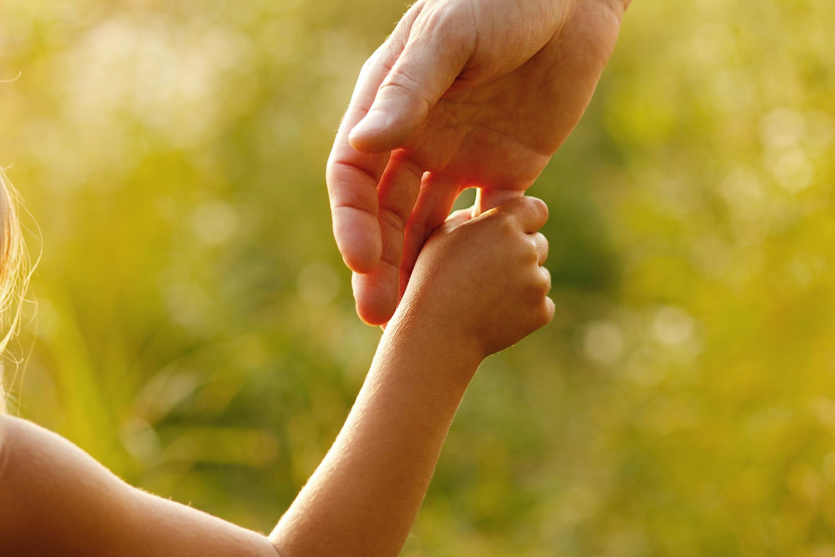
Notes:
Right now God is calling His people
“choose to let”
[continued]

Slide 45
Notes:
This ultimate “choosing to let” surrender
Committing all our choices
God is actively seeking those

Slide 46
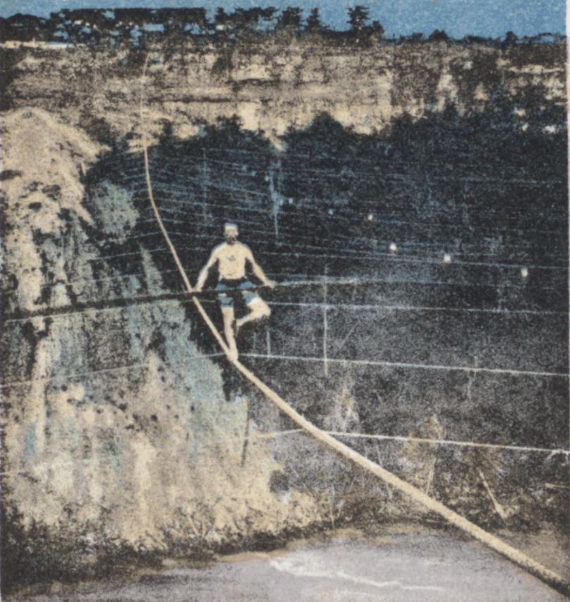
Notes:
Jean-Francois Gravelet
better known-“The Great Blondin”
Famous for Niagara Gorge
1,100 foot rope,3 1/4 inches, 160 high
[continued]

Slide 47
Notes:
Death-defying variations
blindfolded, walking on stilts,
pushing wheelbarrow, backwards.
Cooking omelette

Slide 48
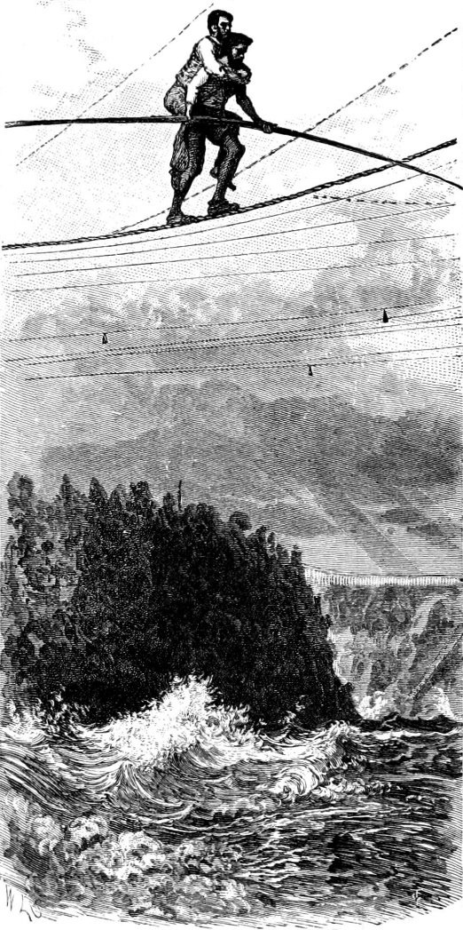
“Look up, Harry.… you are no longer Colcord, you are Blondin. Until I clear this place be a part of me, mind, body, and soul. If I sway, sway with me. Do not attempt to do any balancing yourself. If you do we will both go to our death.”
- Blondin
Notes:
August 14, 1859, Harry Colcord,
Before crossing said to Harry [click]
[continued]

Slide 49
“Look up, Harry.… you are no longer Colcord, you are Blondin. Until I clear this place be a part of me, mind, body, and soul. If I sway, sway with me. Do not attempt to do any balancing yourself. If you do we will both go to our death.”
- Blondin
Notes:
Good illustration of Christian life
God seeking to safely-trouble waters
Free will-must consent, willfully submit
[continued]

Slide 50
“Look up, Harry.… you are no longer Colcord, you are Blondin. Until I clear this place be a part of me, mind, body, and soul. If I sway, sway with me. Do not attempt to do any balancing yourself. If you do we will both go to our death.”
- Blondin
Notes:
God is teaching us to
“look up”, be one with Him
put our lives unresistingly
sway with Him, balance

Slide 51
Notes:
Life-changing miracle of surrender
just a choice away. And it is our choice
[continued]

Slide 52
The Great Cosmic Equation
“As the will of man co-operates with the will of God, it becomes omnipotent”
Christ’s Object Lessons, p. 333
Notes:
[click – read]

Slide 53
Only God can do it
Only you and I can let Him
Notes:
Only God can do it…
[call]

